Slide 1
School Committee
History Fair Program
March 27, 2024

Slide 2
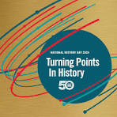
National History Day
11th Grade Research Project - High Honors
Modeled on the National History Day Competition
Choices Galore!
What do you want to research?
Who do you want to work with?
What do you want to make?
Timing
Semester 1 - All students participate
Semester 2 - Extracurricular competition
March - Regionals
April - States
June - Nationals (U. of Maryland)

Slide 3
Bedford: A History of Success!
Started competing in 2005 with Jim Sunderland as advisor
Success = PRIDE in overcoming a challenging task
Have sent a project to the national finals every year!

Slide 4
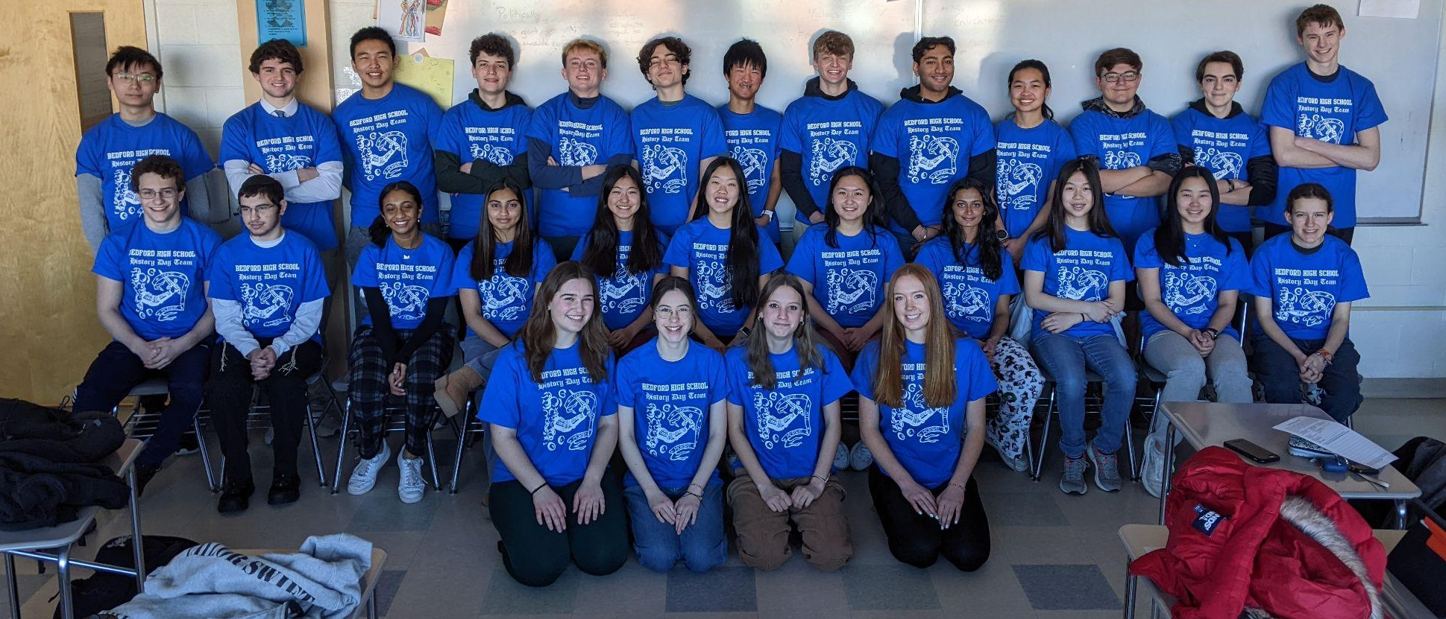
2024 Competition Team

Slide 5
Ellie Sweetland: Individual Website
The Invention and Development of Radar: A Turning Point in World War II & Technological History

Slide 6
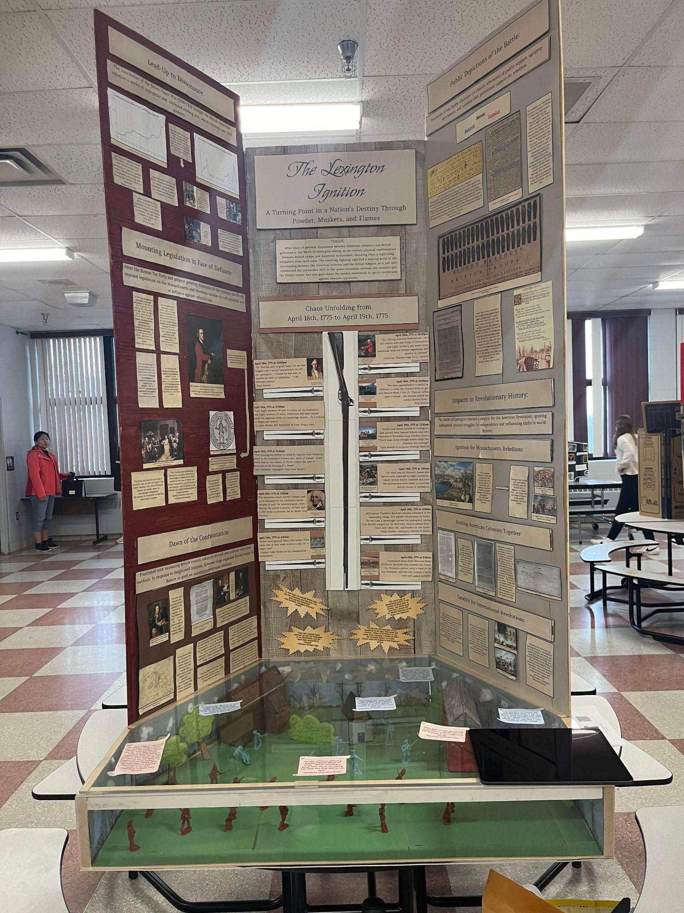
Giullia Caico: Individual Exhibit
The Lexington Ignition: A Turning Point in a Nation’s Destiny Through Powder, Muskets, and Flames

Slide 7
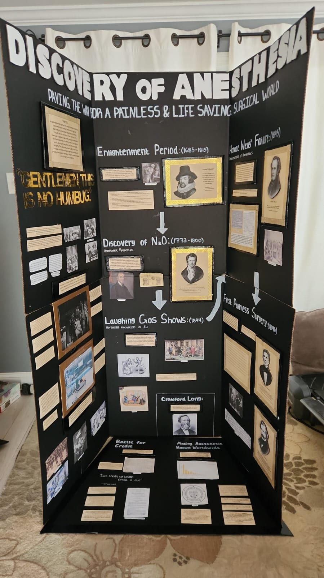
Chloe Borella & Kyra Doherty:
Group Exhibit
Discovery of Anesthesia: Paving the Way for a Painless and Life-Saving Surgical World

