Slide 1
Districtwide

Slide 2
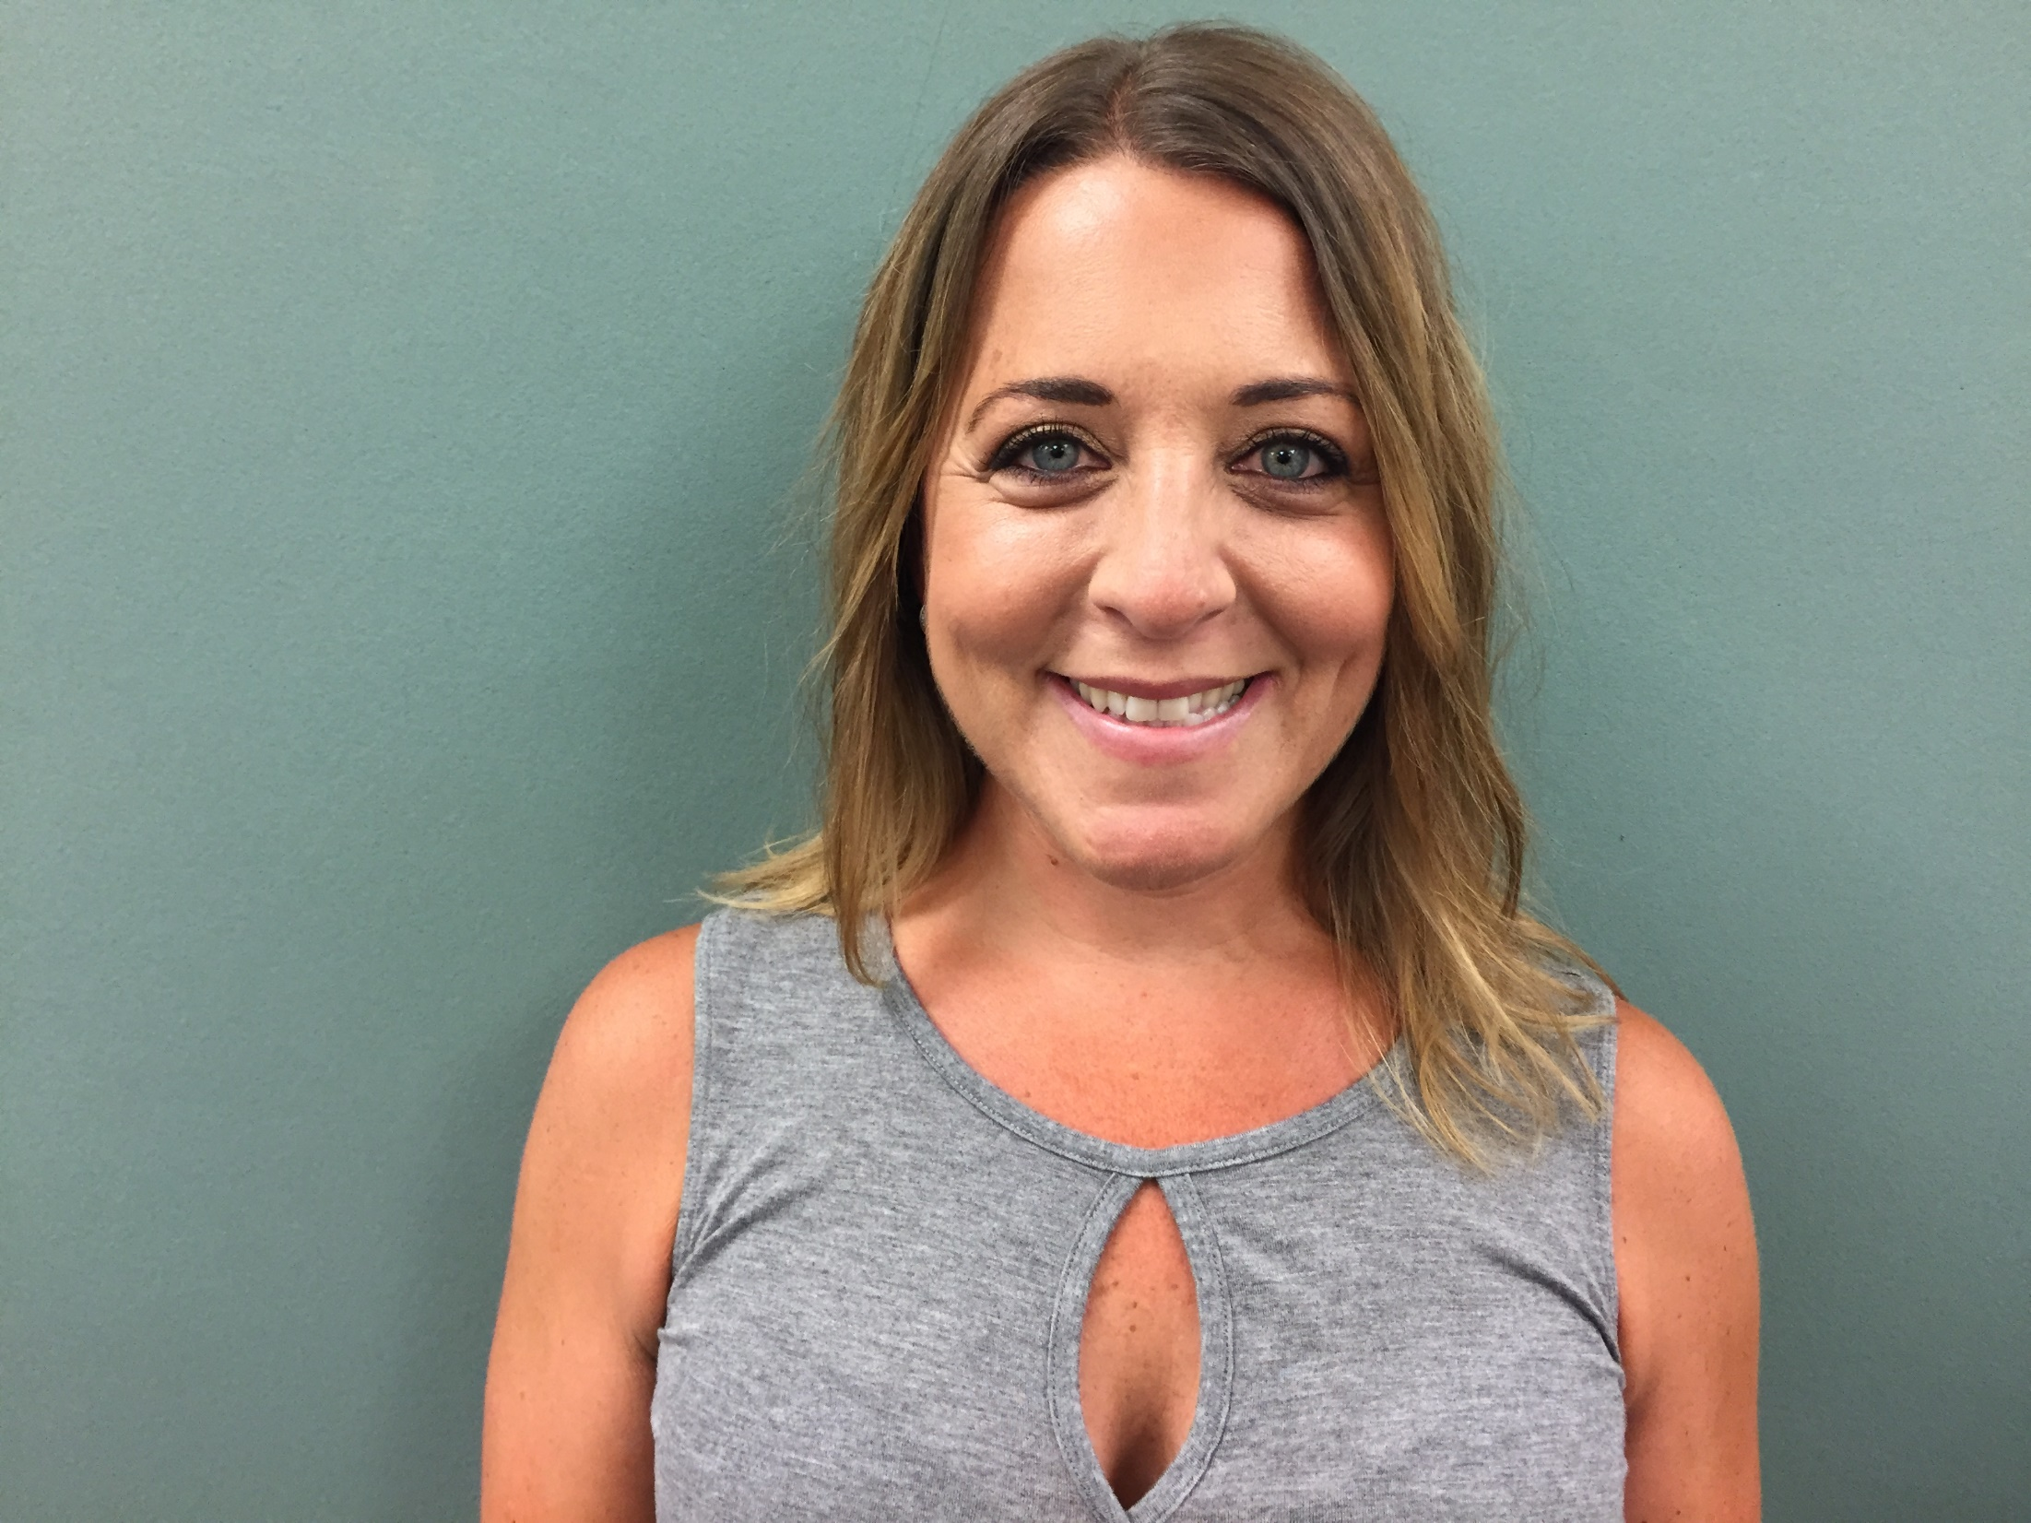
Lisa Brecher
School Psychologist
Districtwide

Slide 3
Integrated Preschool

Slide 4
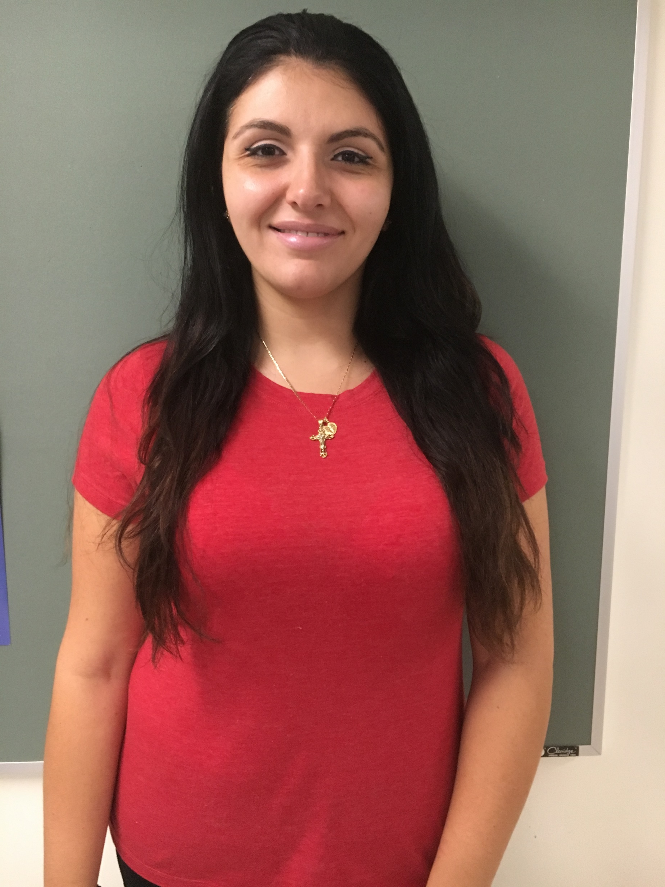
Stephanie Barounis
Teaching Assistant
Integrated Preschool

Slide 5
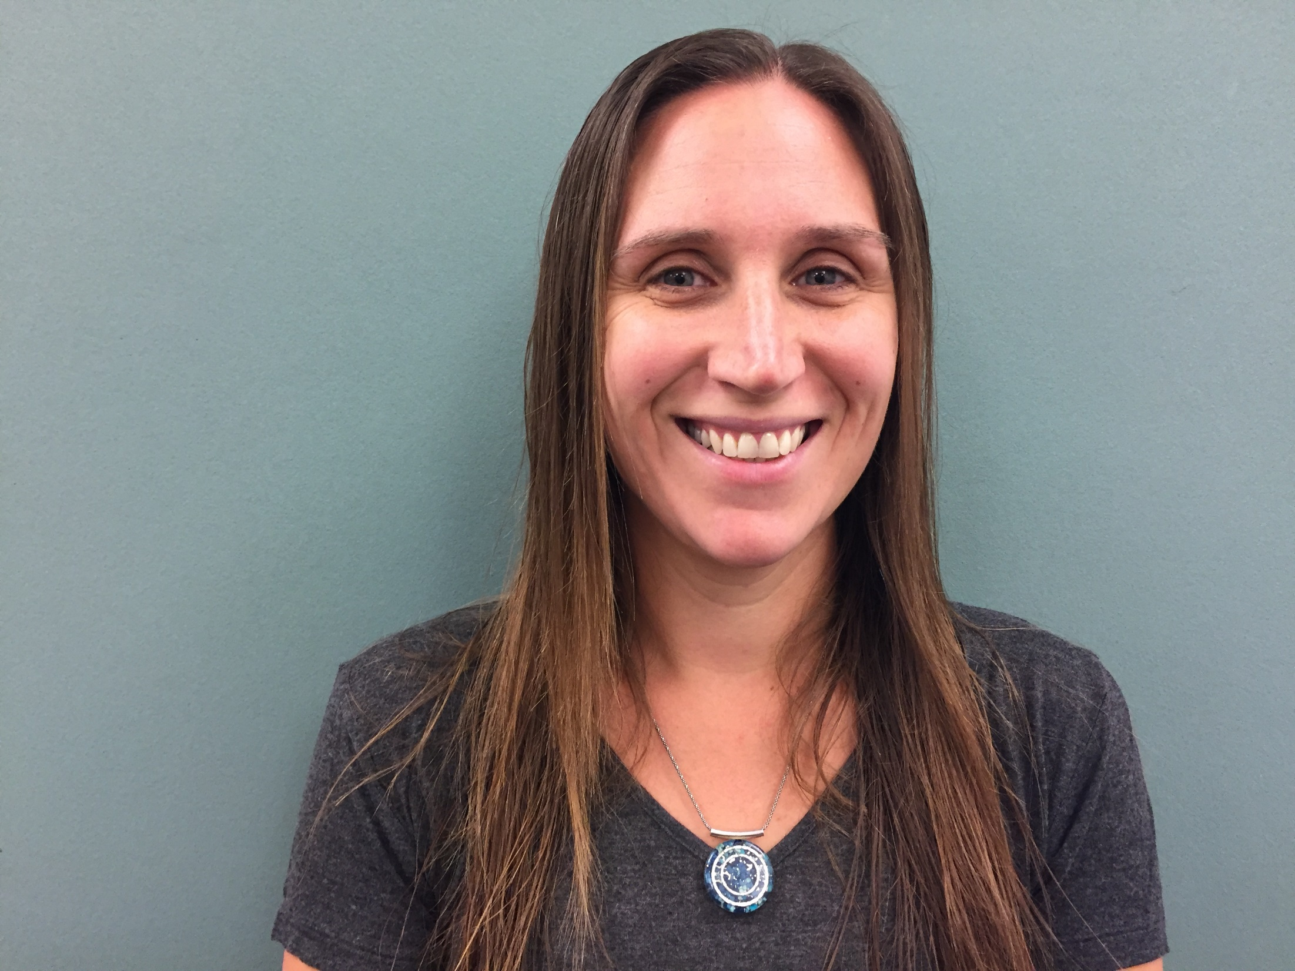
Elizabeth Brosgol
Teaching Assistant
Integrated Preschool

Slide 6
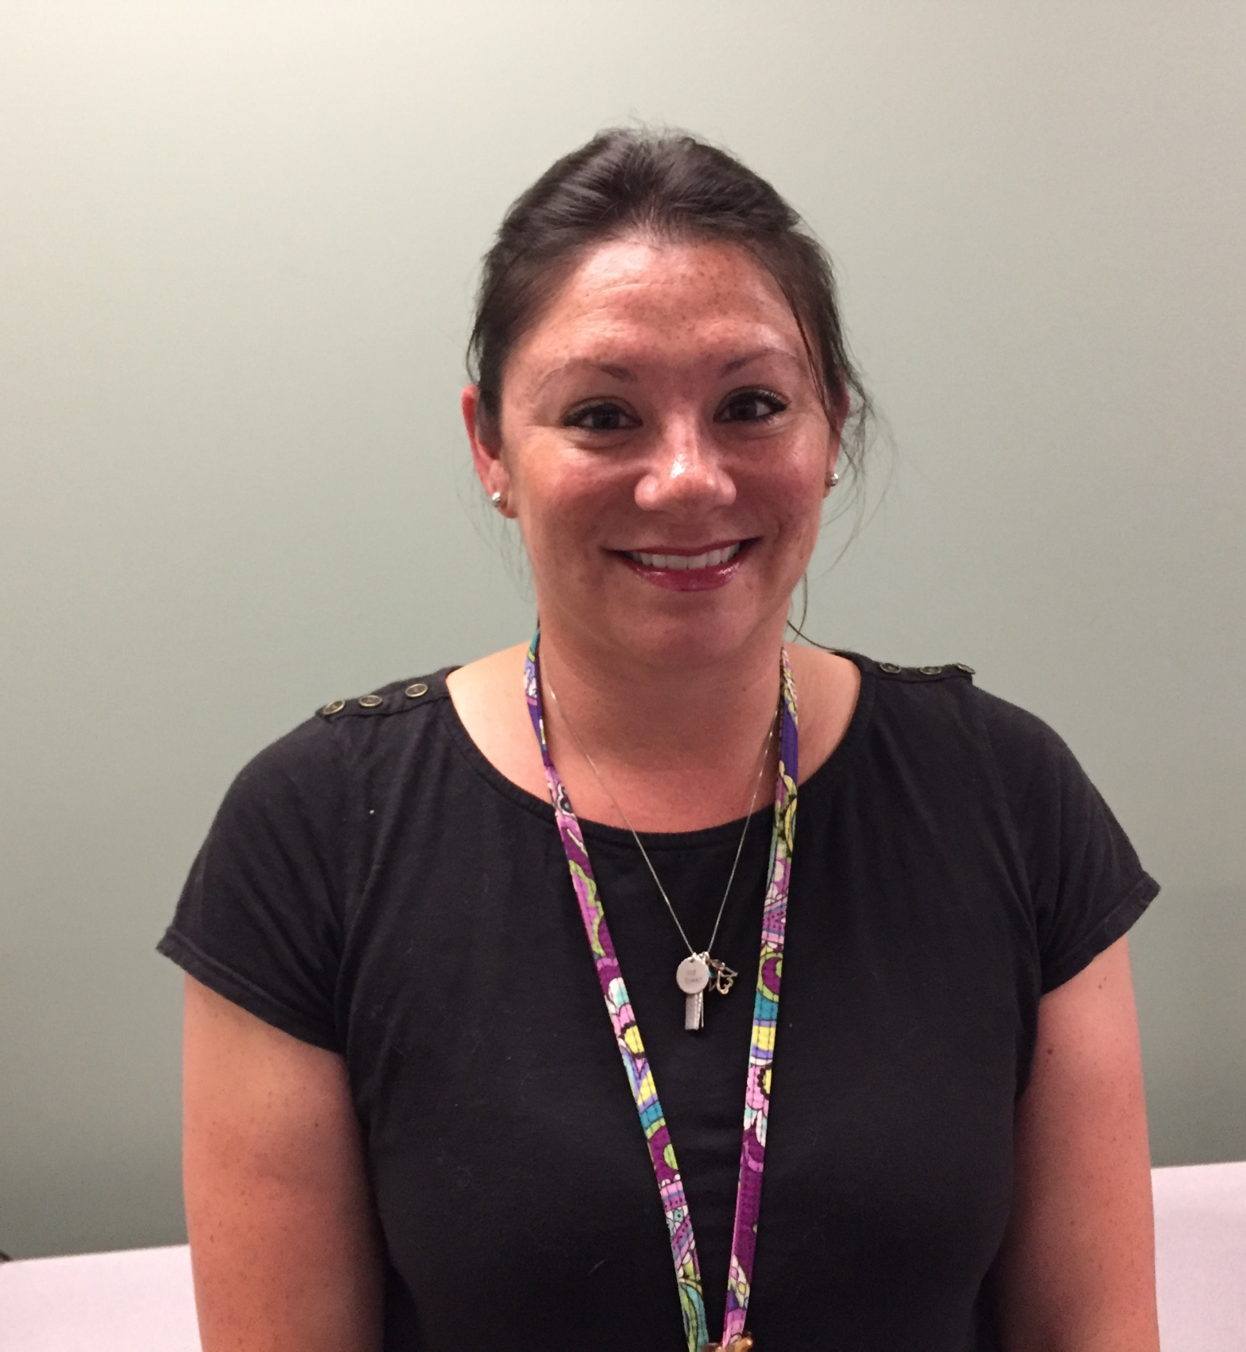
Amanda Cincotta
SPED Teacher
Integrated Preschool

Slide 7
Tracey Derderian
Educational Assistant
Integrated Preschool

Slide 8
Shannon Fama
Educational Assistant
Integrated Preschool

Slide 9
Brittany Hamel
Teaching Assistant
Integrated Preschool

Slide 10
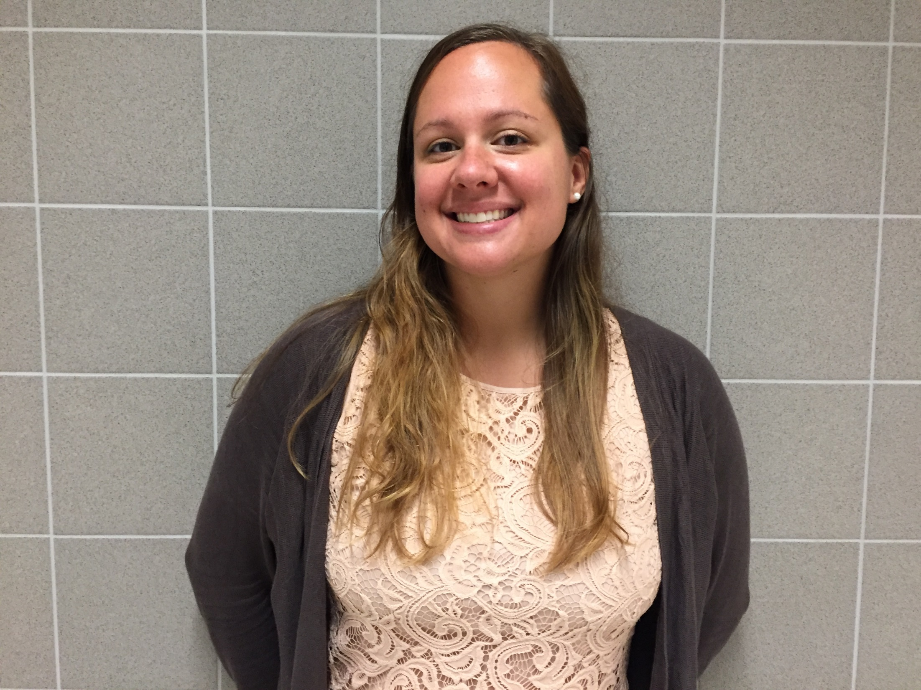
Rebecca Lam
School Psychologist
Integrated Preschool

Slide 11
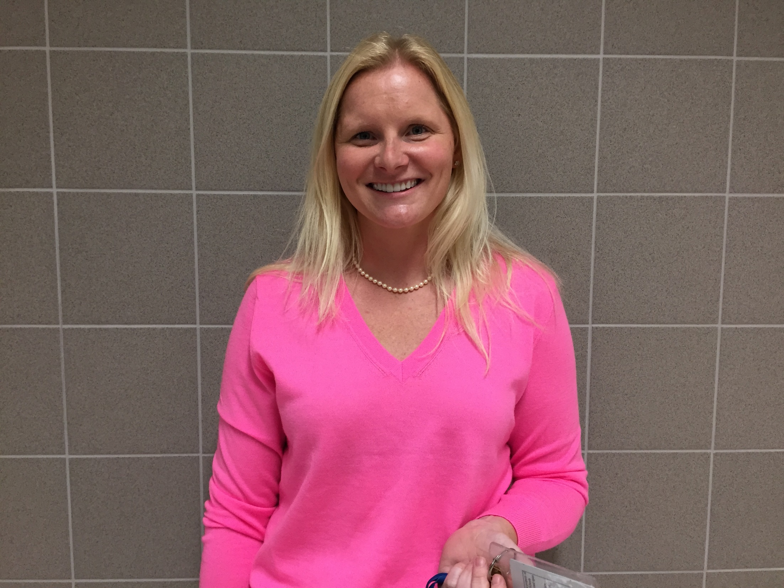
Courtney McKelvey
Occupational Therapist
Integrated Preschool

Slide 12
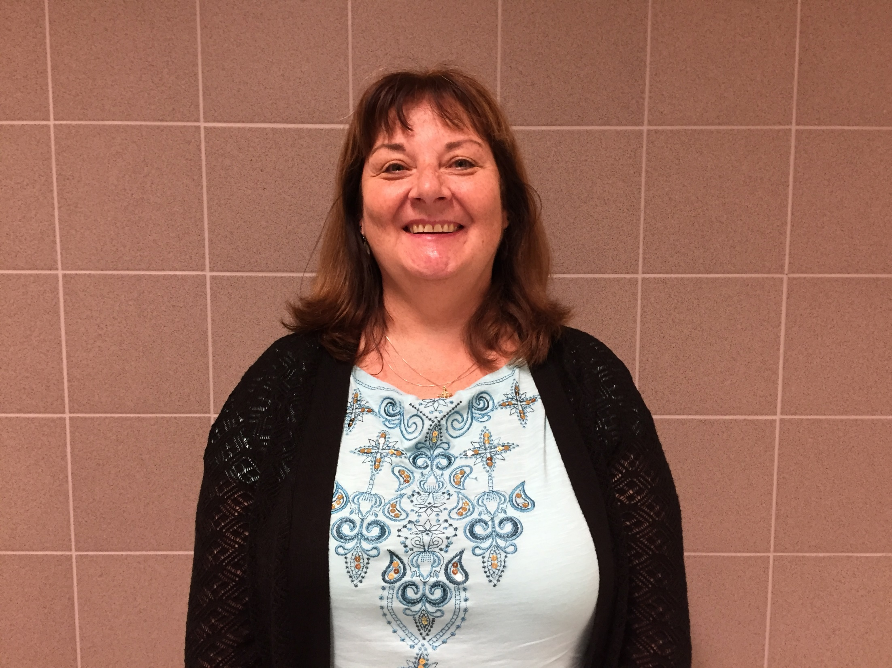
Deborah Murphy
ReadingTeacher
Integrated Preschool

Slide 13
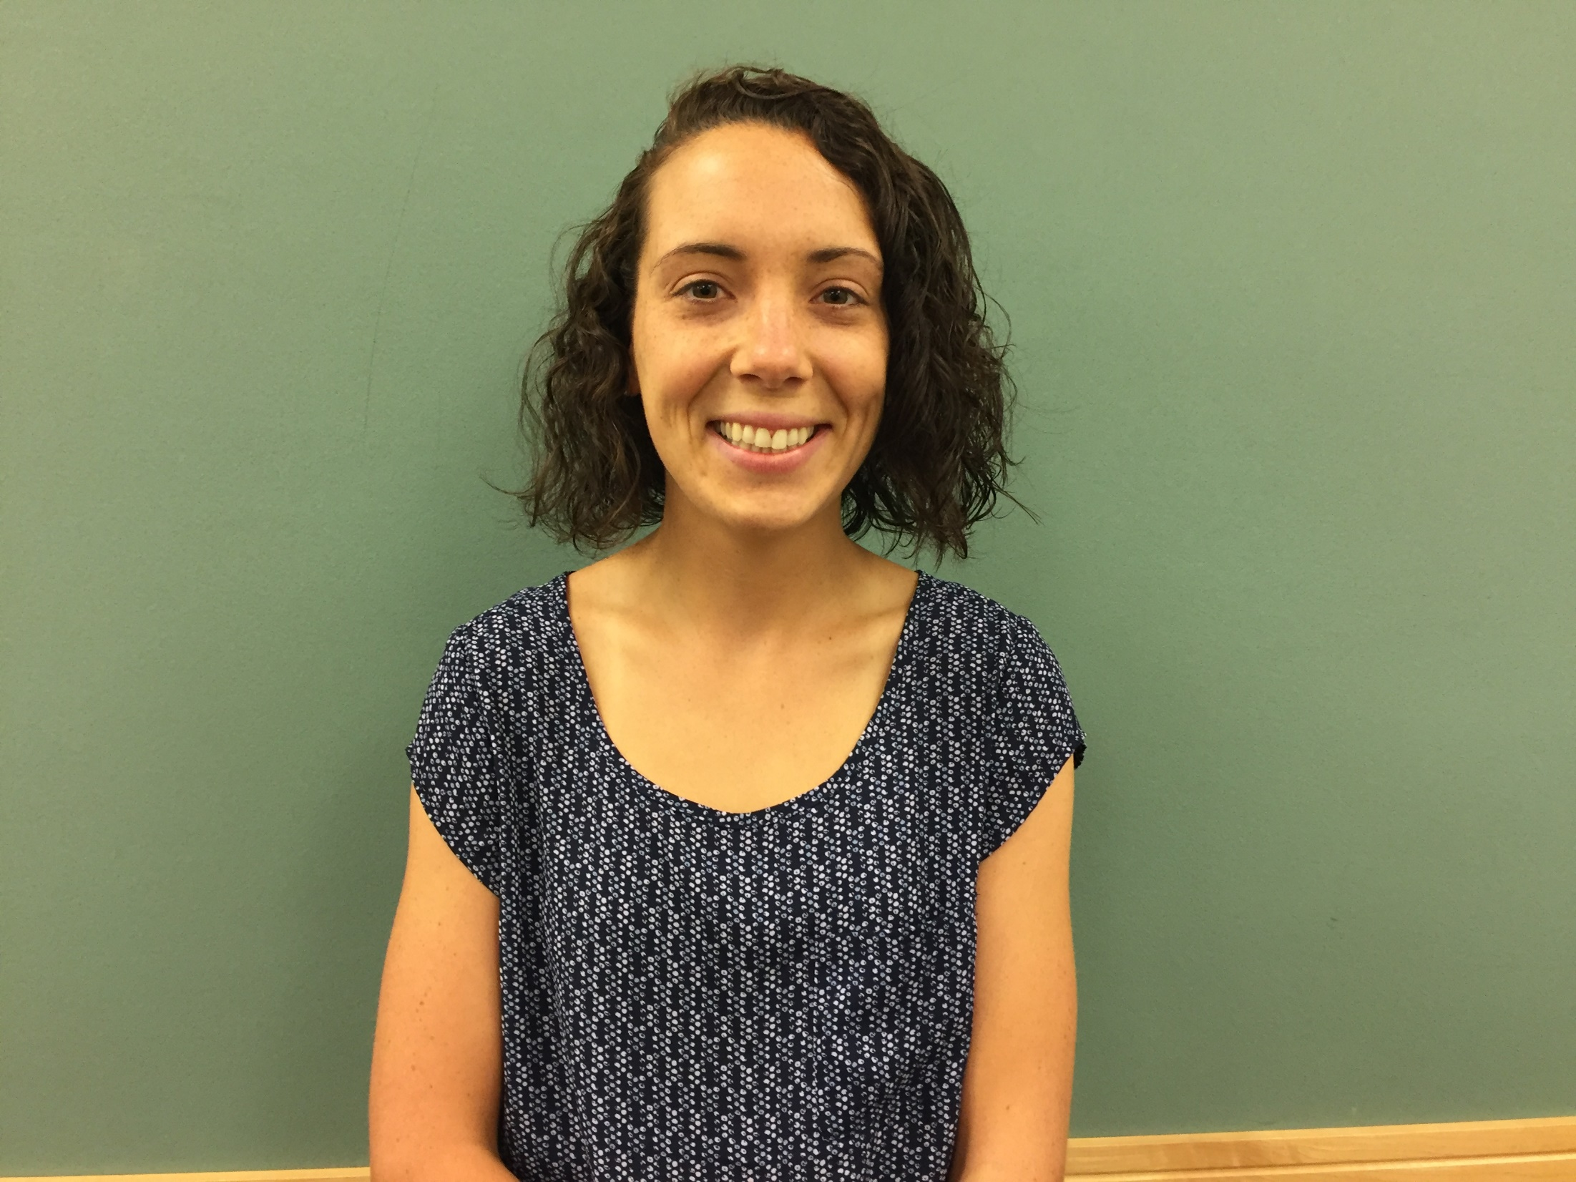
Emily Ruggiero
Teaching Assistant
Integrated Preschool

Slide 14
Davis Elementary School

Slide 15
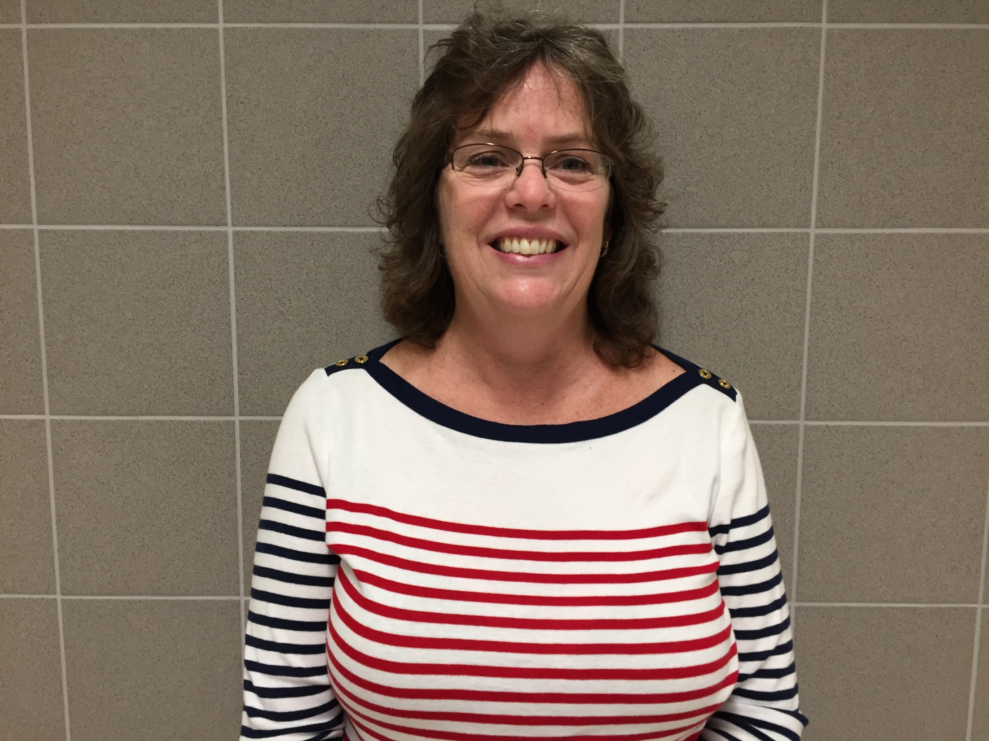
Christine Connor
Teaching Assistant
Davis Elementary School

Slide 16
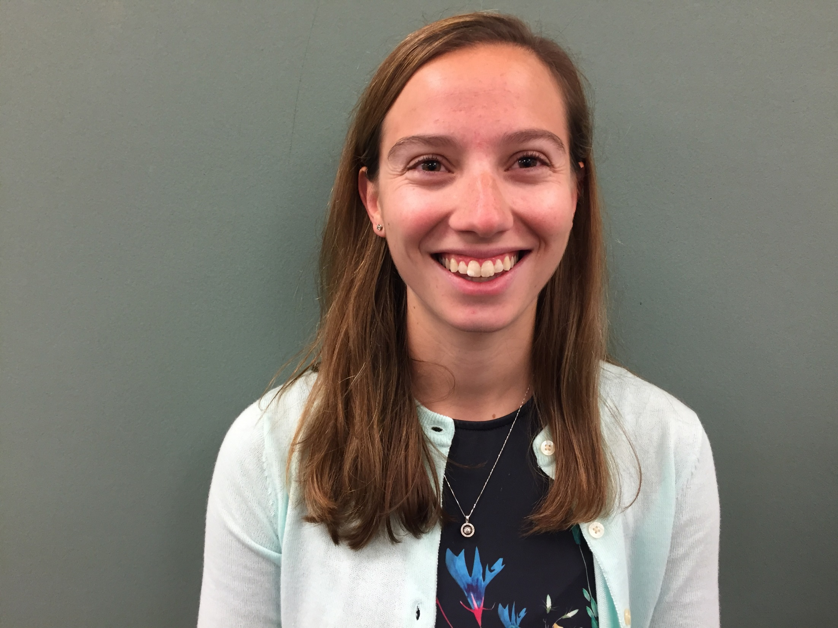
Samantha Dembitzky
Teaching Assistant
Davis Elementary School

Slide 17
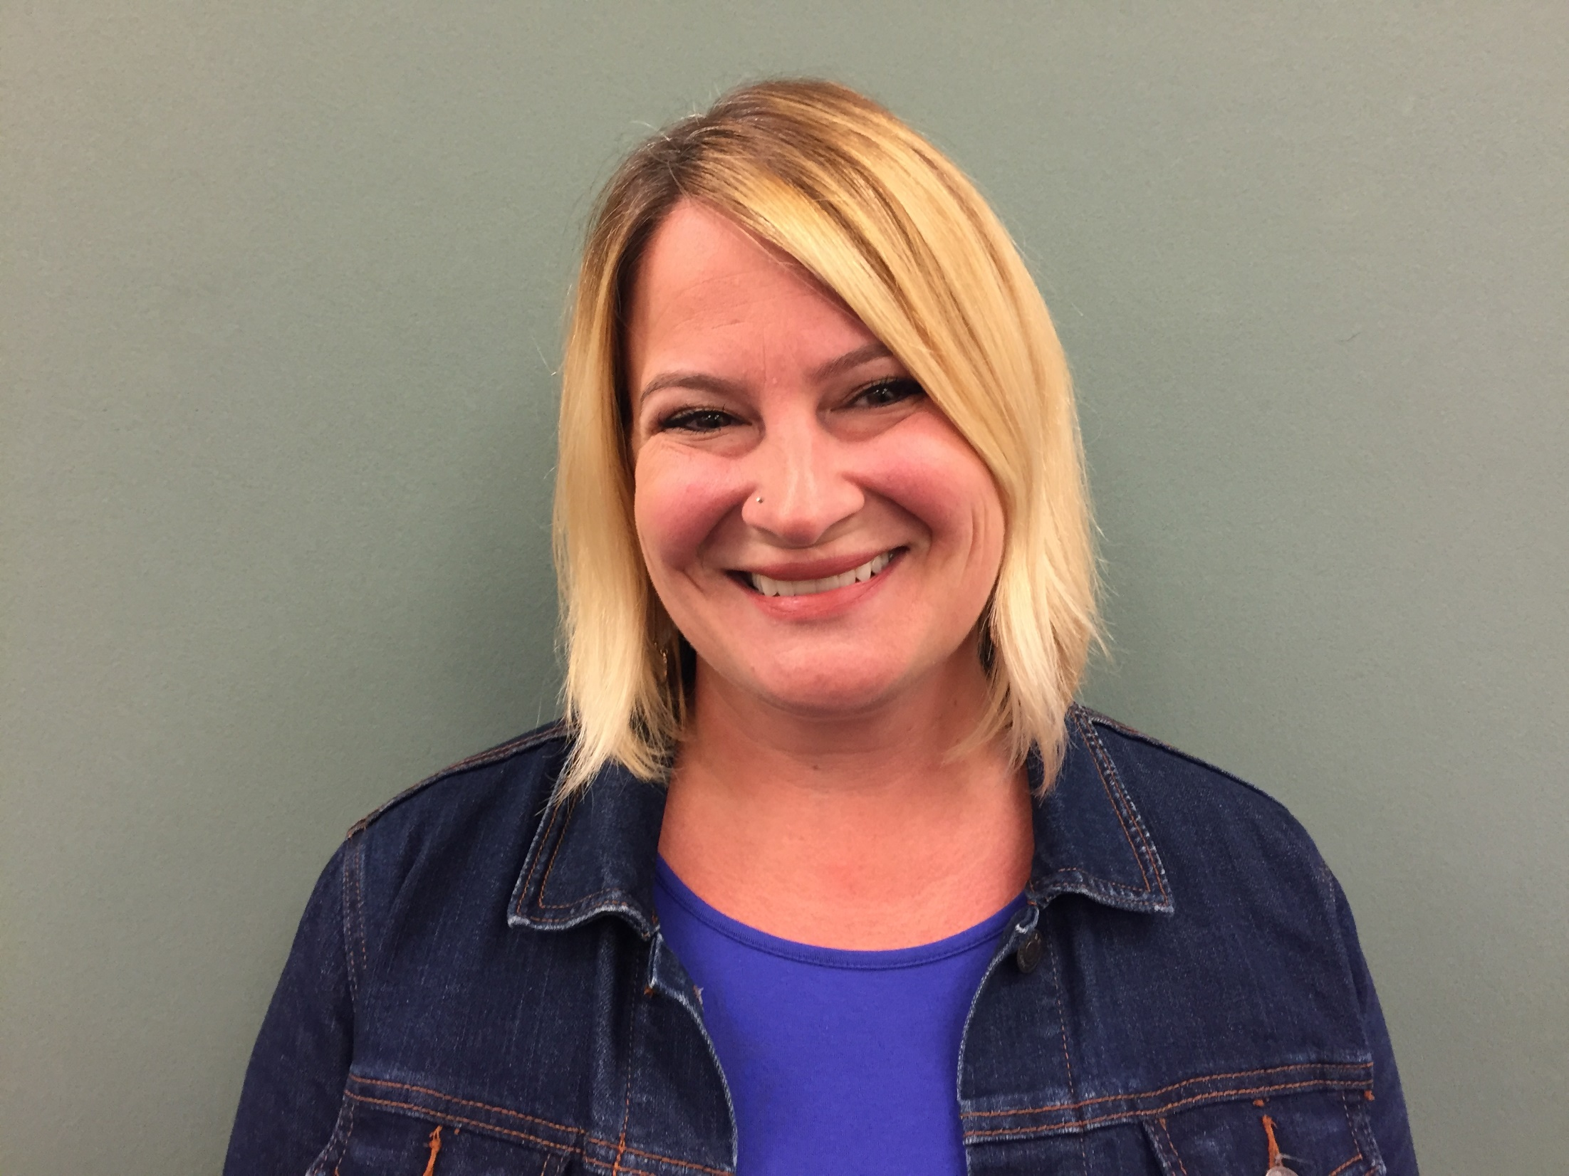
Maisy Draper
Teaching Assistant
Davis Elementary School

Slide 18
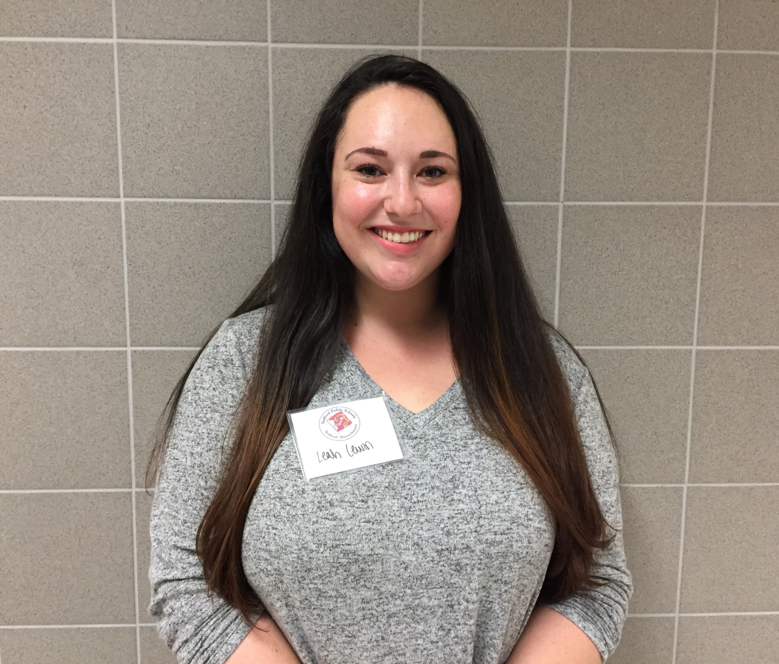
Leah Lewin
Teaching Assistant
Davis Elementary School

Slide 19
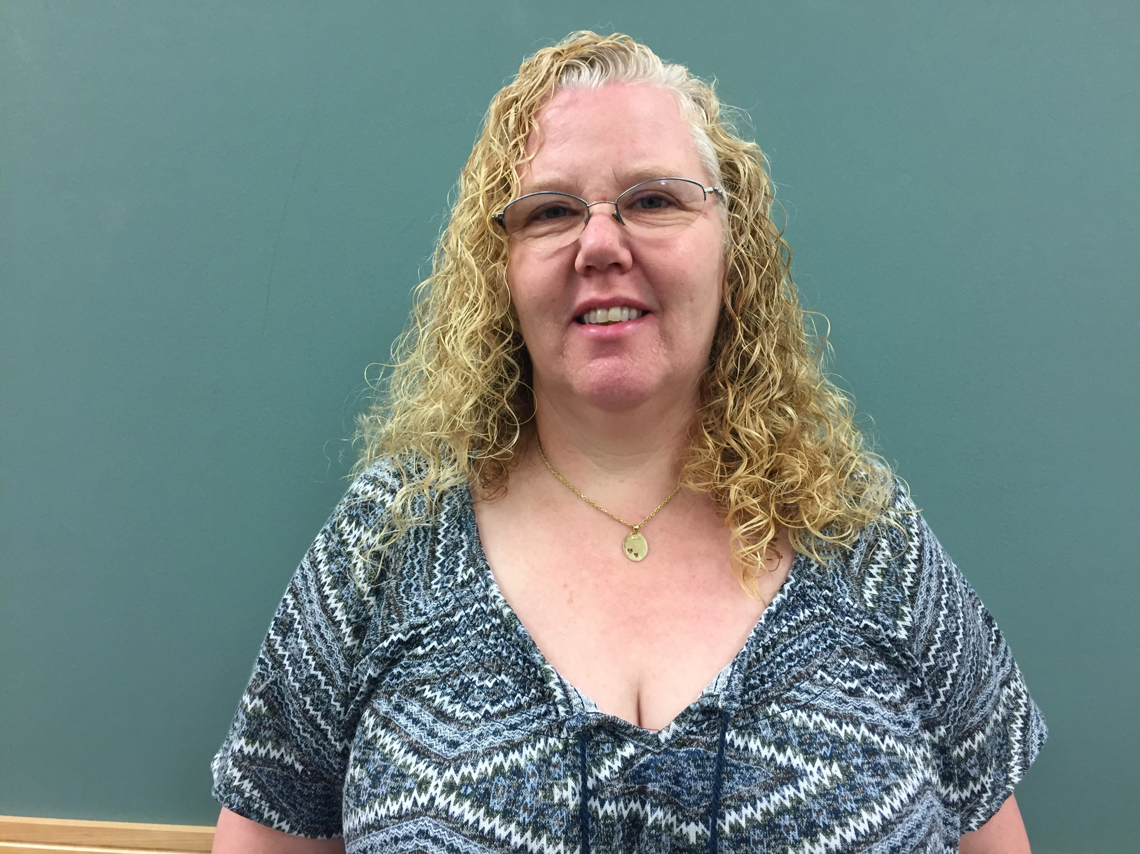
Johnna Mangan
SPED Teacher
Davis Elementary School

Slide 20
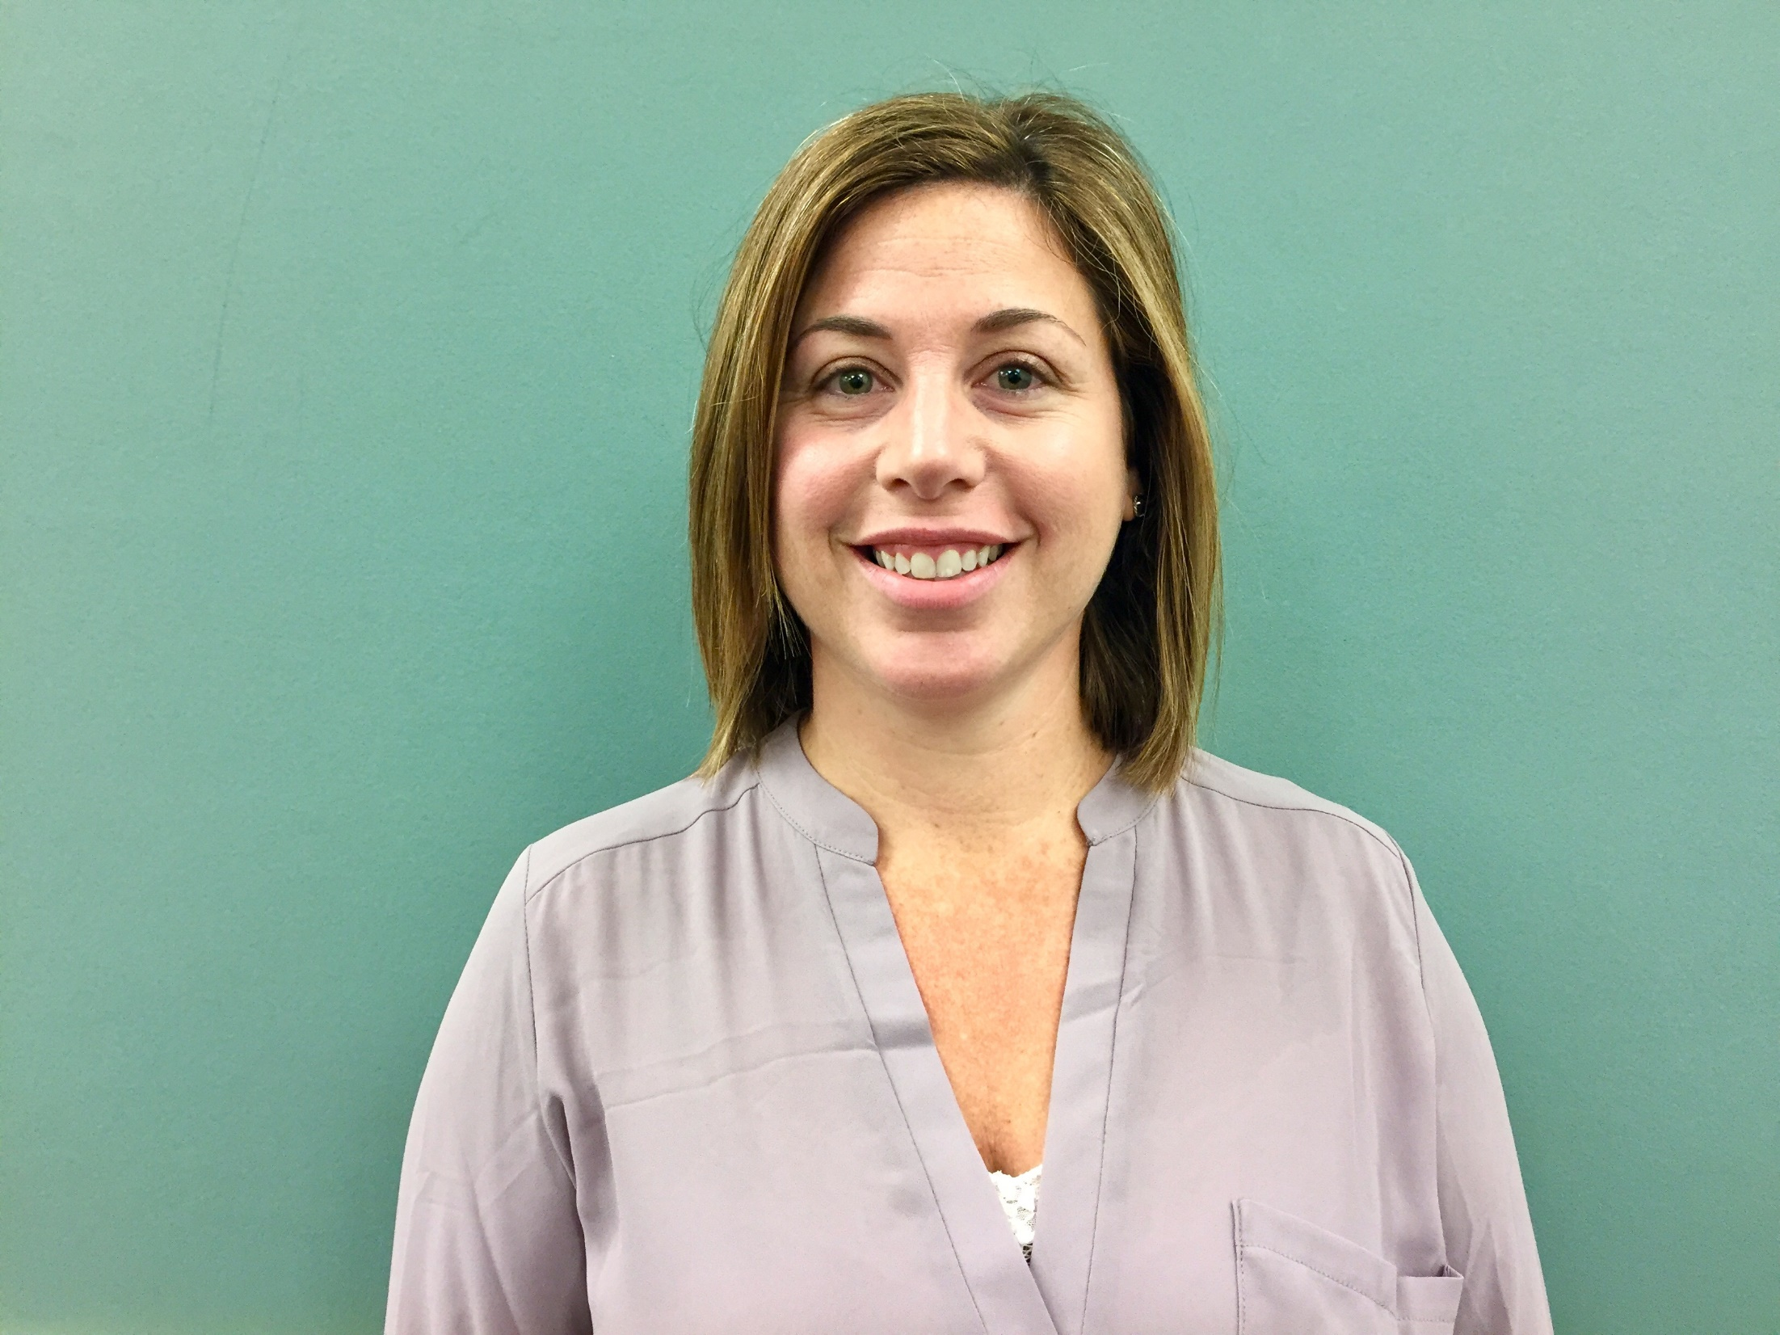
Kristin Murray
Reading Teacher
Davis Elementary School

Slide 21
Lane Elementary School

Slide 22
Megan Armstrong
Teaching Assistant
Lane Elementary School

Slide 23
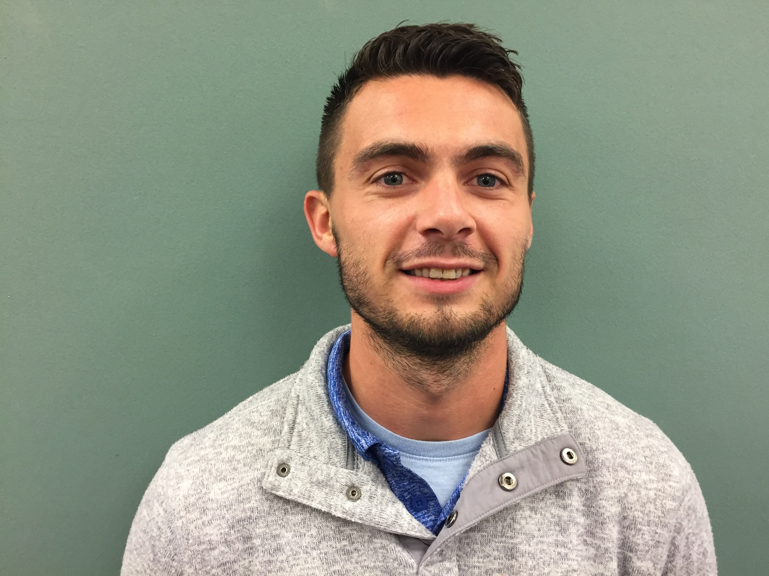
Michael Aronian
Teaching Assistant
Lane Elementary School

Slide 24
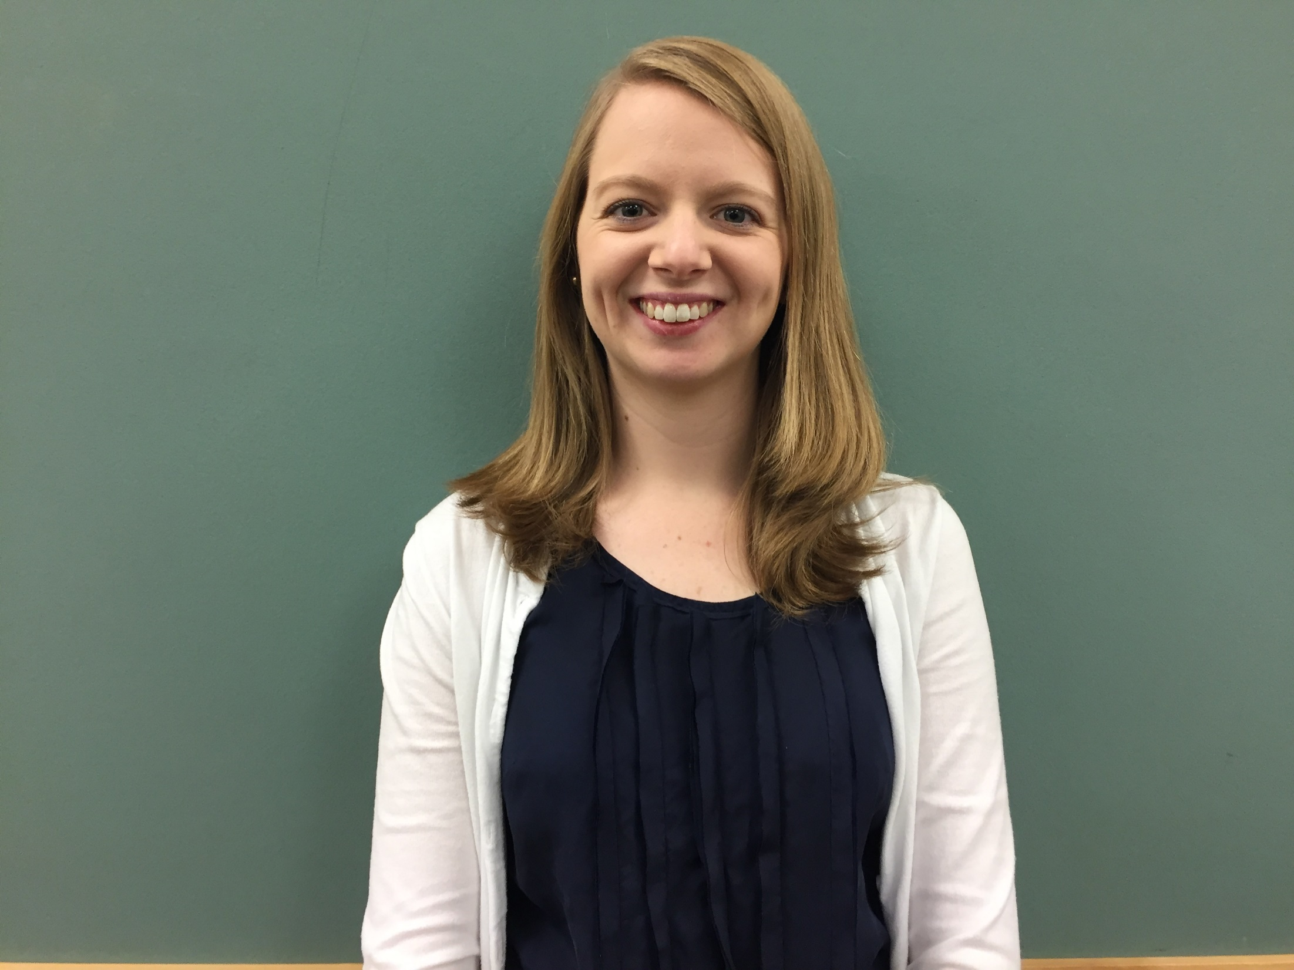
Carolyn Carr
SPED Teacher
Lane Elementary School

Slide 25
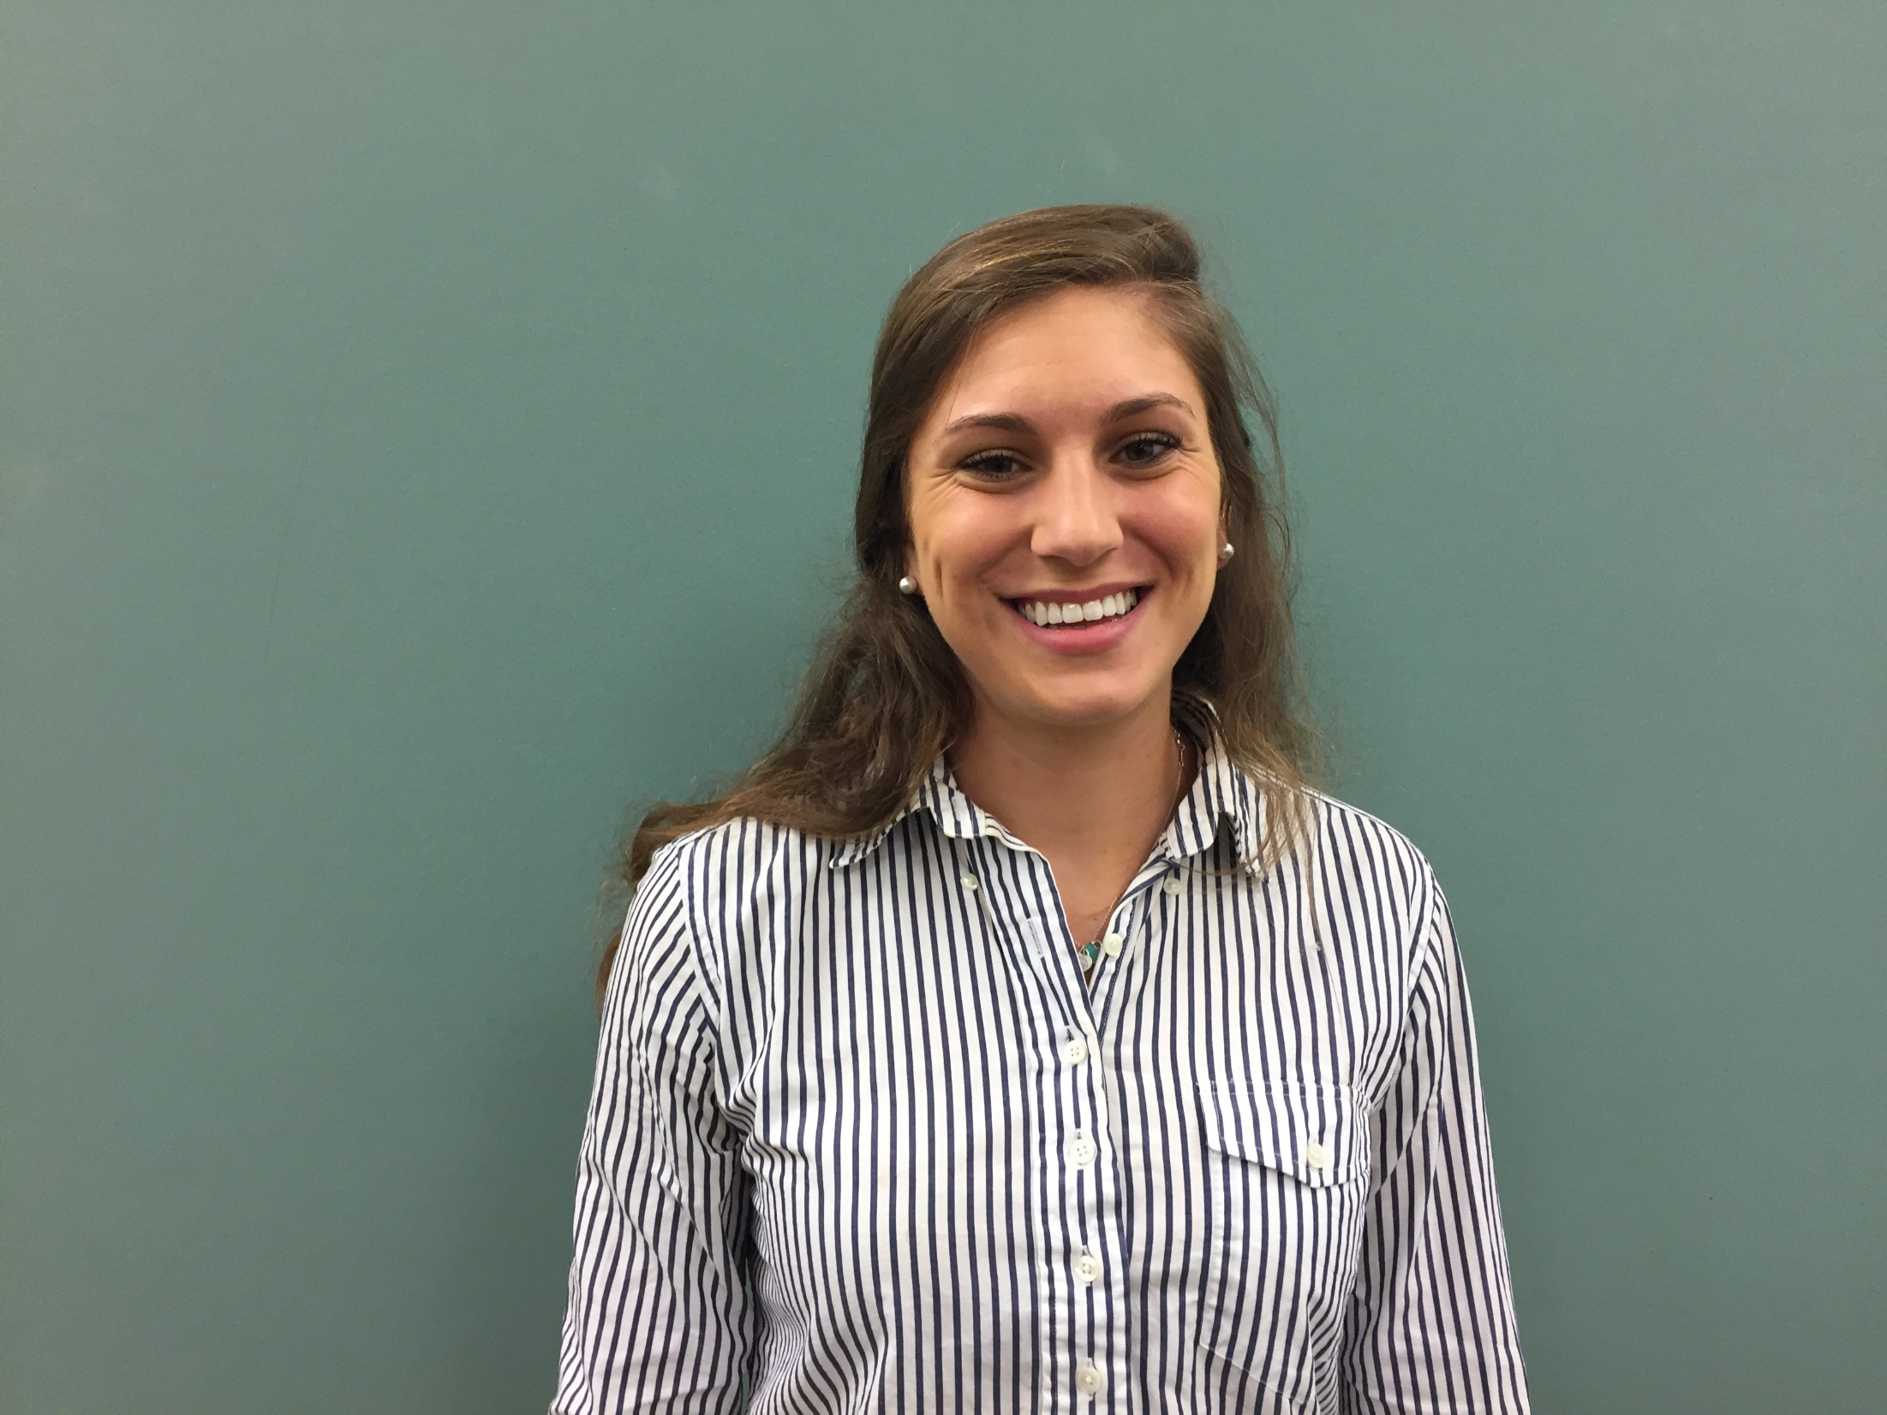
Jessica Casteline
Classroom Teacher
Lane Elementary School

Slide 26
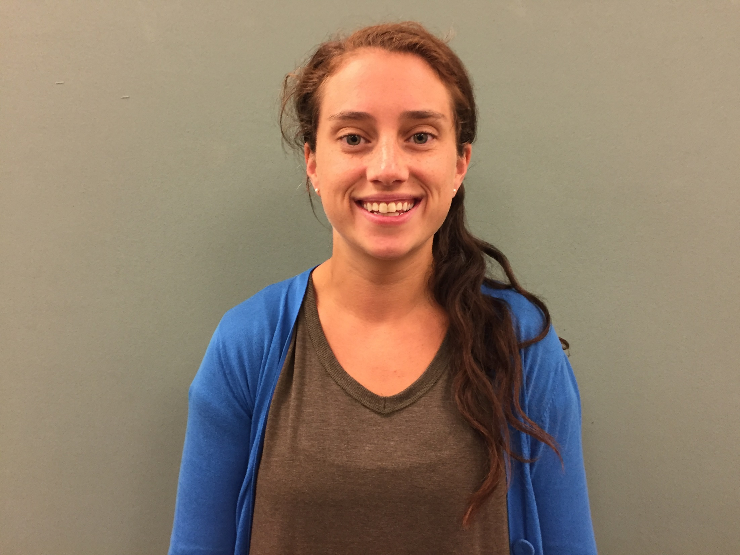
Kaitlin Curran
SPED Teacher
Lane Elementary School

Slide 27
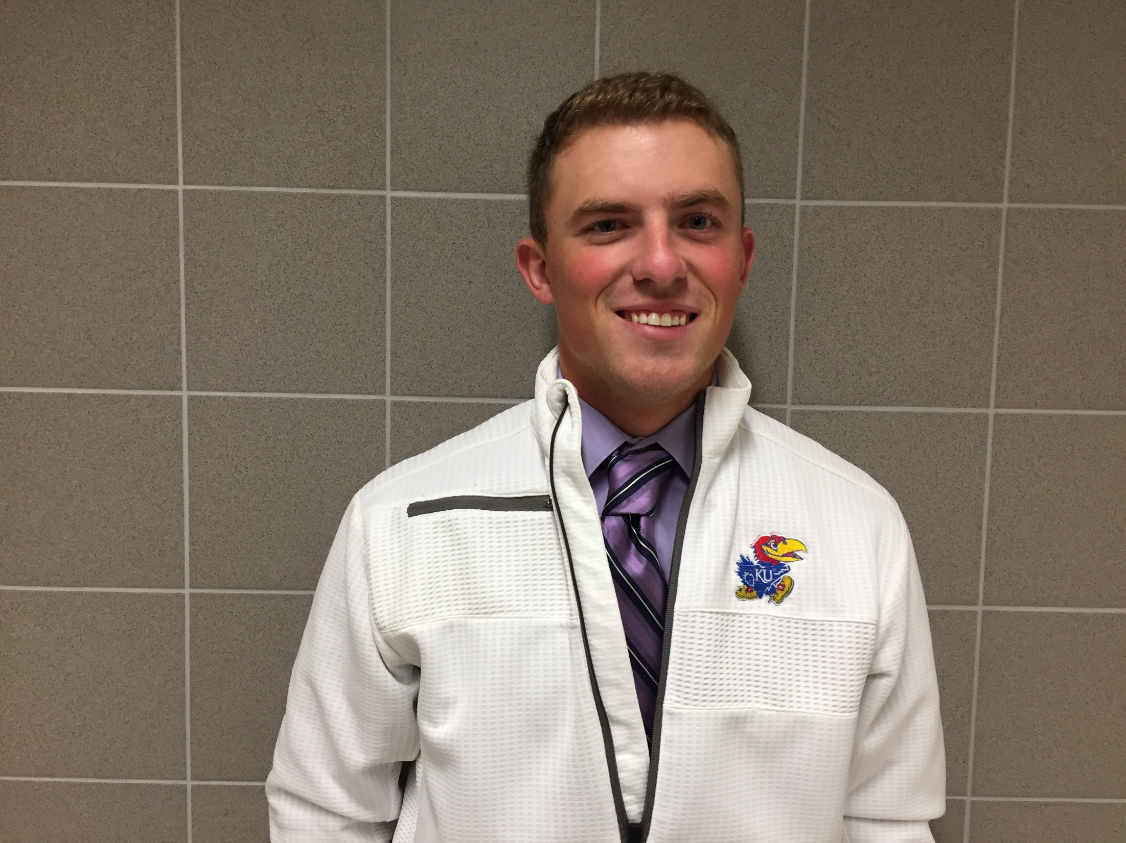
Alex Delavan
Teaching Assistant
Lane Elemetary School

Slide 28
Yrene Despradel
Educational Assistant
Lane Elementary School

Slide 29
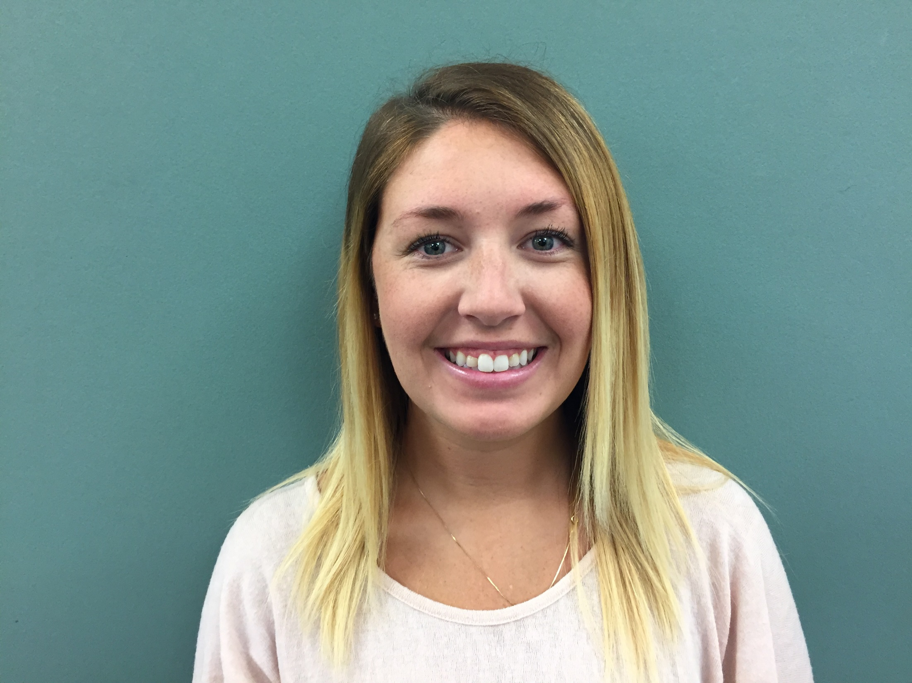
Kelly Devellis
Teaching Assistant
Lane Elementary School

Slide 30
Michael Fahy
Teaching Assistant
Lane Elementary School

Slide 31
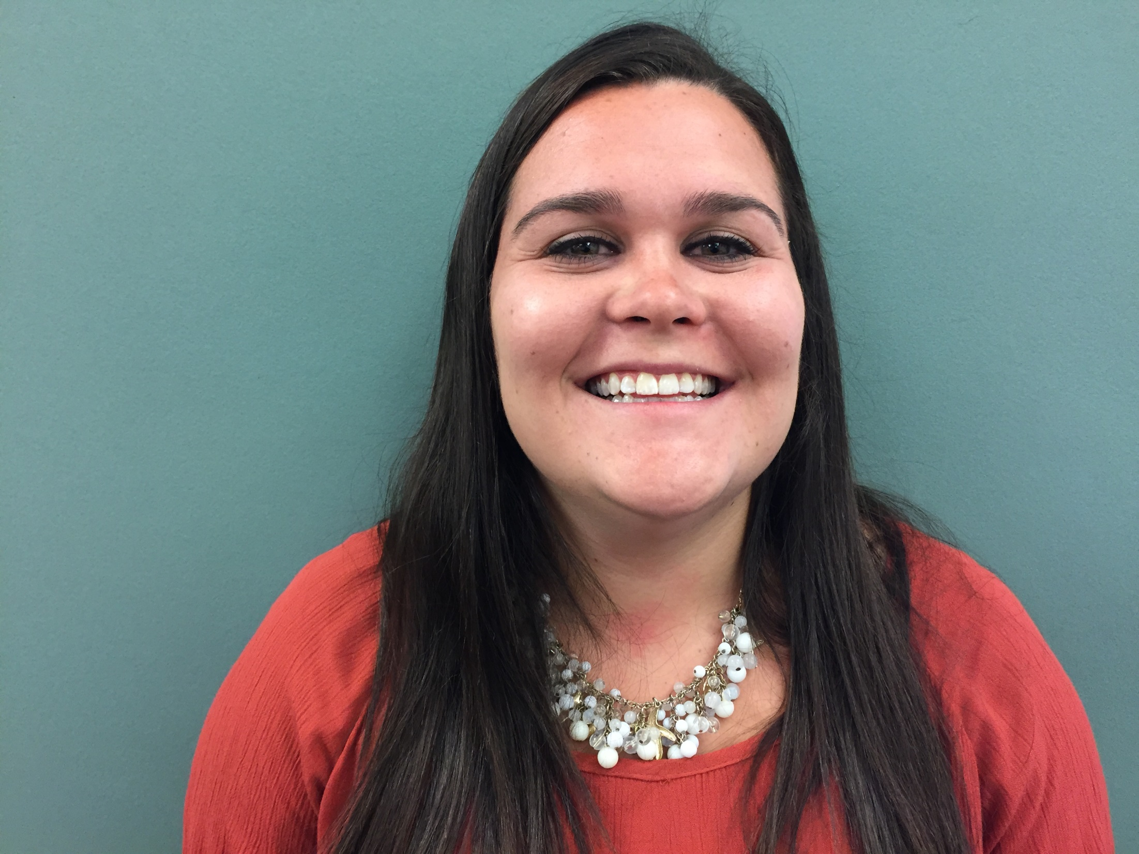
Danielle Hickox
Teaching Assistant
Lane Elementary School

Slide 32
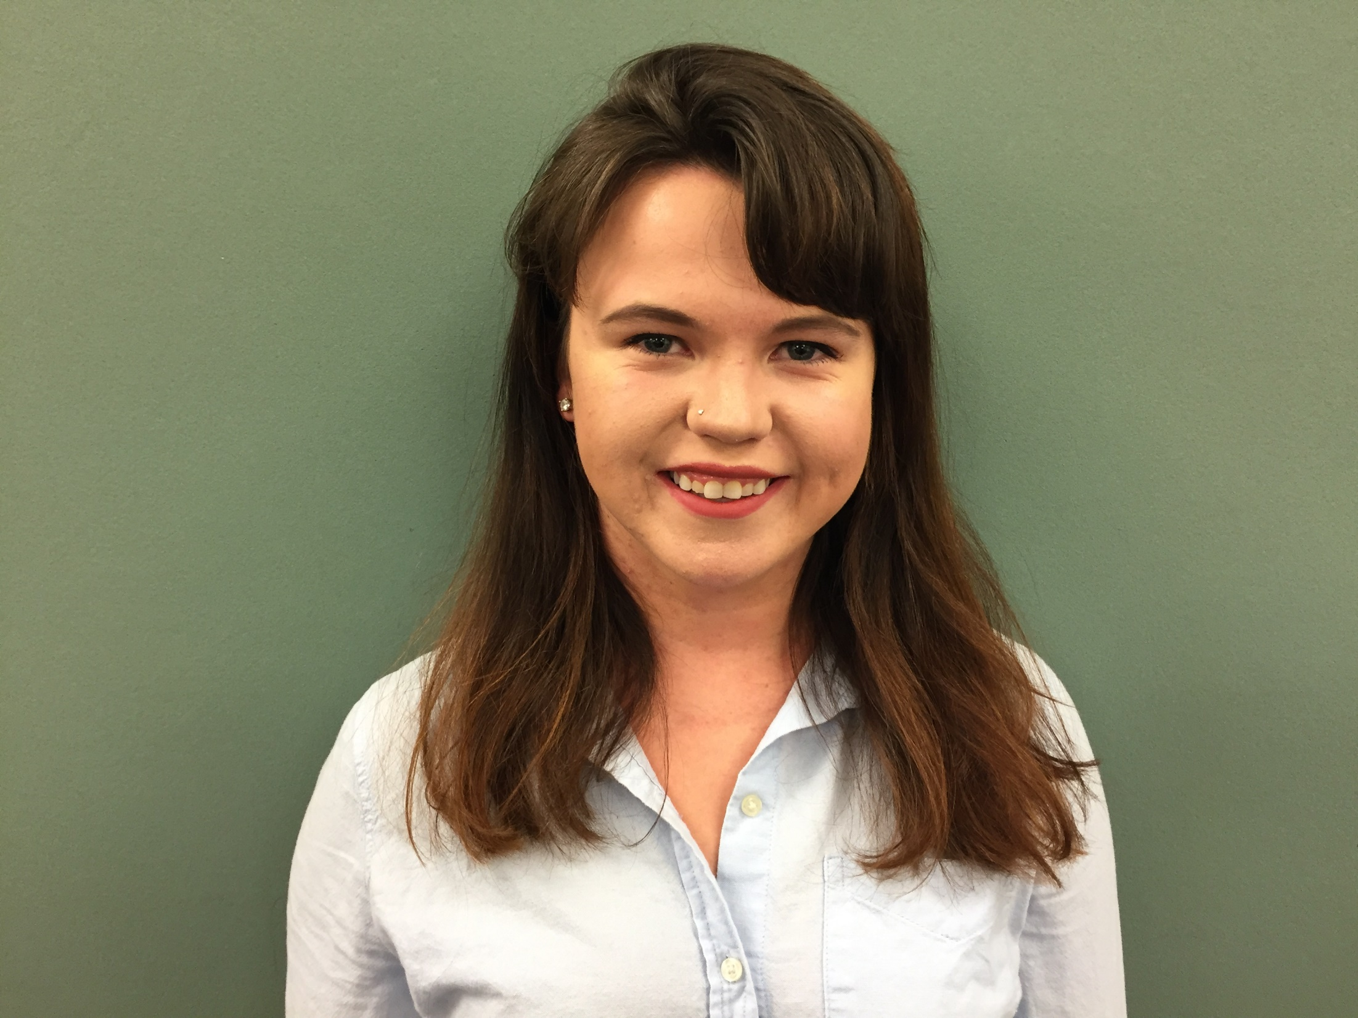
Erin Mawhinney
Teaching Assistant
Lane Elementary School

Slide 33
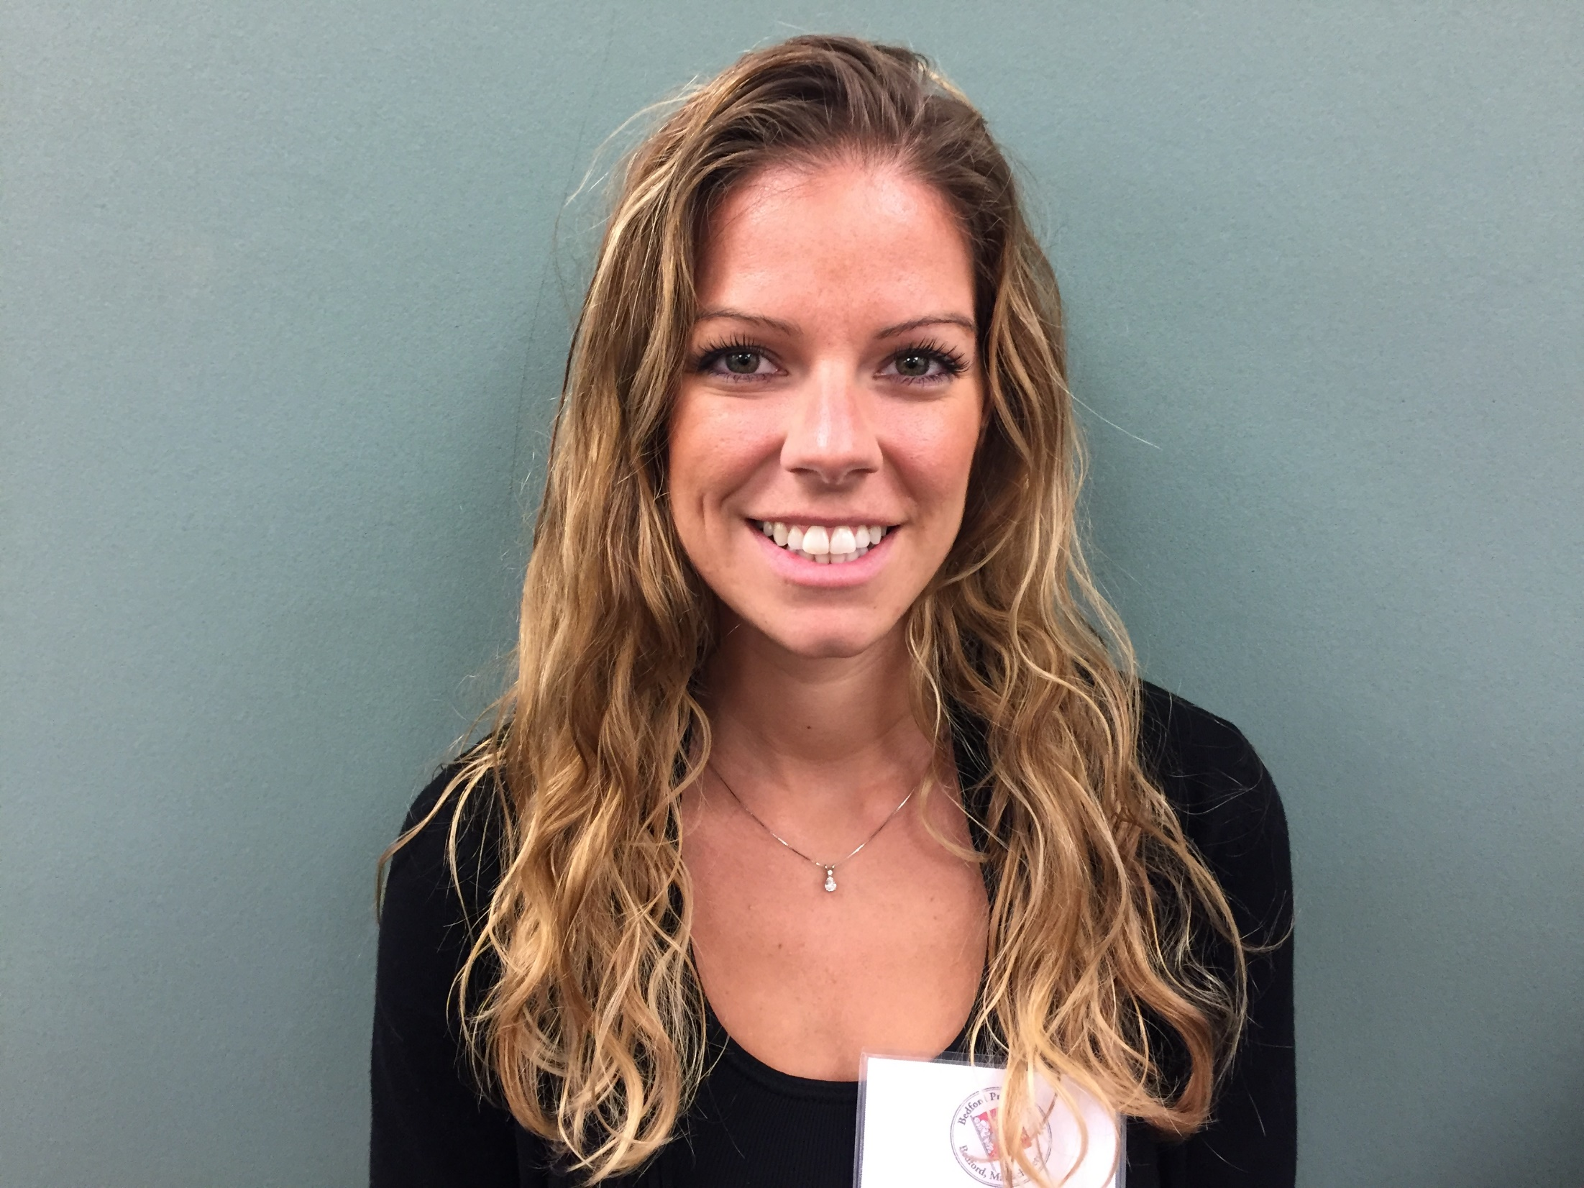
Katlyn Seaver
Classroom Teacher
Lane Elementary School

Slide 34
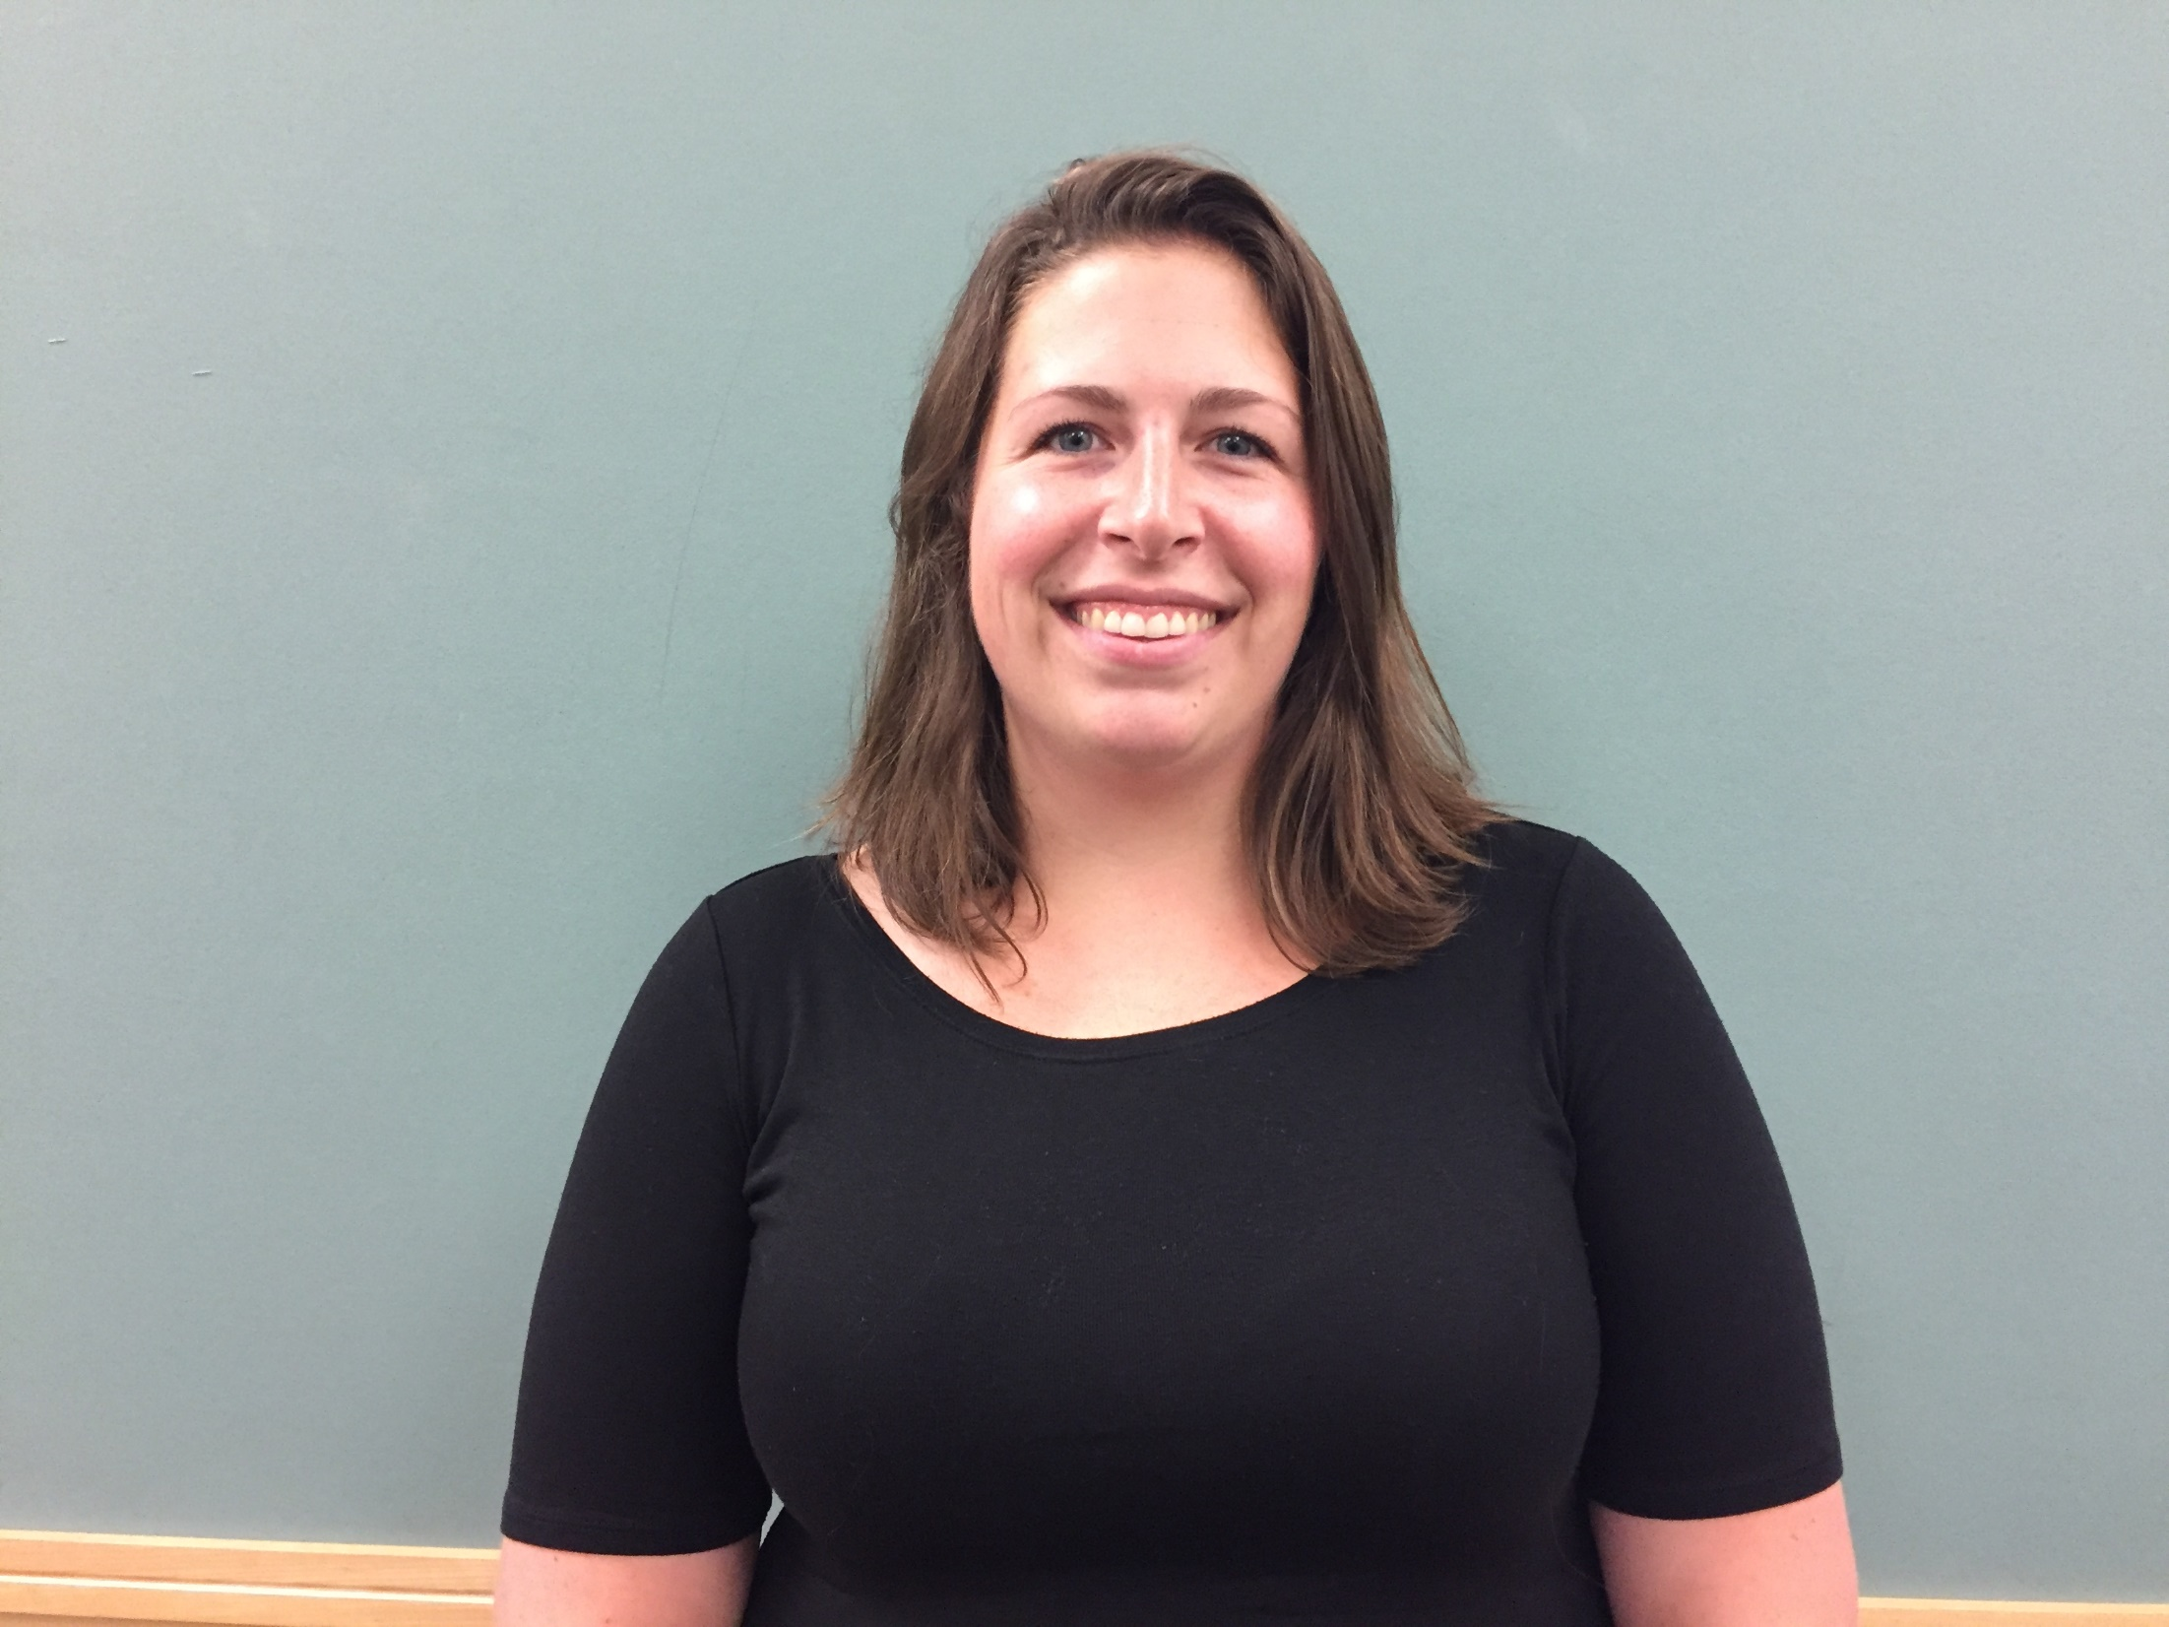
Brittany Stanley
Grade 4 Teacher
Lane Elementary School

Slide 35
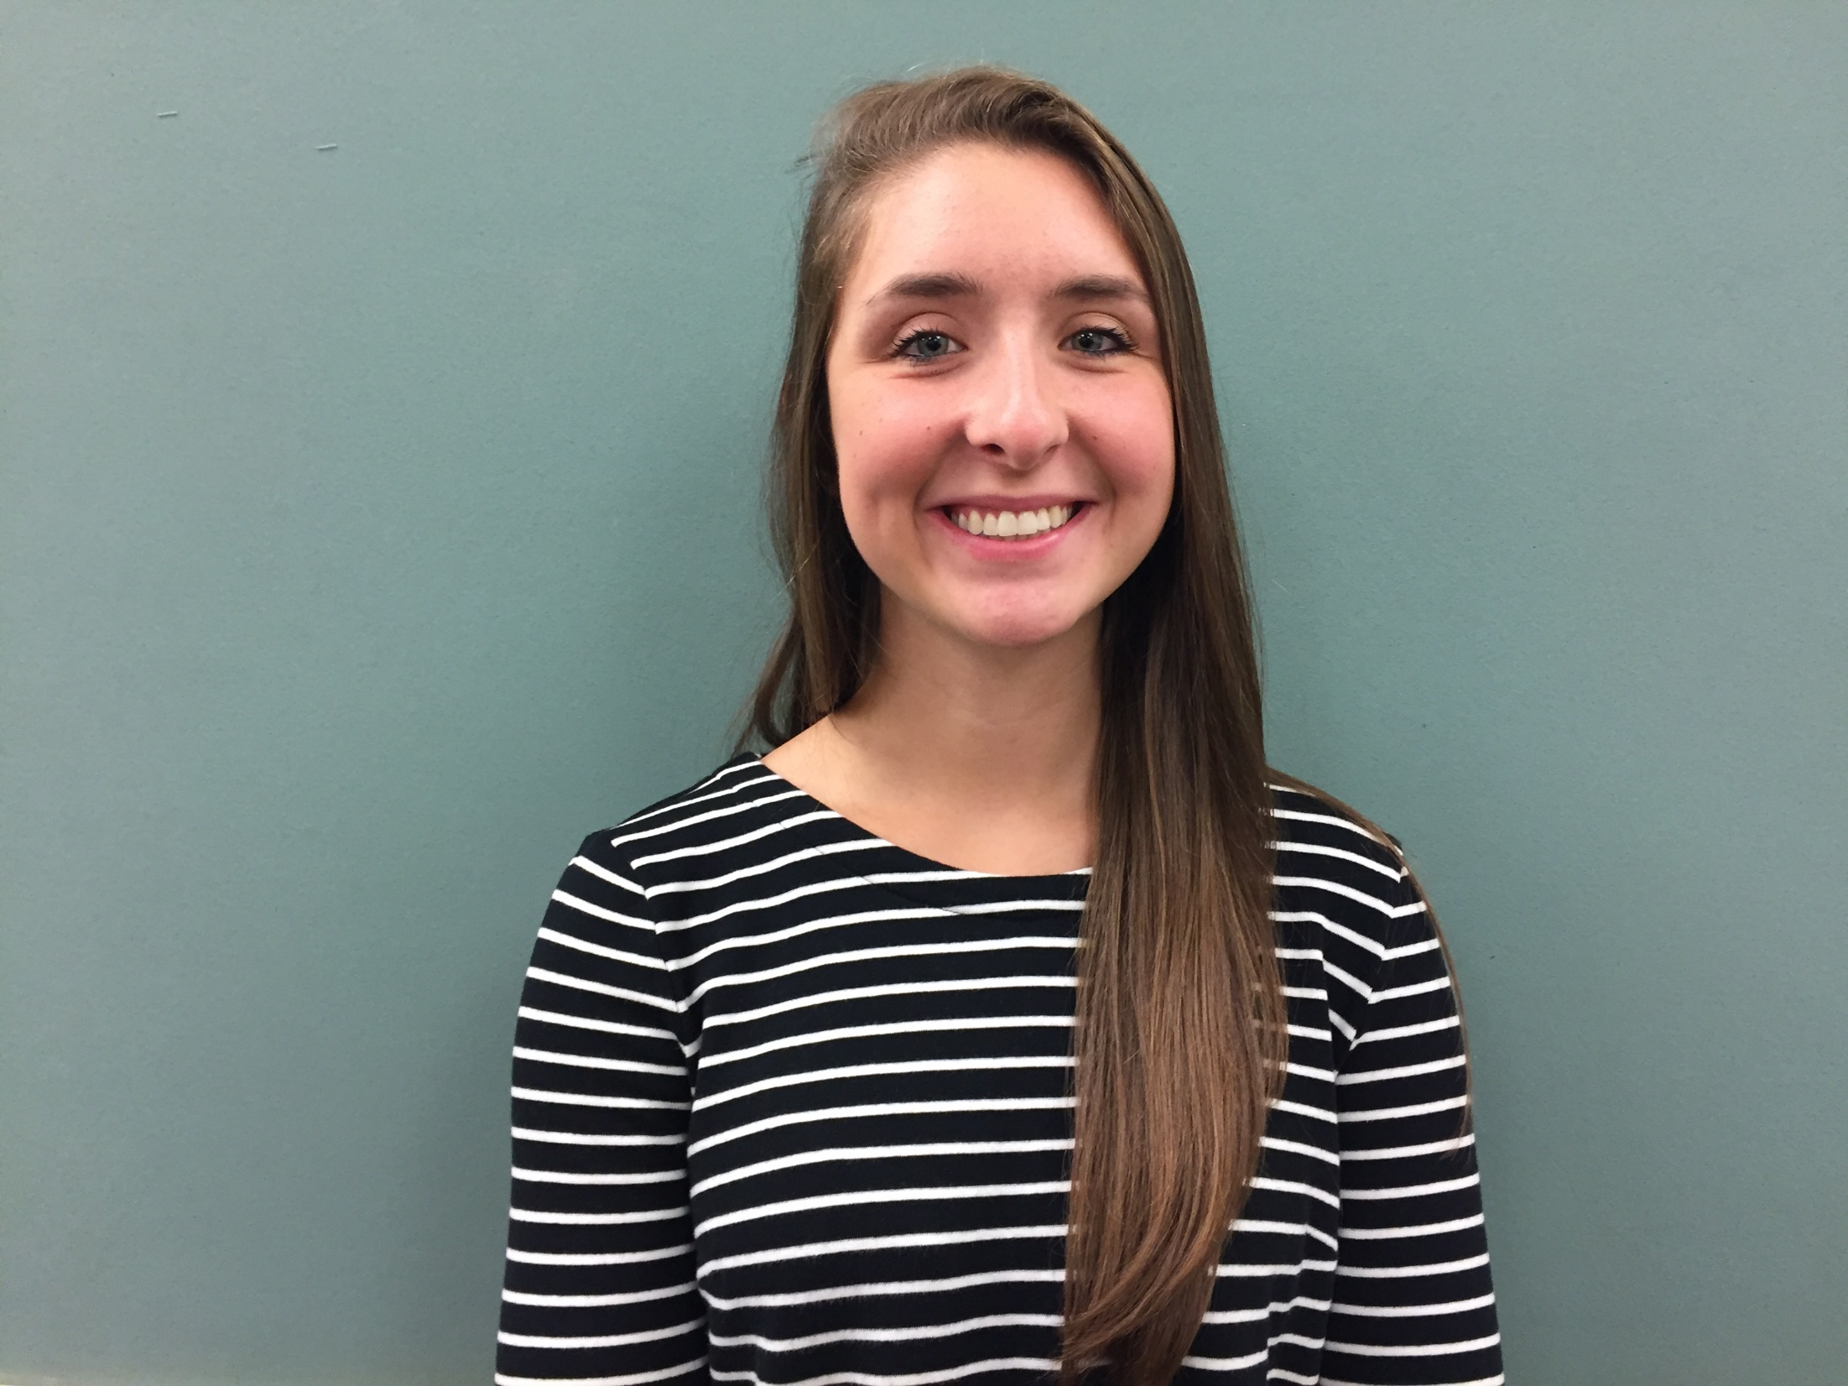
Caitlin Worthen
Teaching Assistant
Lane Elementary School

Slide 36
John Glenn Middle School

Slide 37
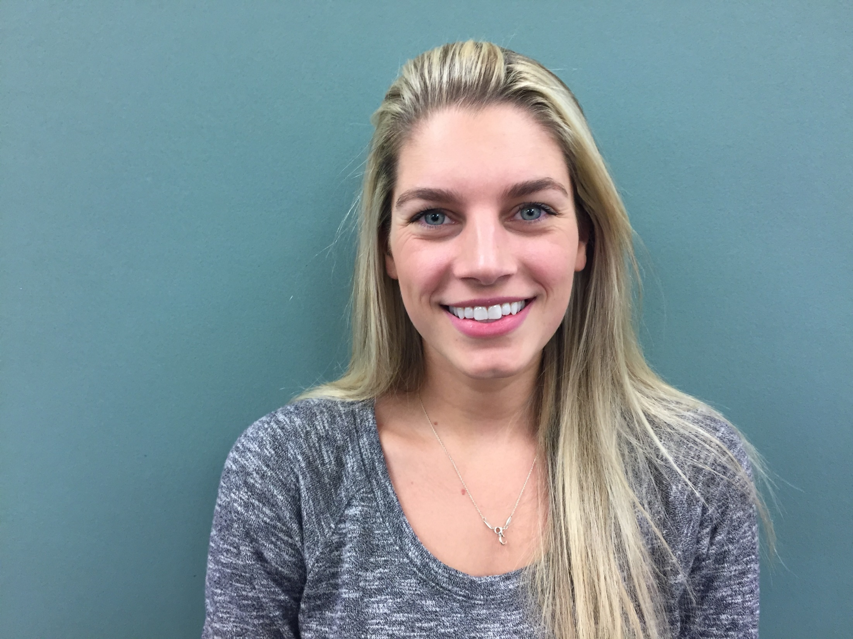
Samantha Boland
Teaching Assistant
JGMS

Slide 38
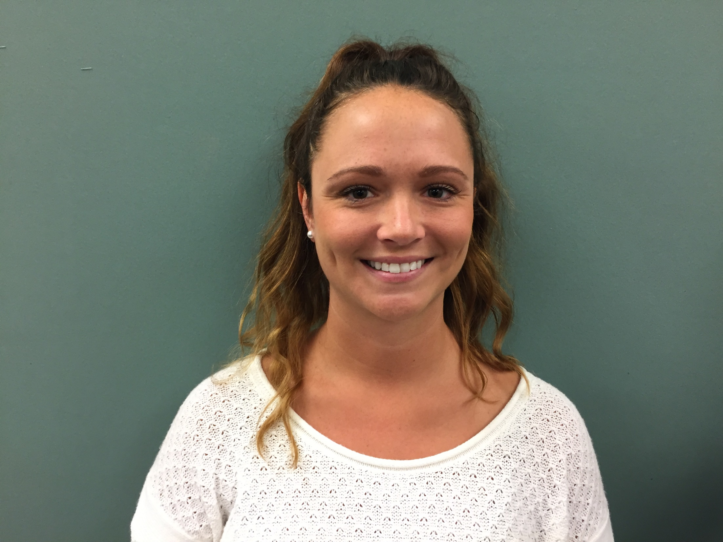
Lisa Butterfield
Adjustment Counselor
Bridge/SAIL Program
JGMS

Slide 39
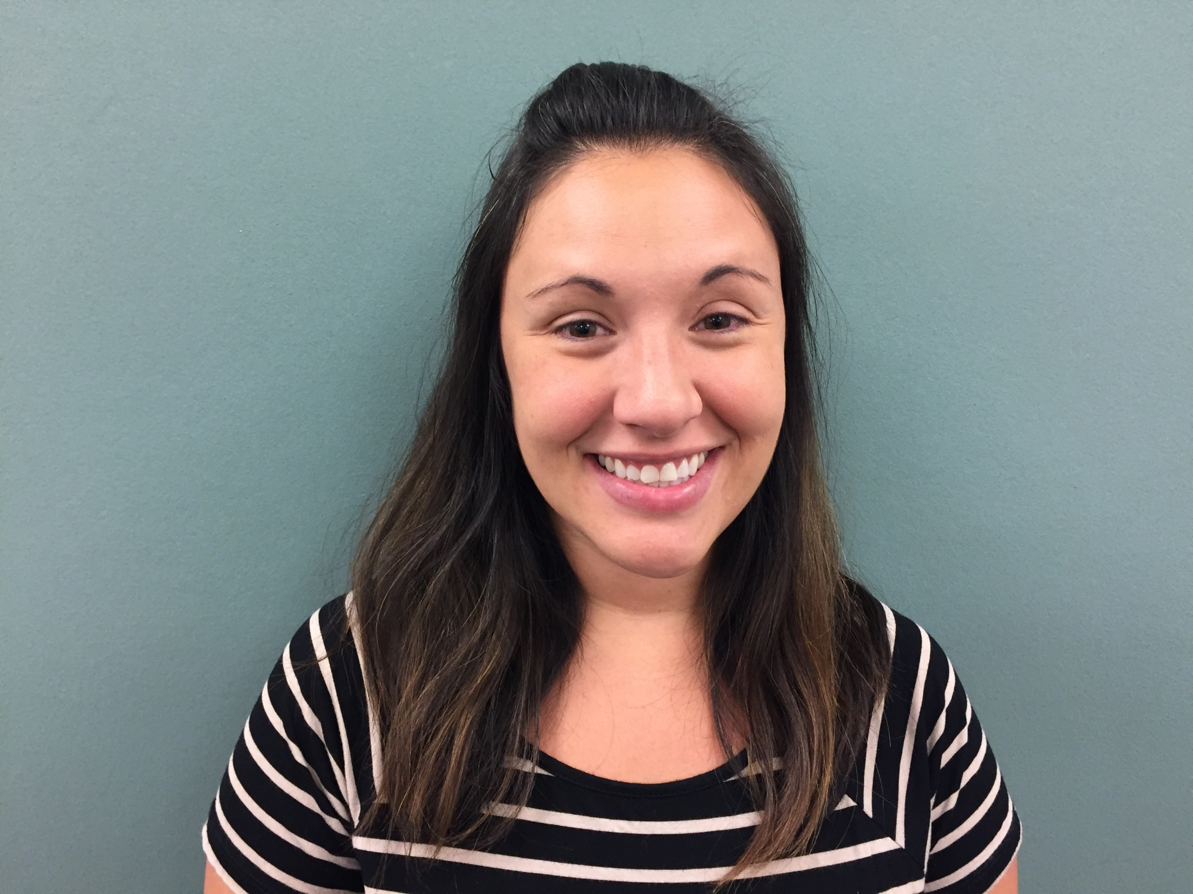
Jennifer Capece
School Nurse
JGMS

Slide 40
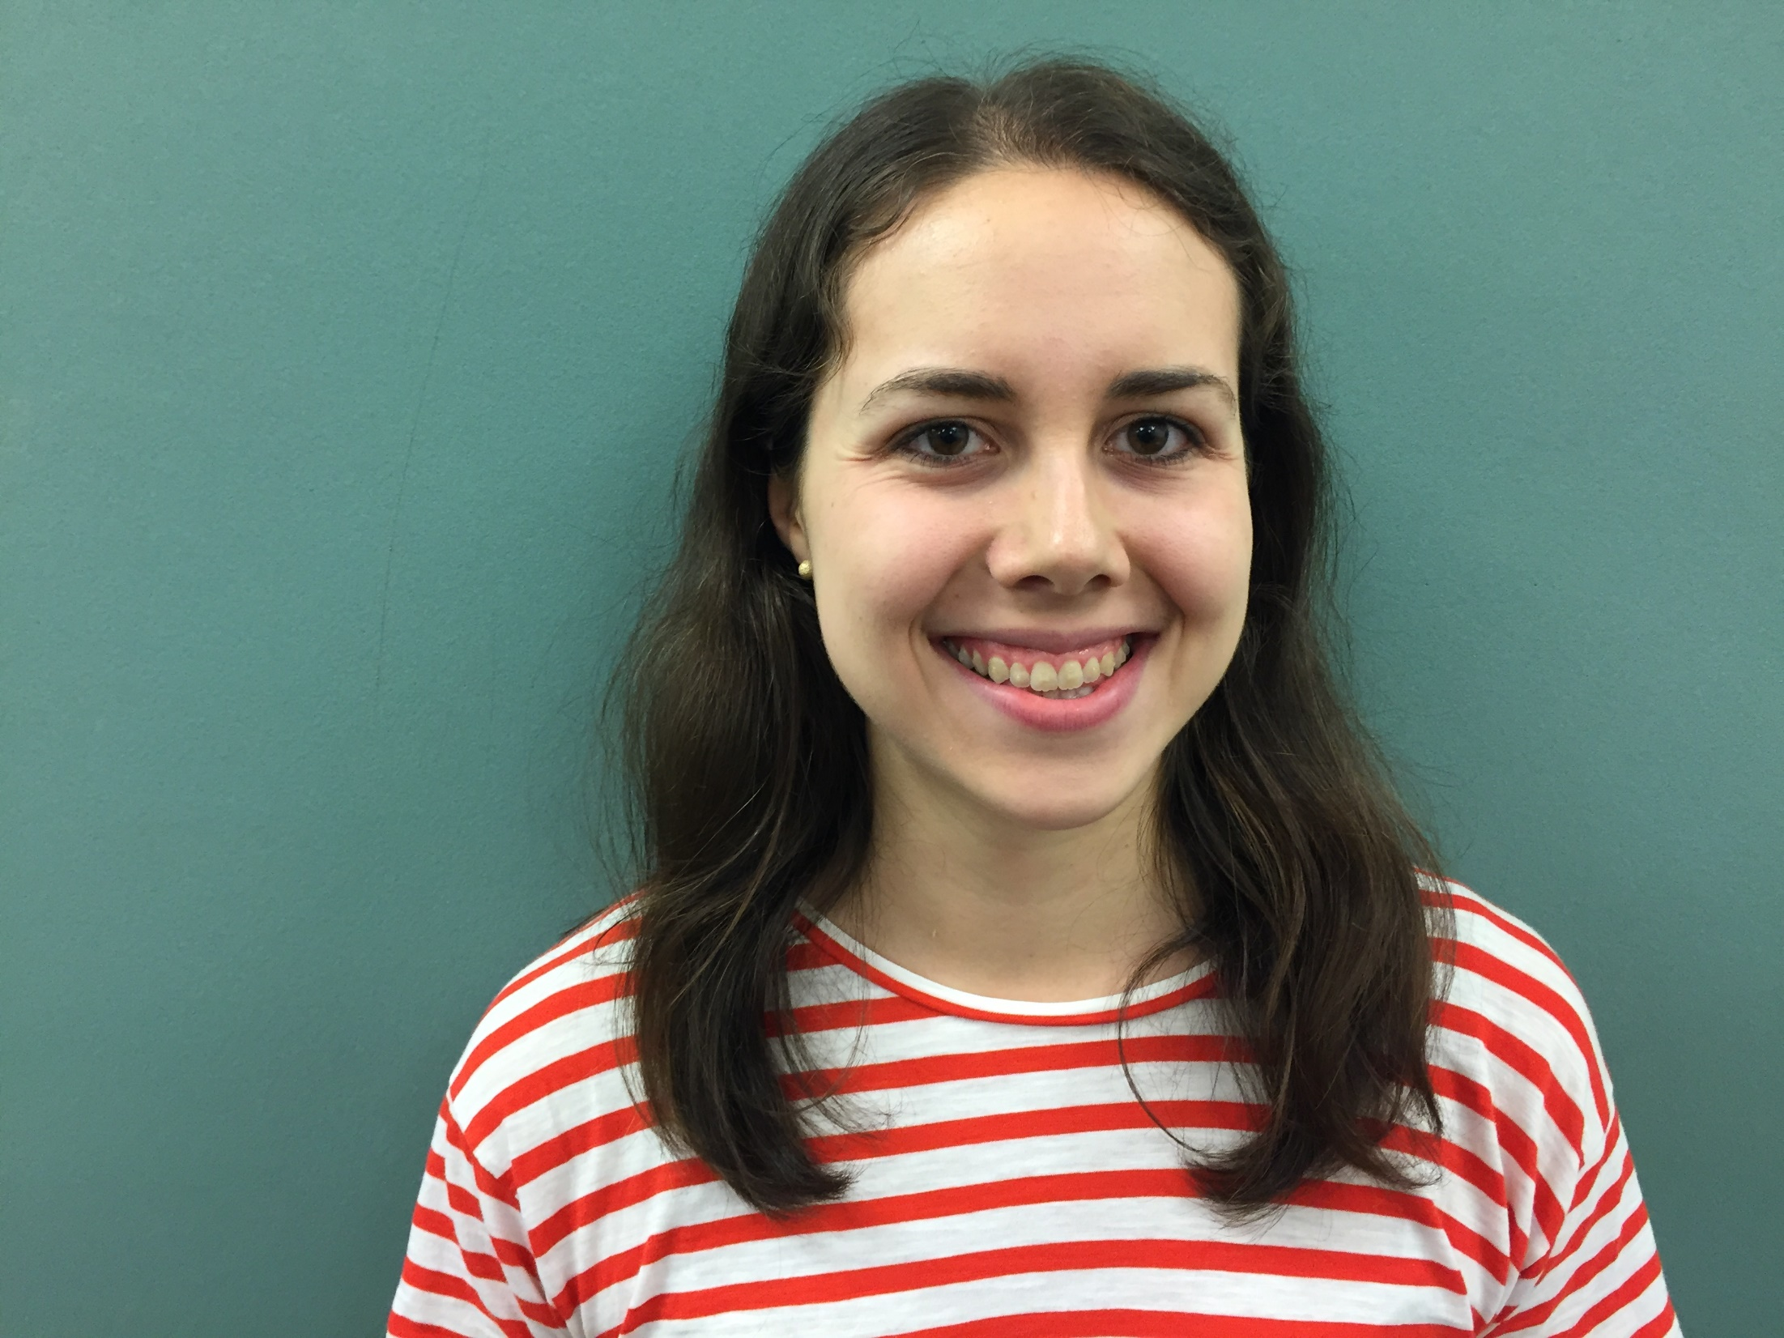
Katherine Connell
Teaching Assistant
JGMS

Slide 41
Erik Driscoll
Teaching Assistant
JGMS

Slide 42
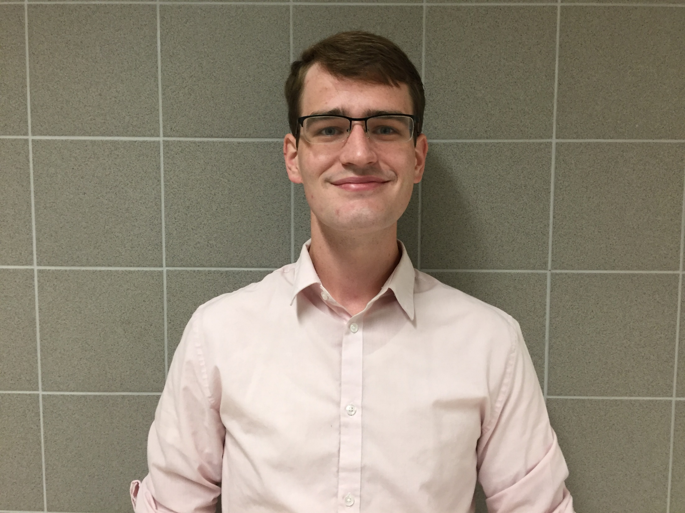
Andrew Goetschius
ELL Teacher
JGMS

Slide 43
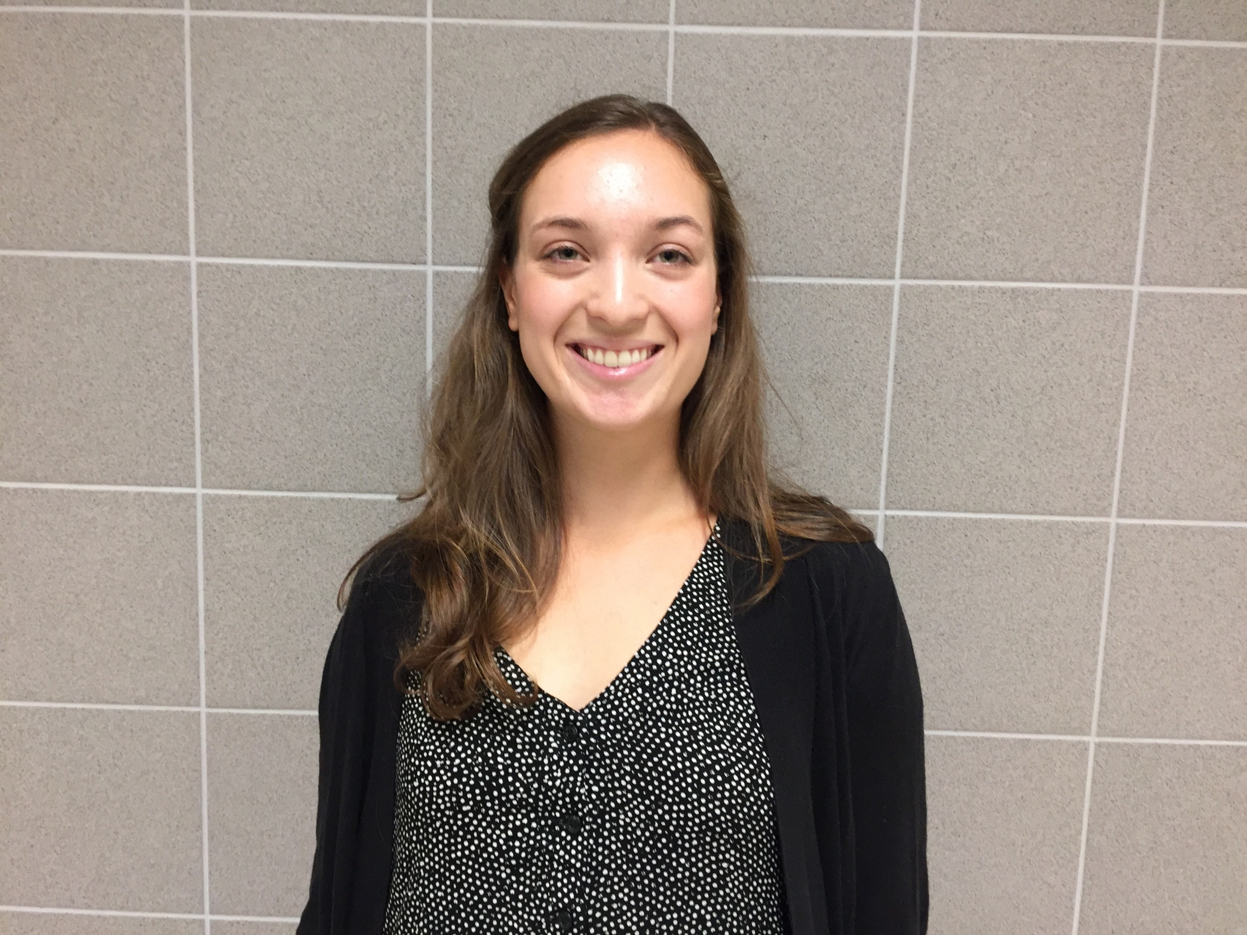
Rebecca Hawk
Grade 6 Teacher
JGMS

Slide 44
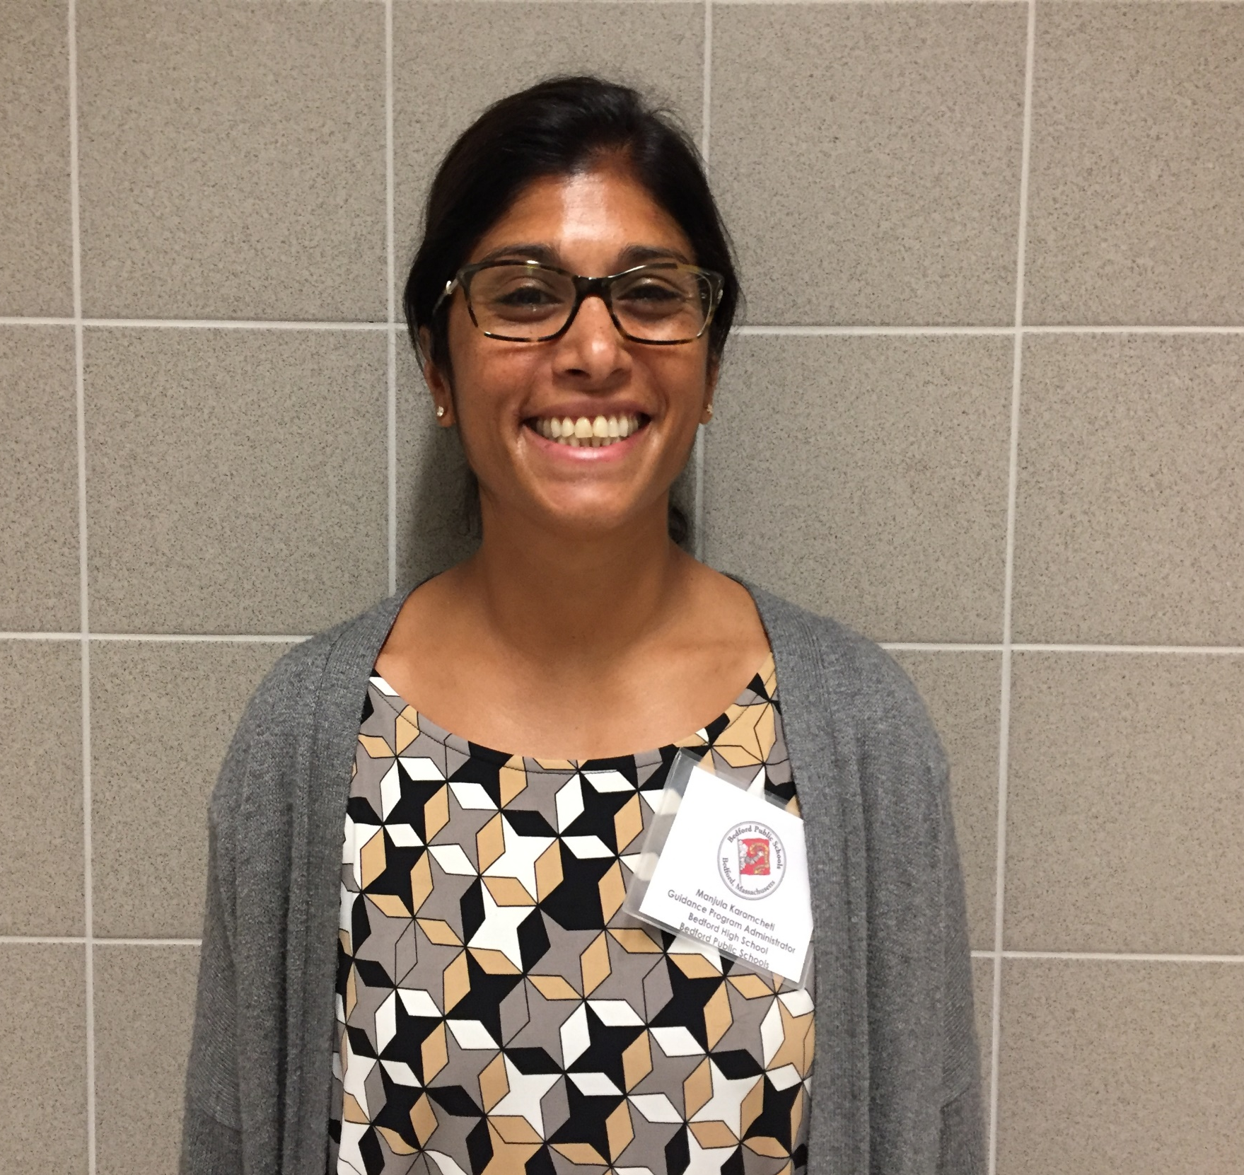
Manjula Karamcheti
Guidance Program Administrator
JGMS and High School

Slide 45
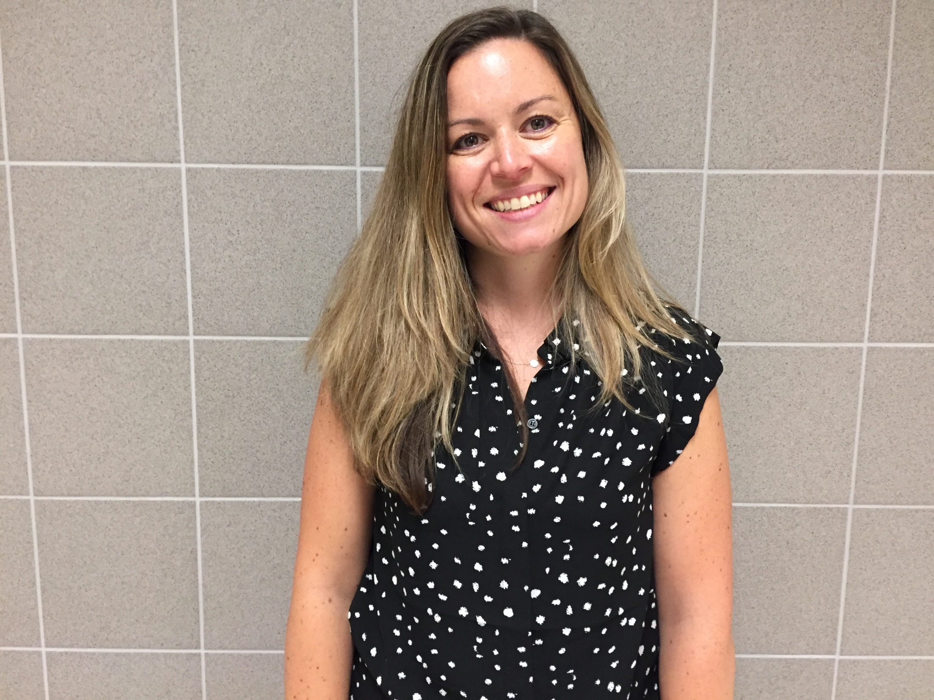
Anya Kennedy
Grade 6 ELA Teacher
JGMS

Slide 46
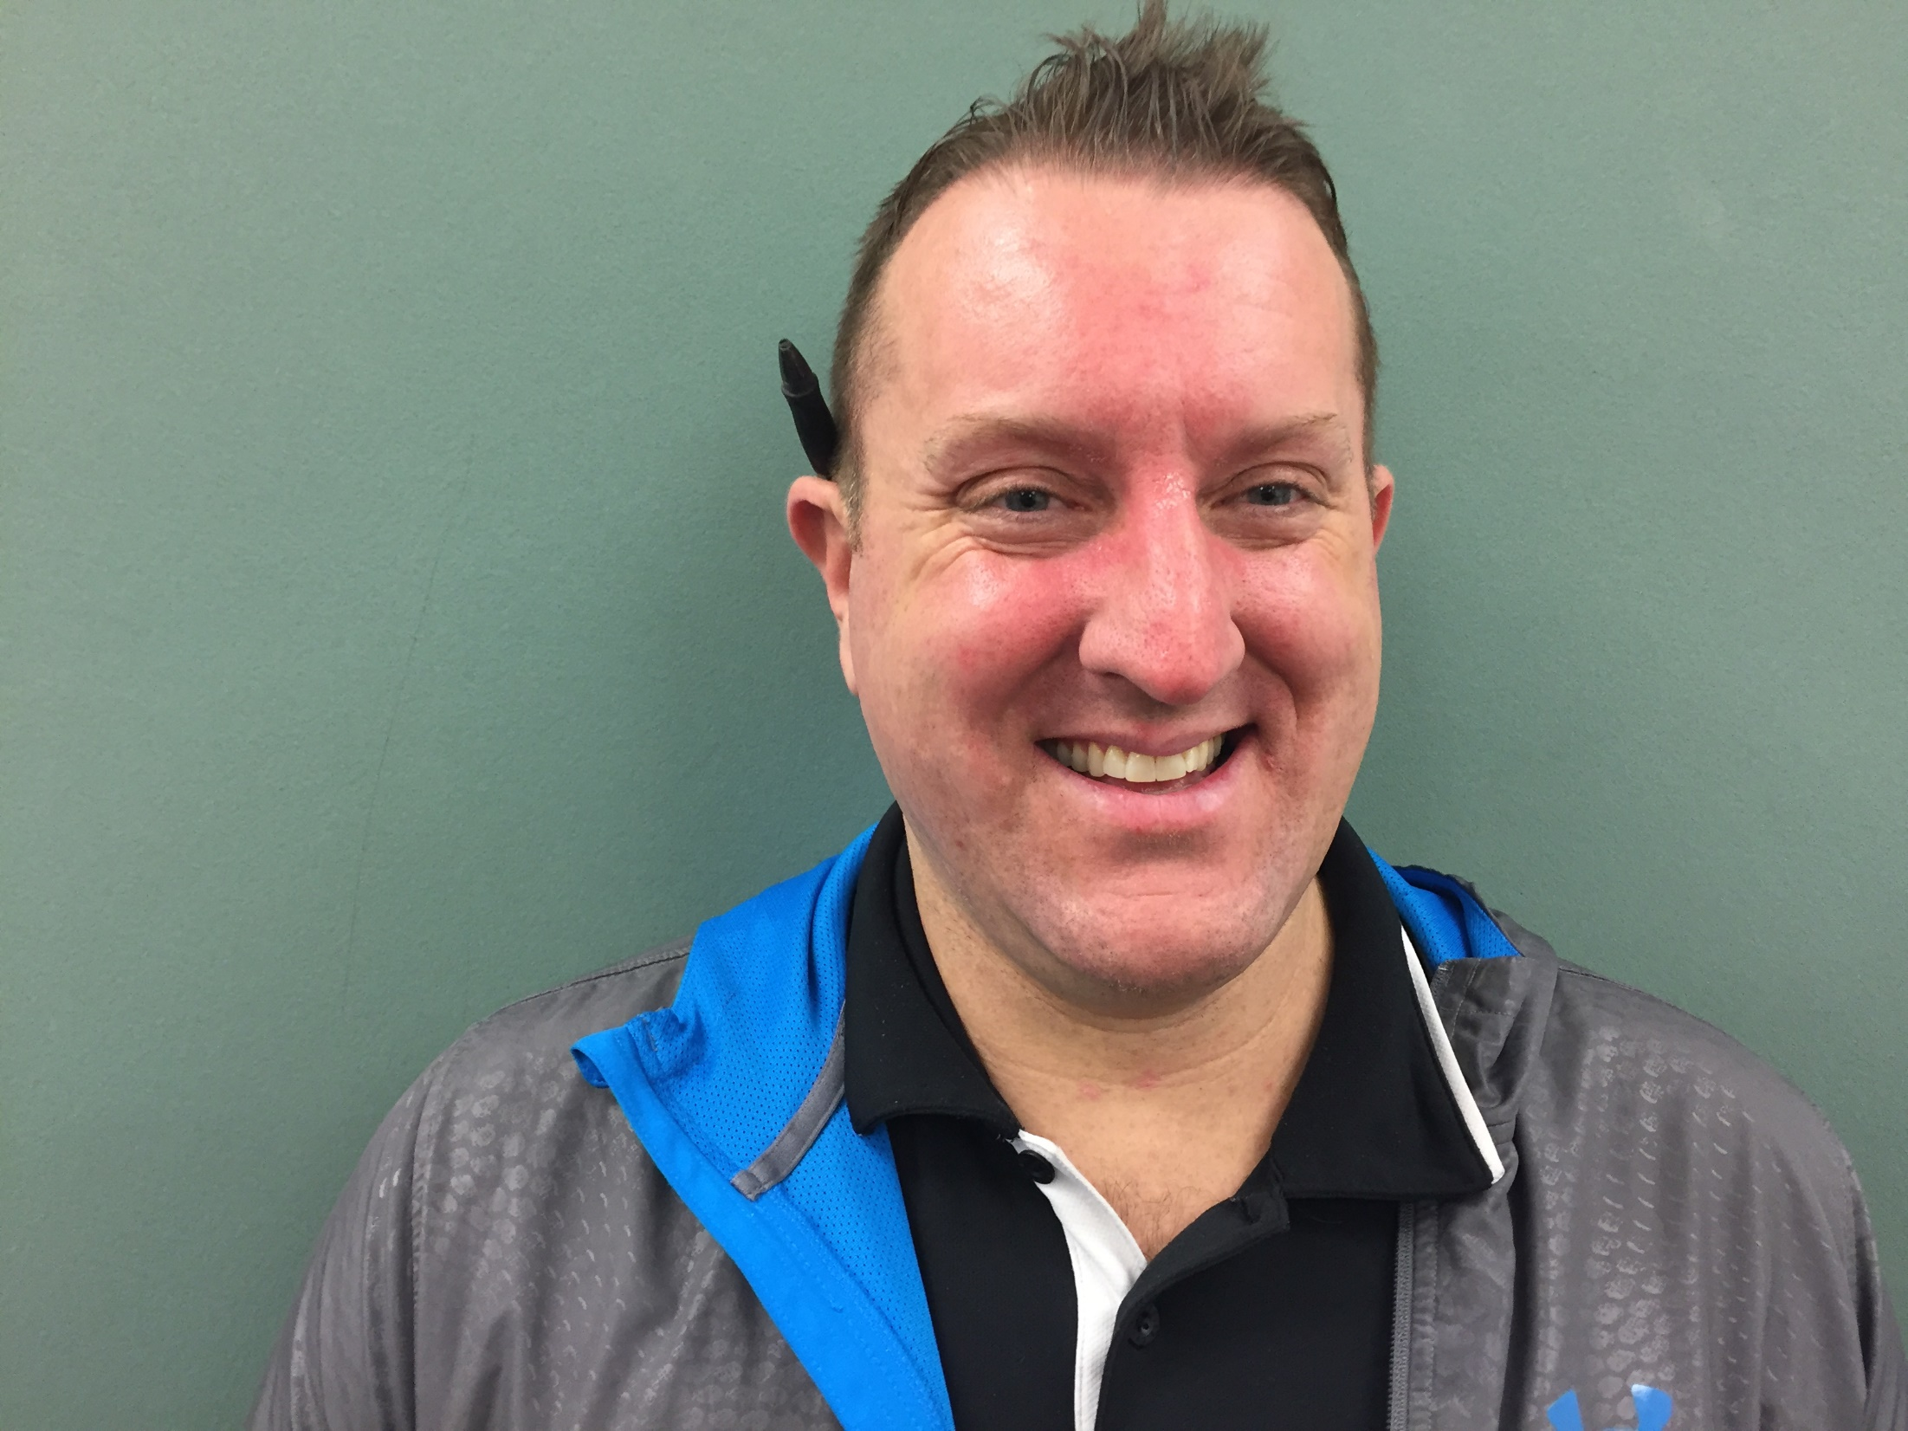
Ryan Kilian
PE/Health Teacher
JGMS

Slide 47
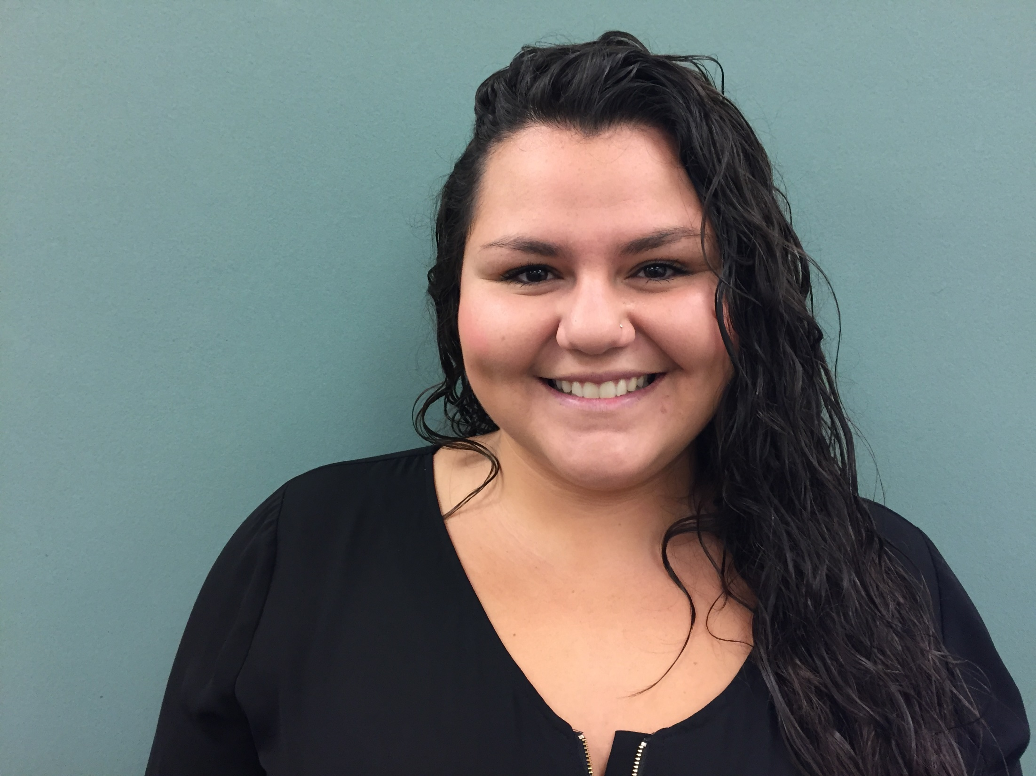
Kari Lua
Teaching Assistant
JGMS

Slide 48
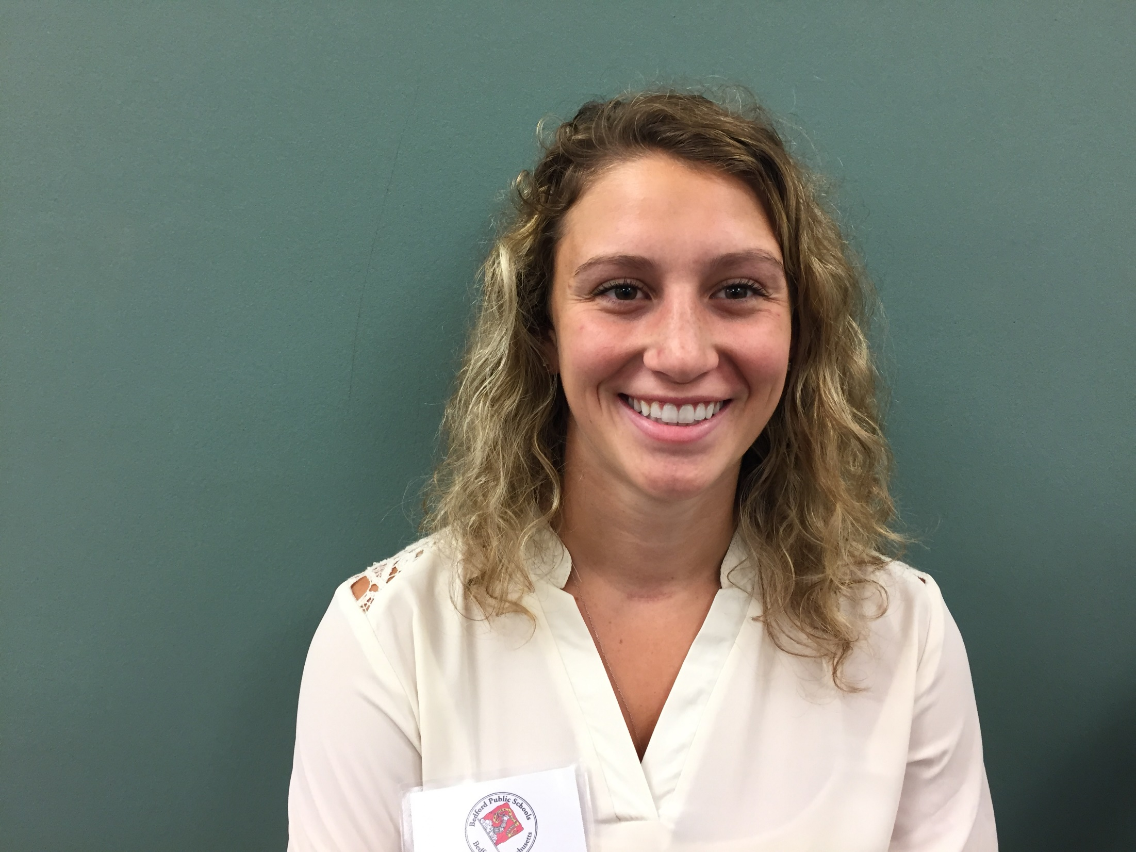
Allison Luppi
ELA Teacher
JGMS

Slide 49
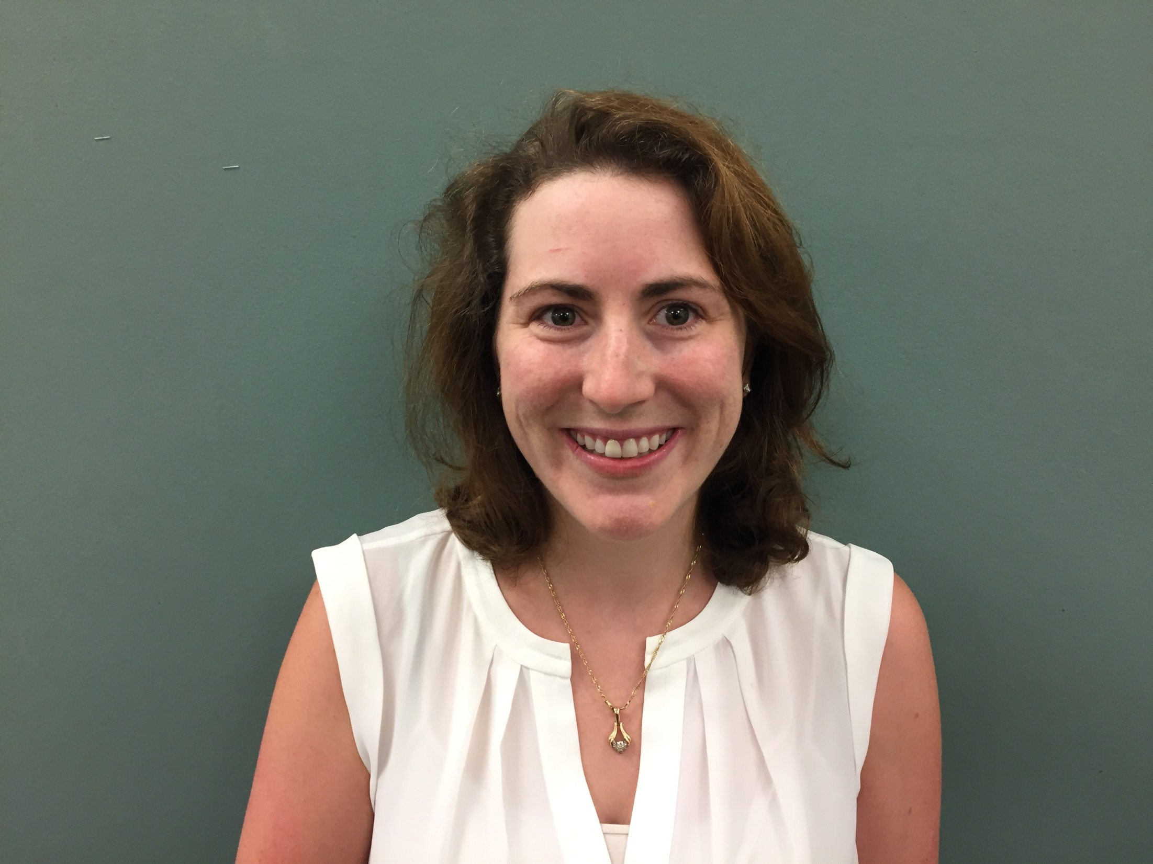
Katherine Zindars
SPED Teacher
JGMS

Slide 50
Bedford High School

Slide 51
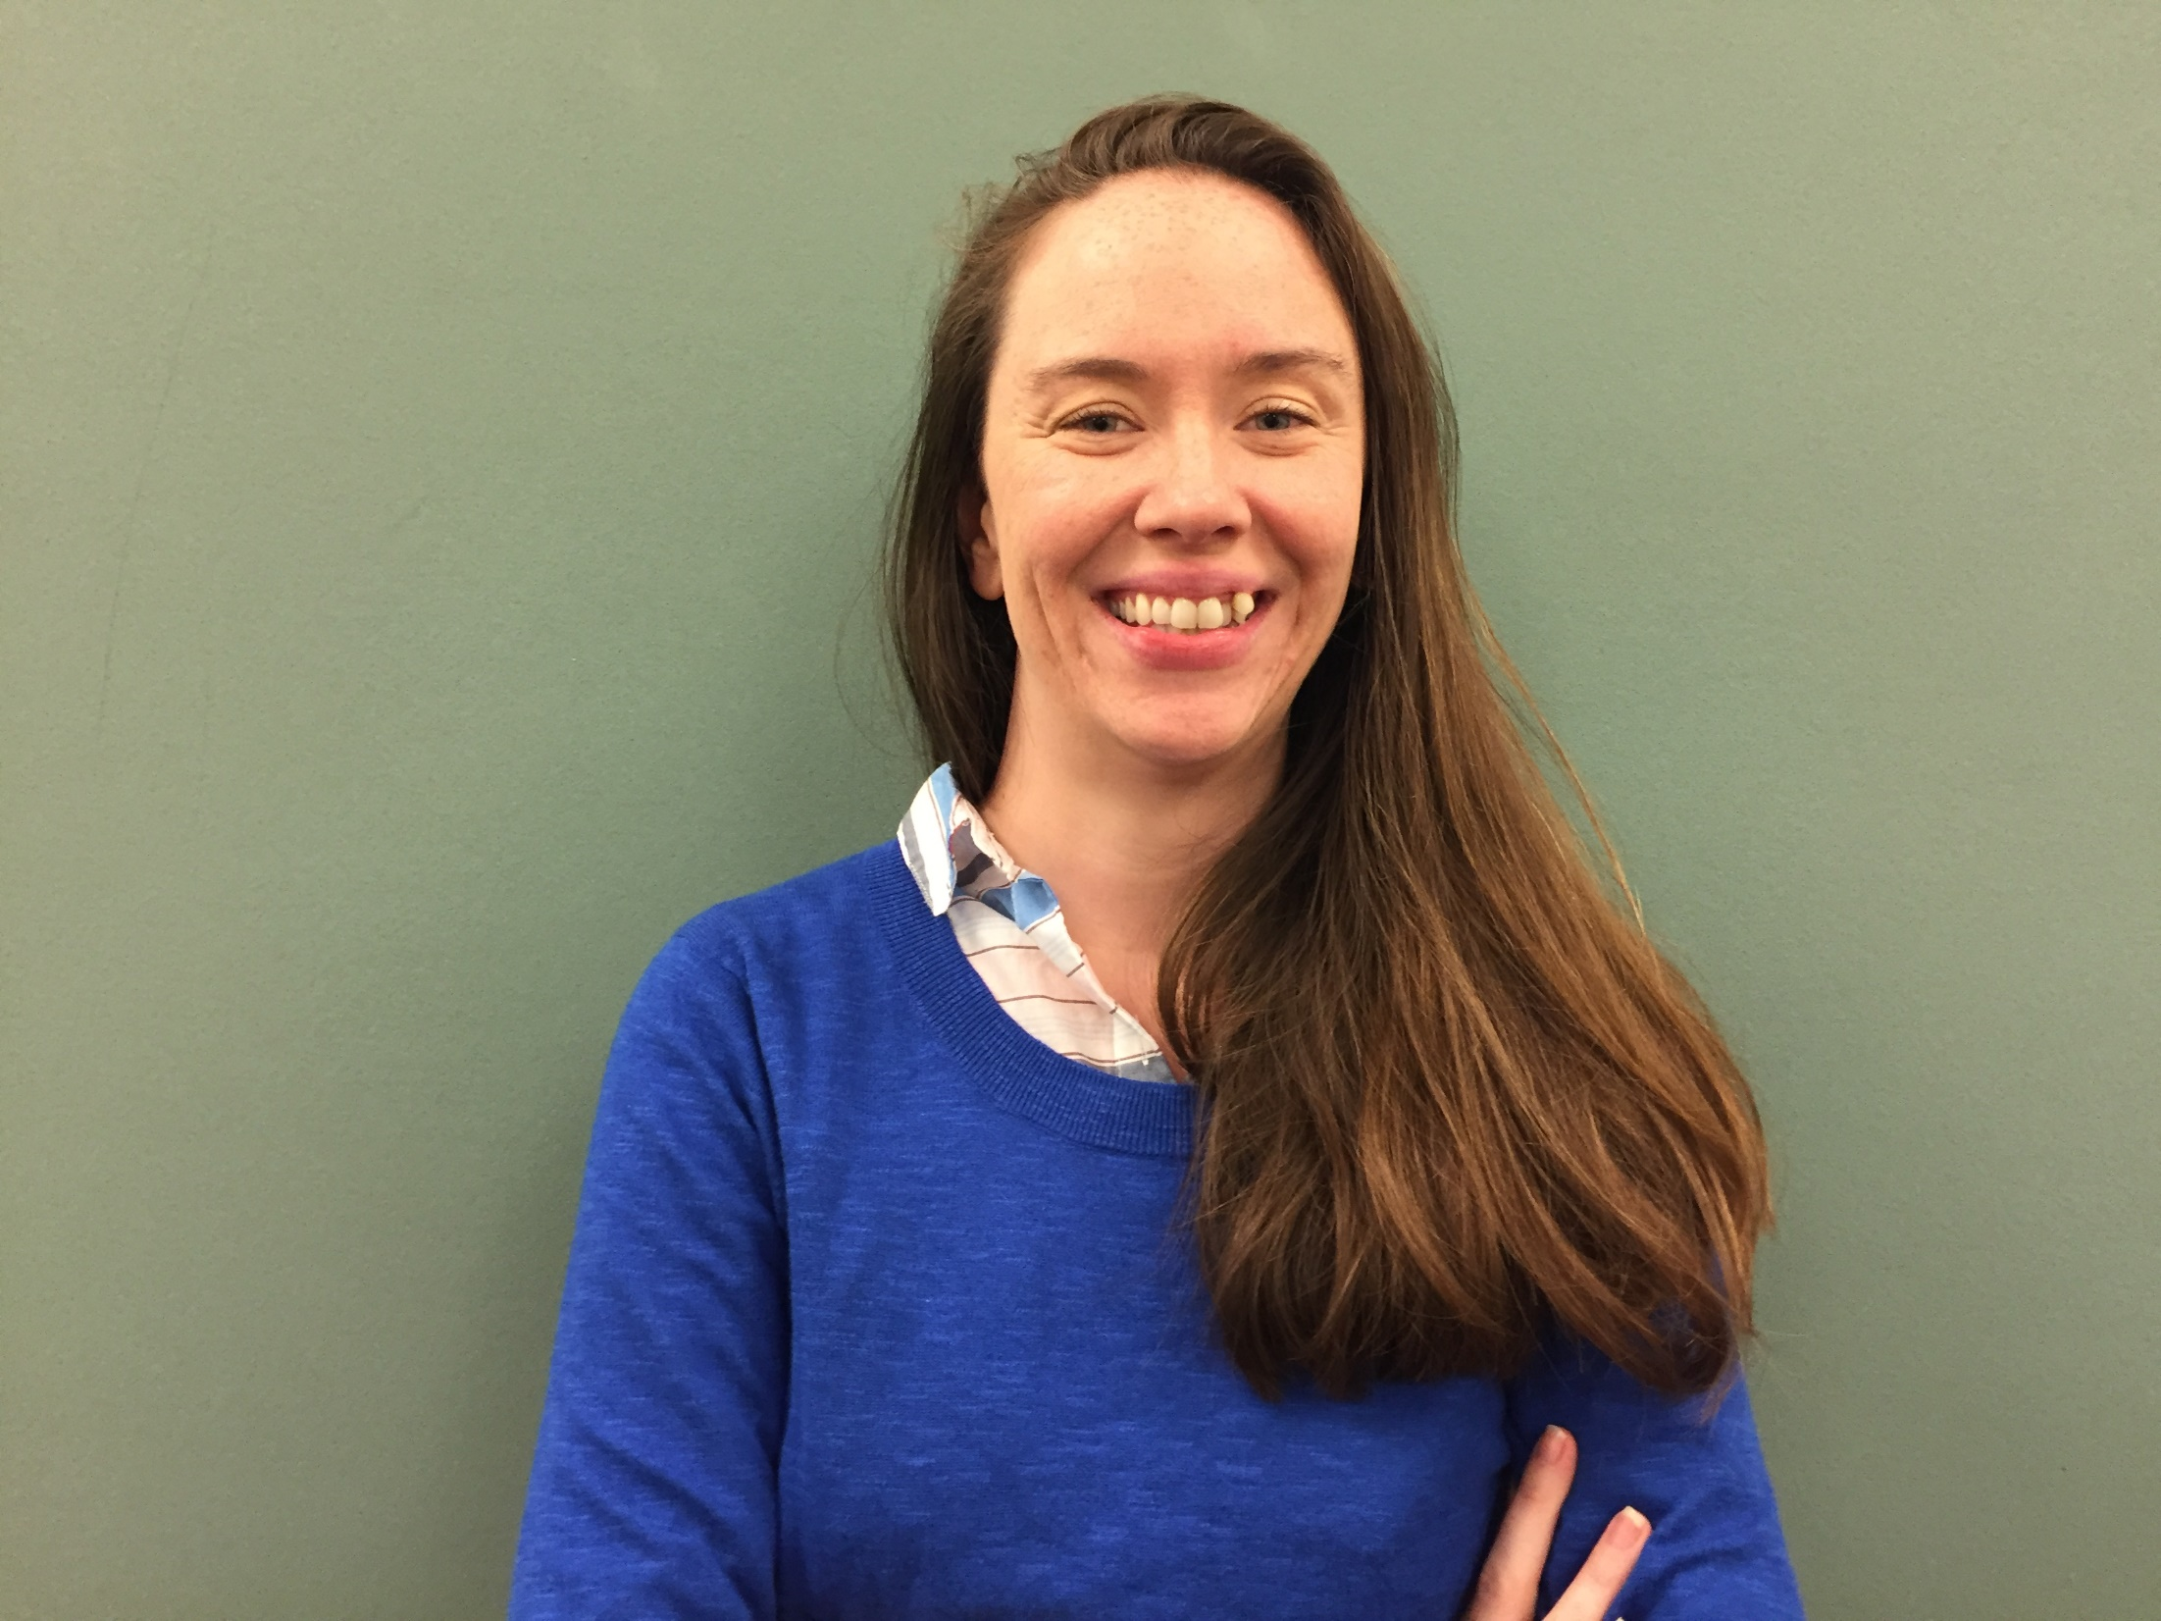
Charlene Abebe
School Adjustment Counselor
High School

Slide 52
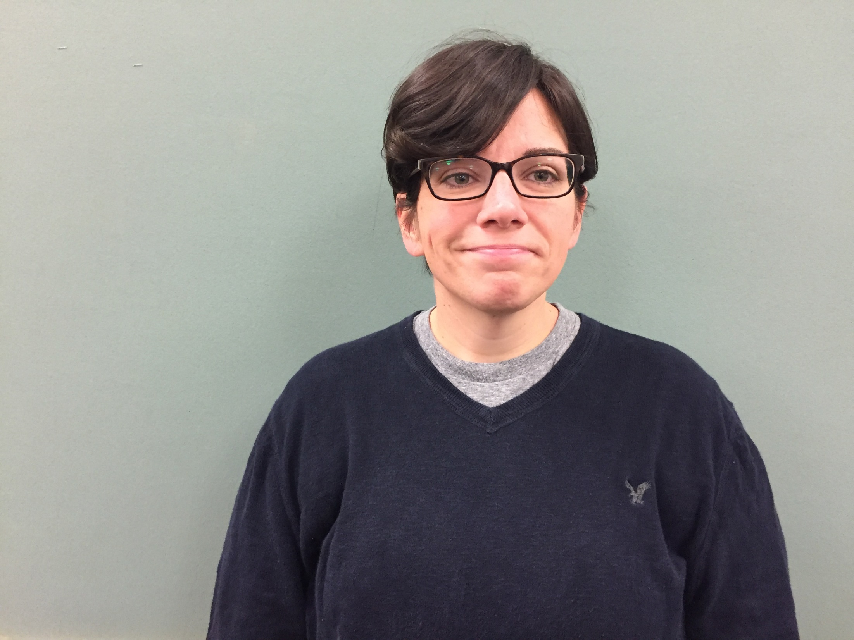
Jillian Butler
ELA Teacher
High School

Slide 53
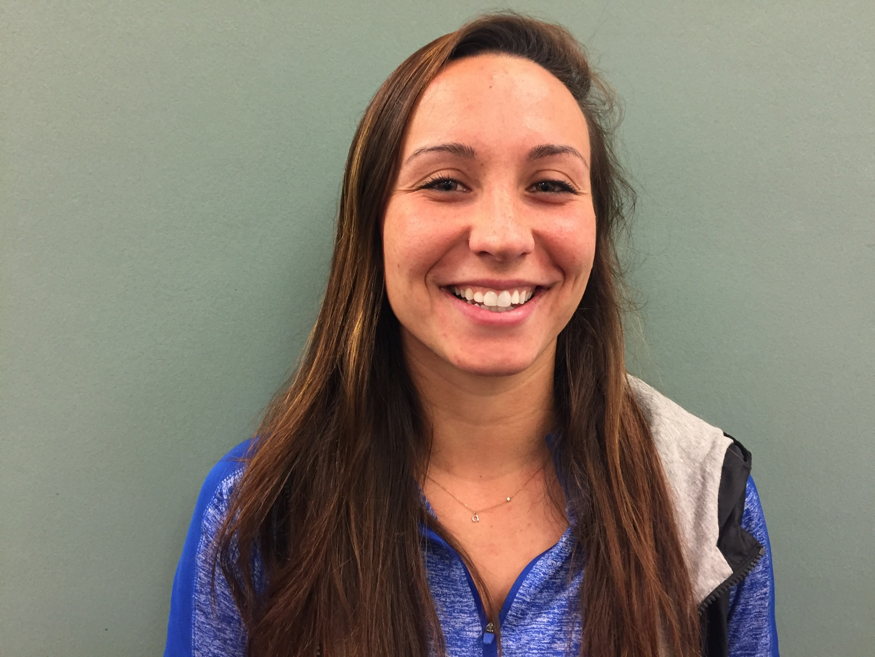
Alexis Duffy-Protentis
Teaching Assistant
High School

Slide 54
Manjula Karamcheti
Guidance Program Administrator
High School and JGMS

Slide 55
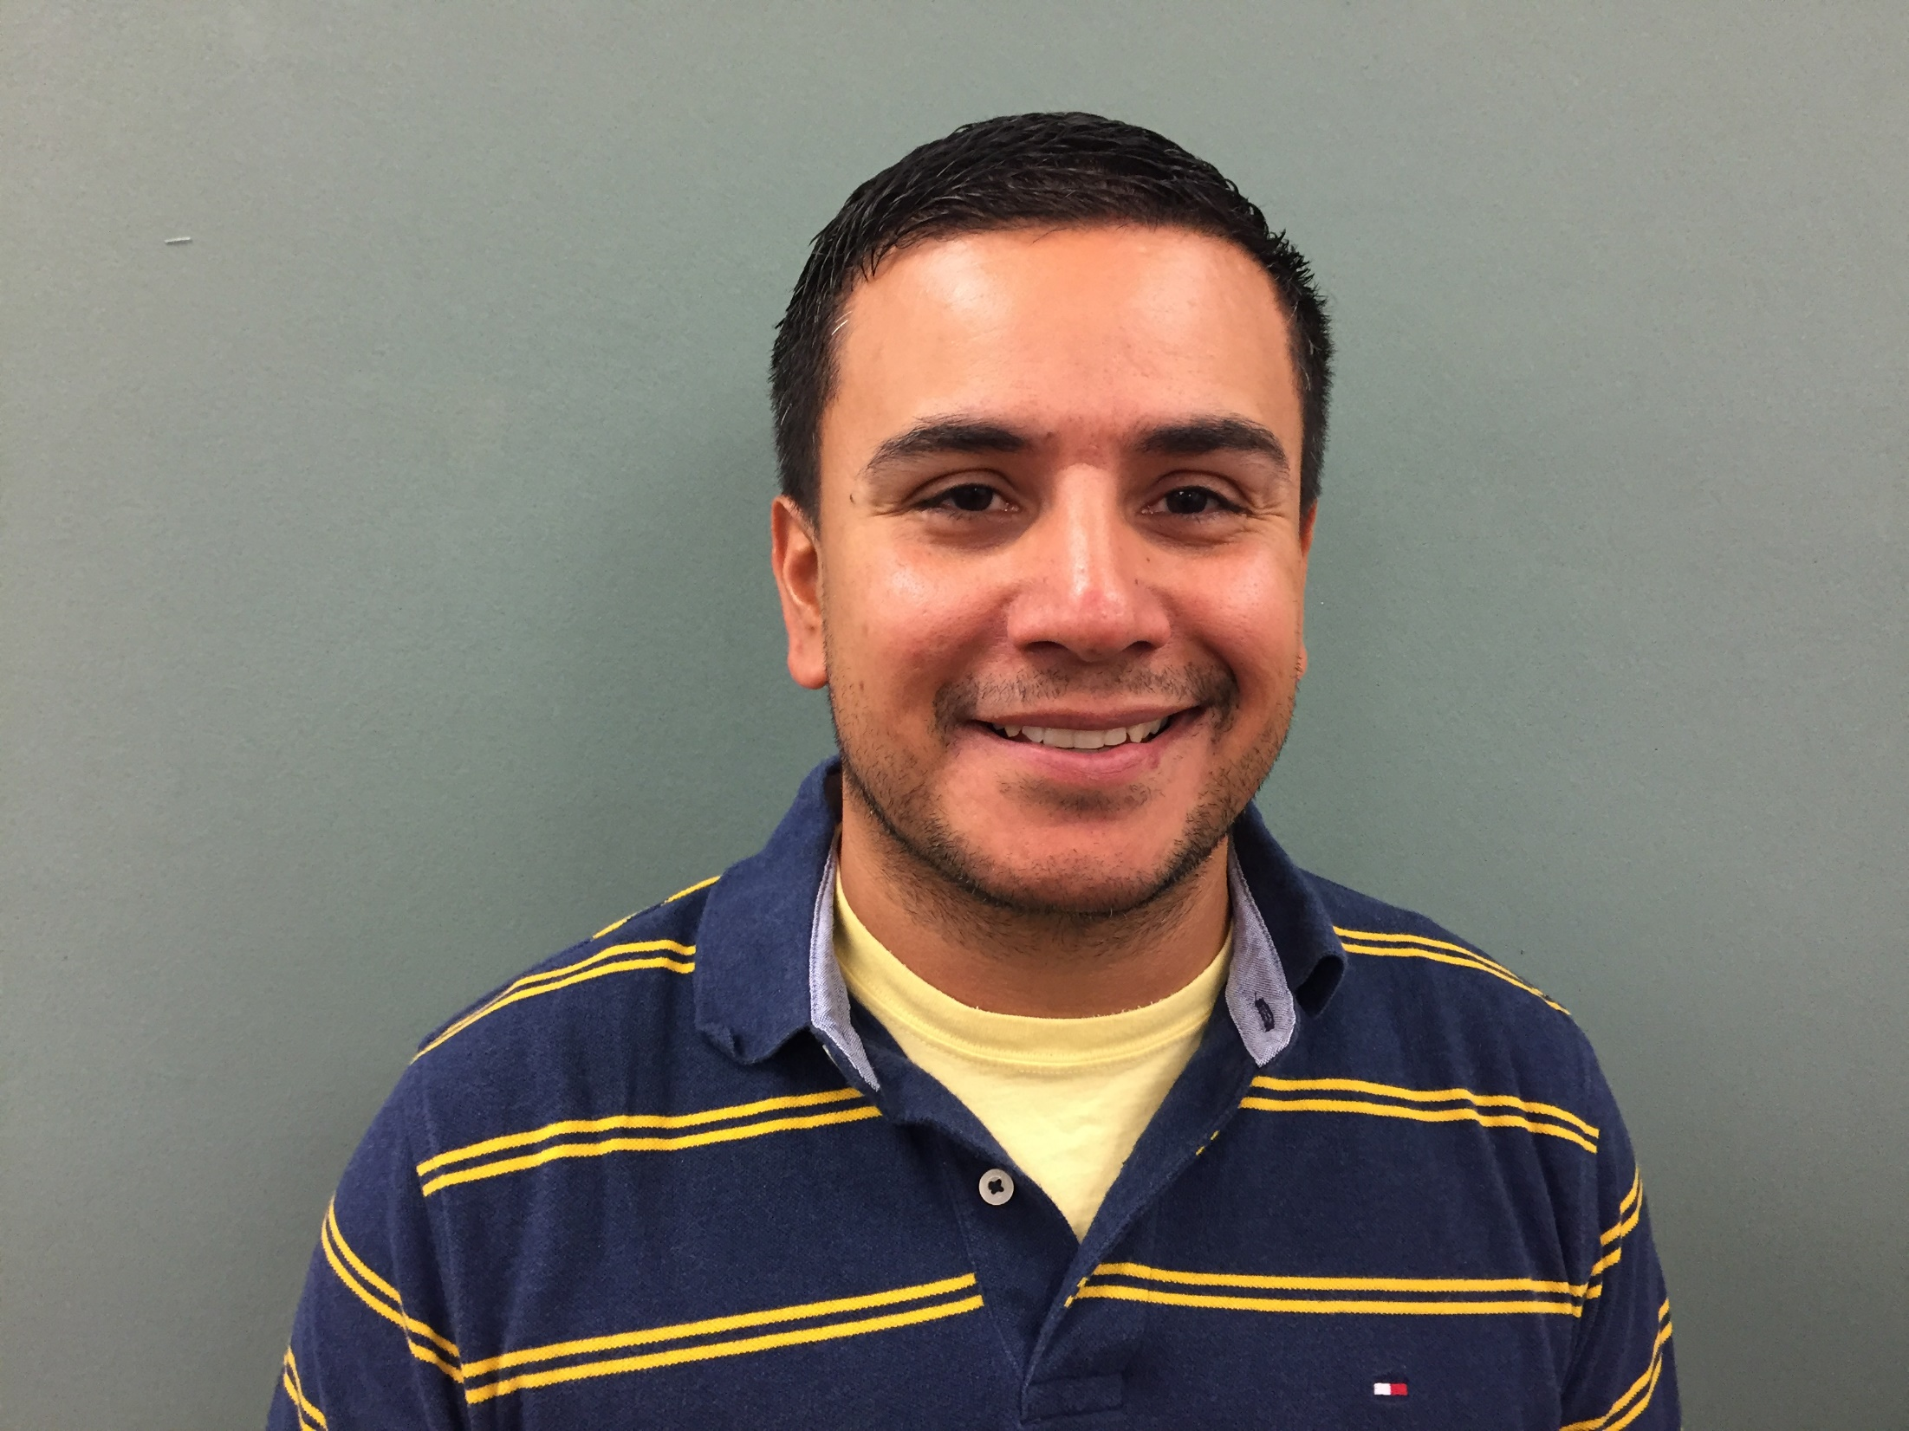
James Parker
Special Ed Program Administrator
High School

Slide 56
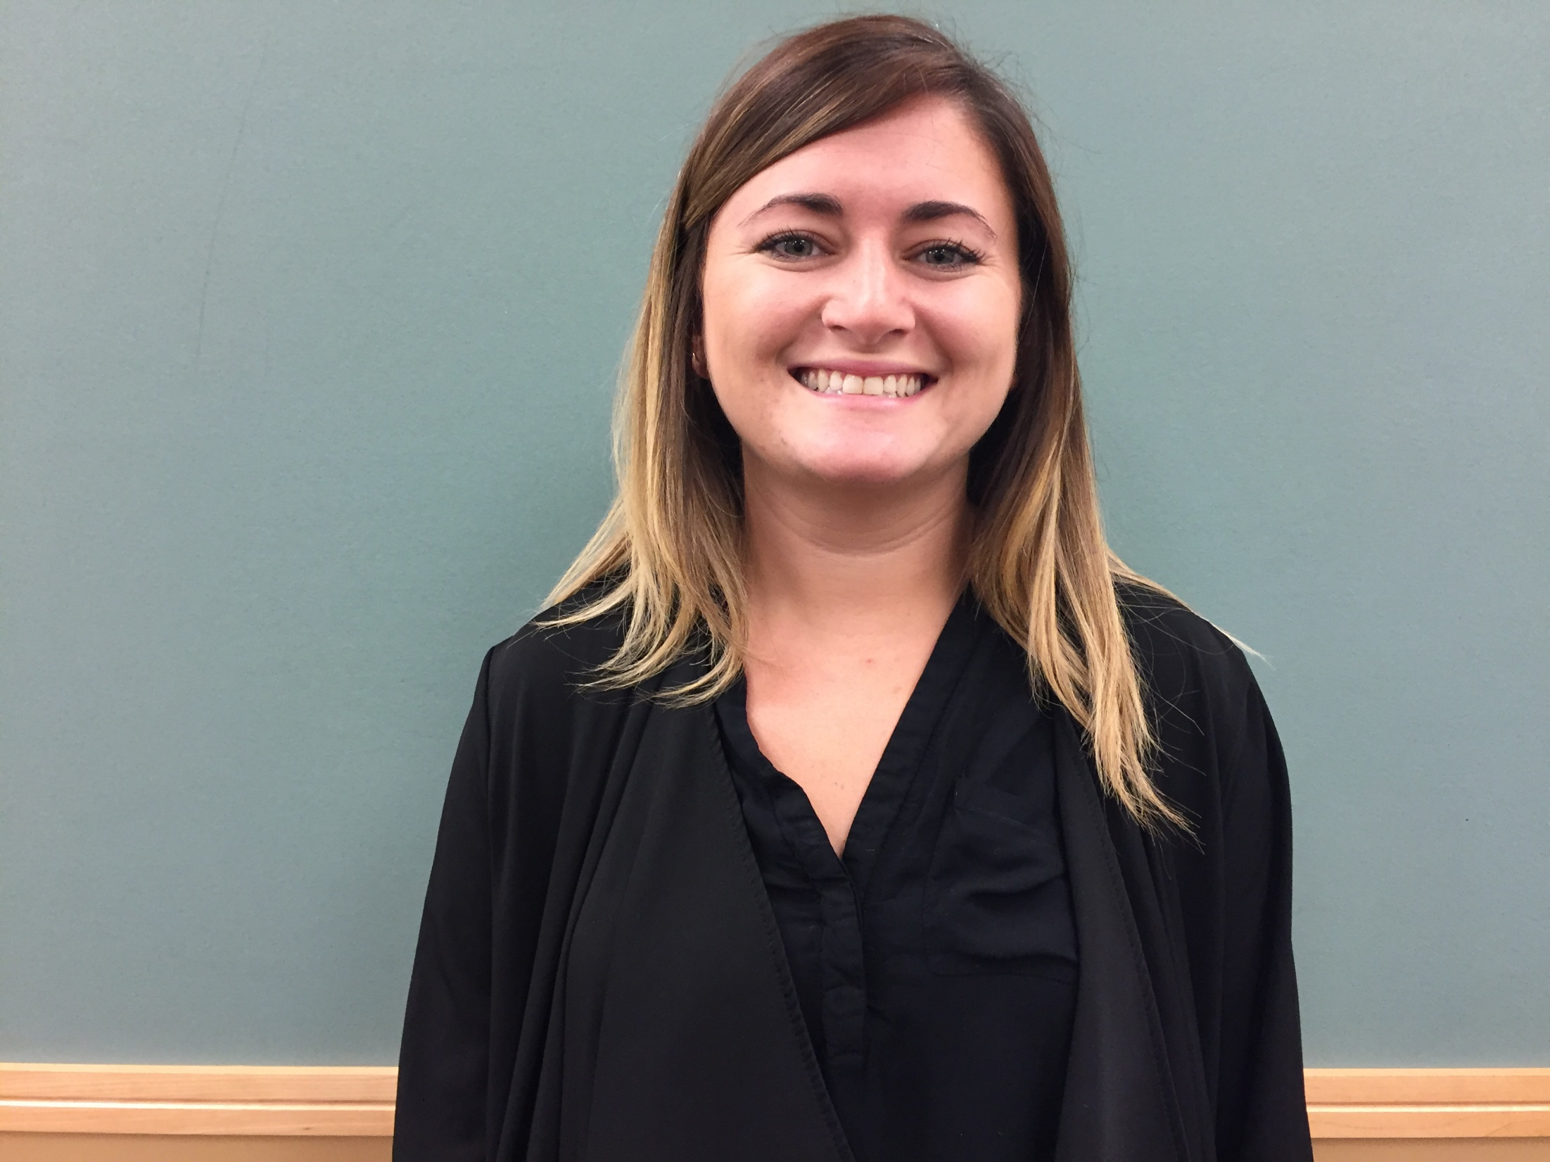
Kara Rosenberg
Counselor
High School

Slide 57
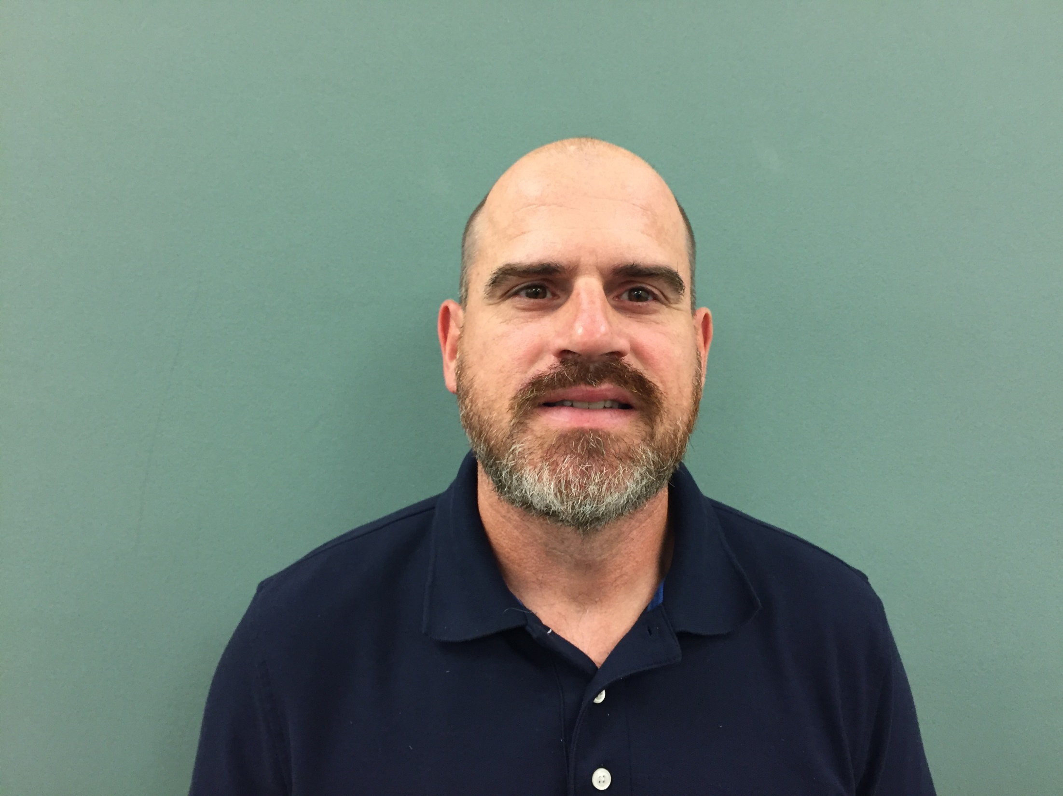
Mike Schreiber
SPED/Math Teacher
High School

Slide 58
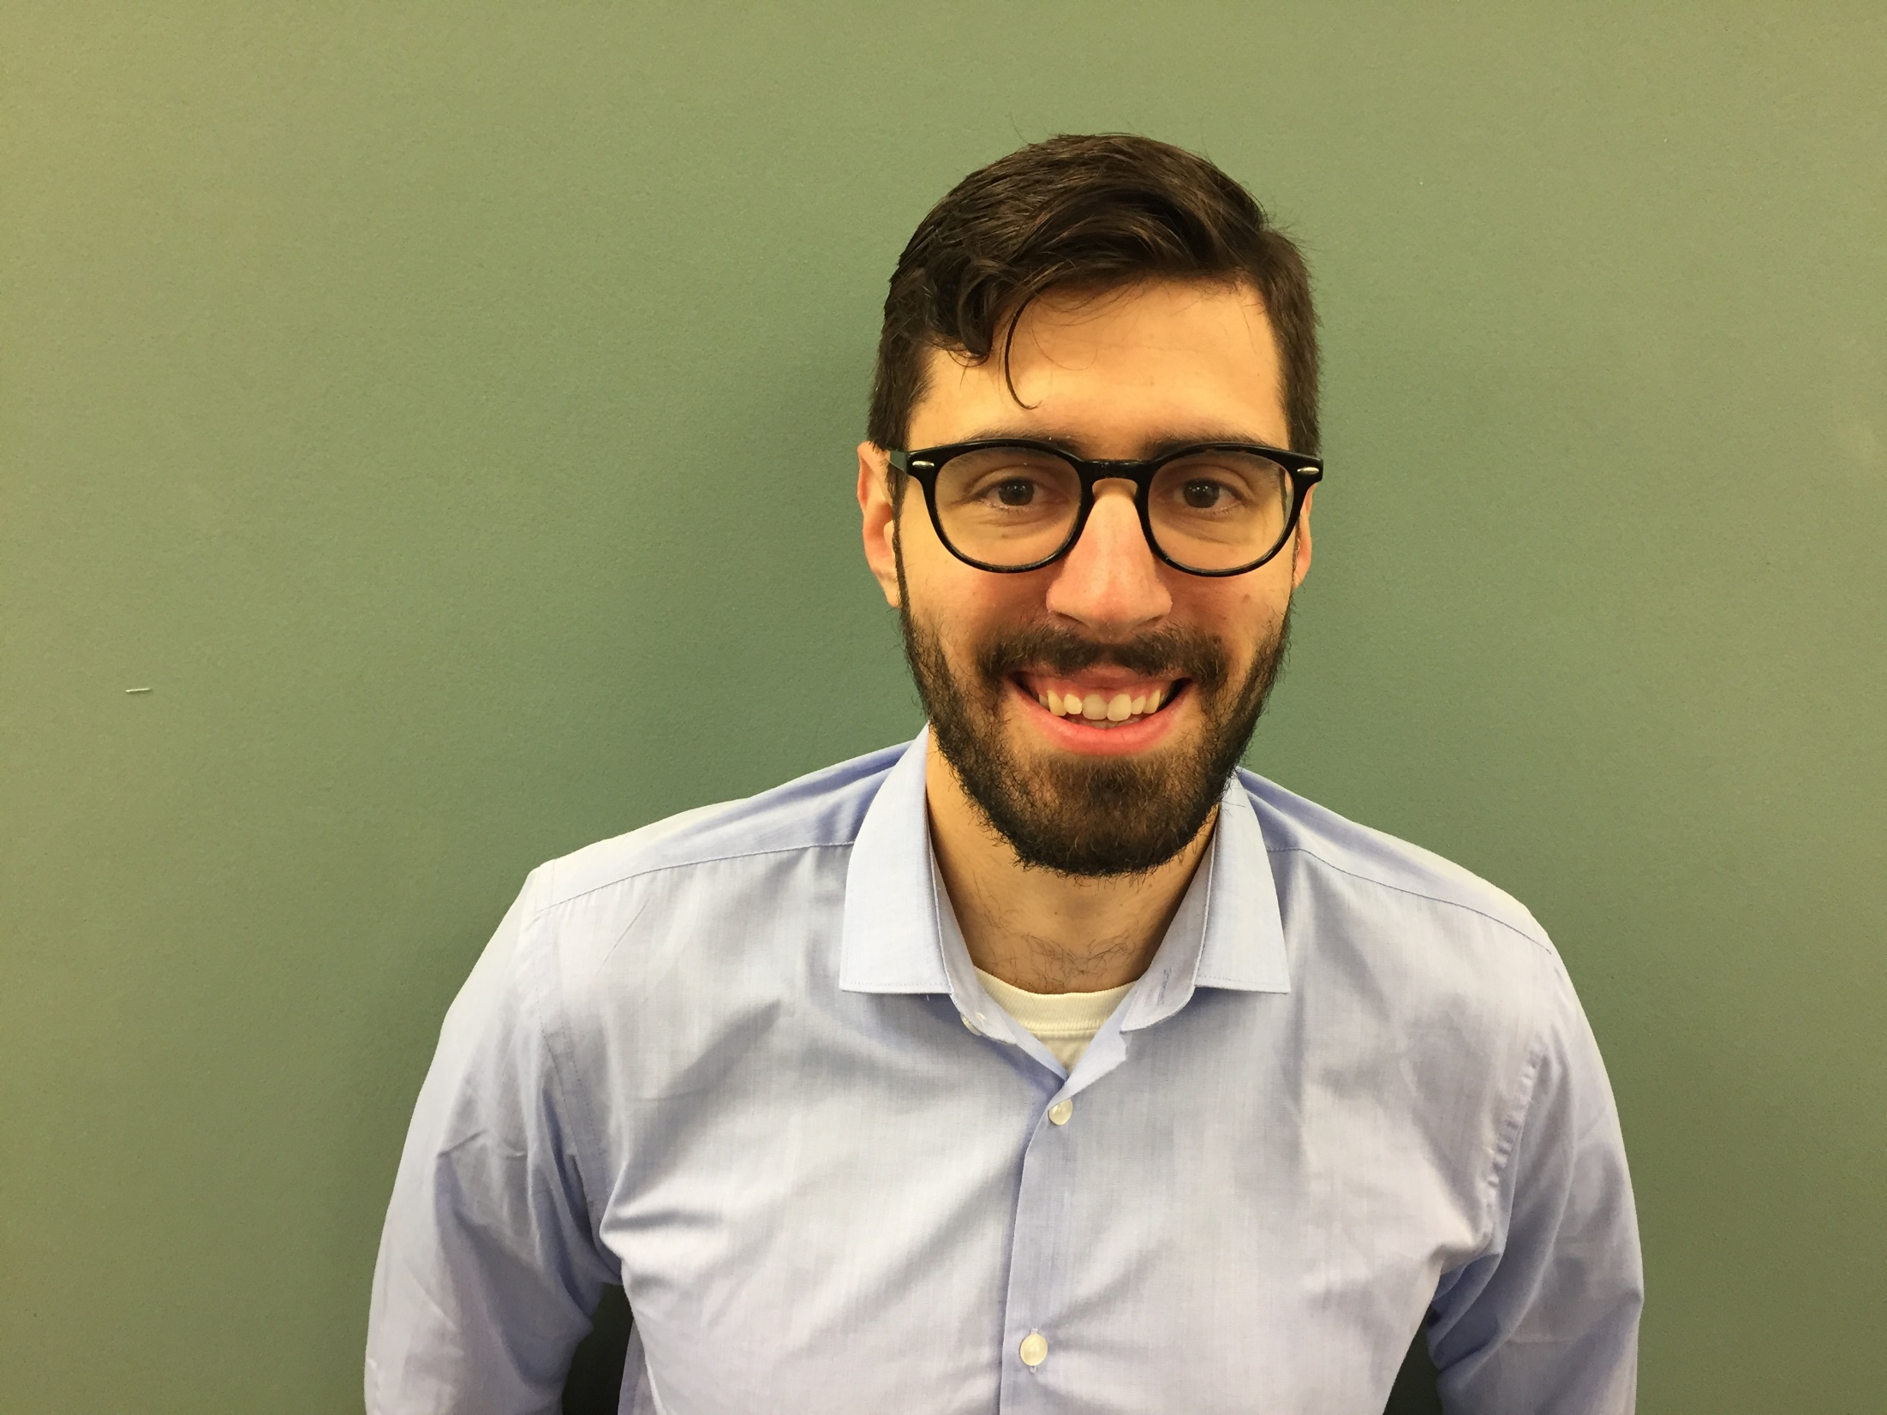
Sam Sprangel
Math Teacher
High School

Slide 59
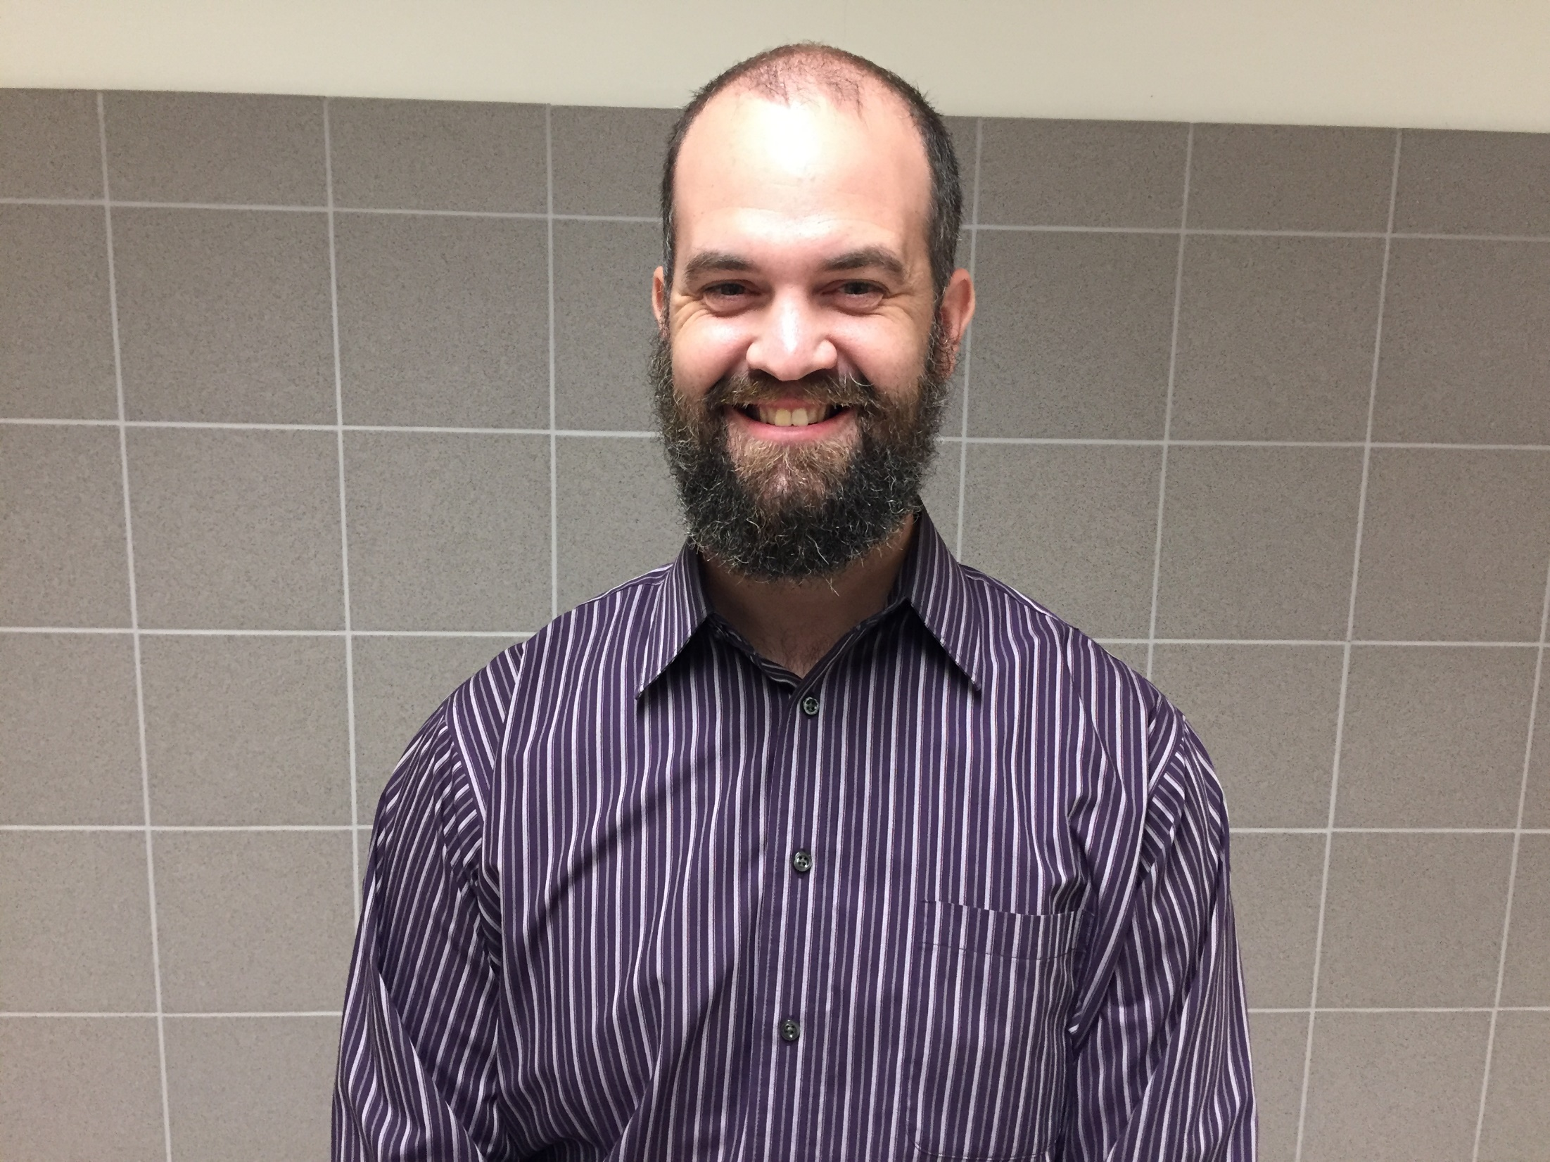
Lucas Wickham
Physics Teacher
High School

Slide 60
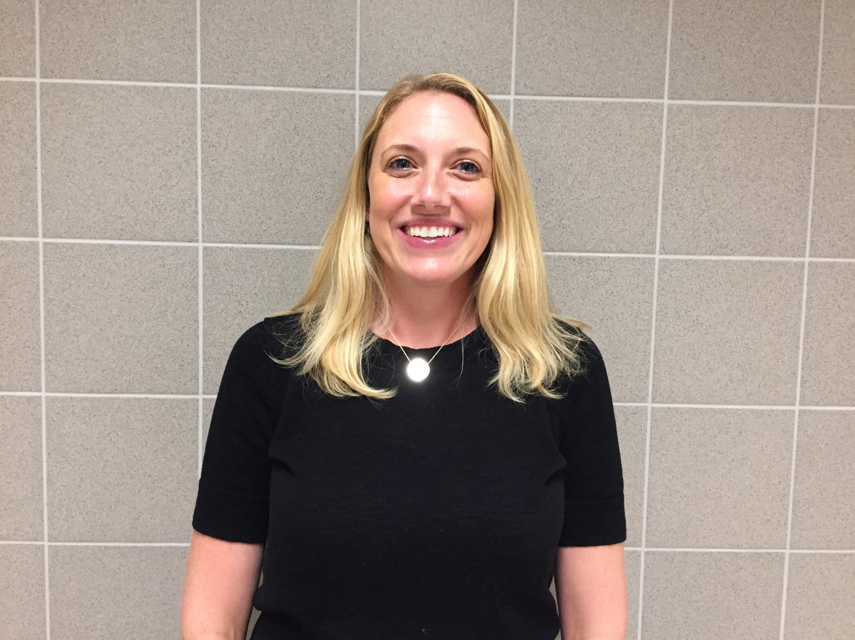
Danielle Wood
BCBA
High School

