Slide 1
Space Planning Process
Summer 2020: Initial evalution of spaces and capacity for hybrid model, removed some furnishings.
Fall 2020: Continuing redesign of space to accommodate expansion of cohorts
December 2020: Full Space Inventory and Classroom Demos
January on: Continued investigation to support transition to fully in-person learning by September 2021 - in conjunction with public health expert guidance and school and instructional leaders.

Slide 2
Space Utilization - Summary
The purpose of the space study was to verify the raw square footage that exists within each of our four school buildings. Classroom capacity was calculated utilizing the 6ft social distancing protocol currently in place. Actual classroom set ups have now taken places at all four schools.
Non-traditional spaces, such as the gyms, cafes, and libraries were explored for space utilization, however, more input from the schools staff would be needed for the kind of space use. These spaces, although they are big in square footage, they may have limitations in use.
Please note that all classroom set ups, especially at Davis School, assume individual student desks and the removal of classroom equipment including teacher desks, book shelves, and other classroom items. These items would need to be stored outside the classroom.

Slide 3
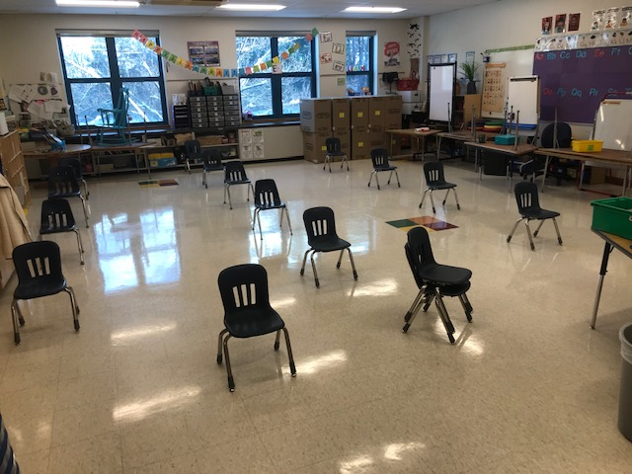
Davis School
Current Set Up
New Set Up –Assuming Individual Desks (16-18)

Slide 4
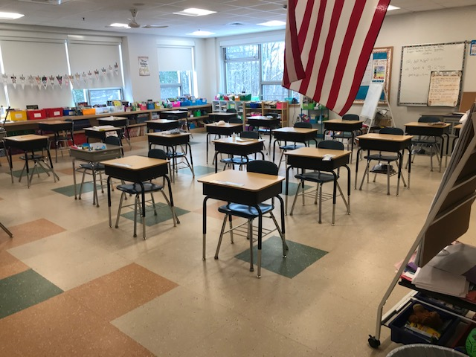
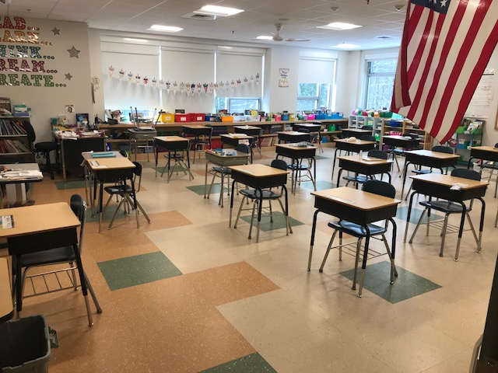
Lane School
RM 237 (18+)

Slide 5
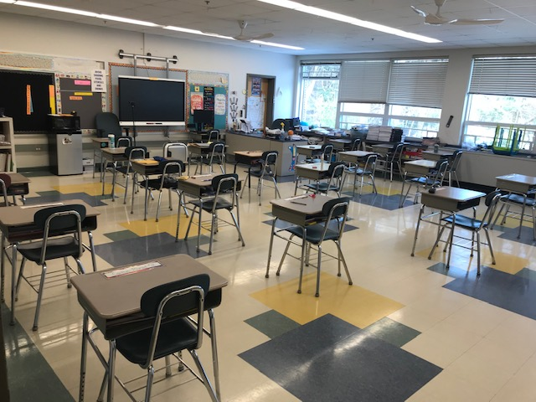
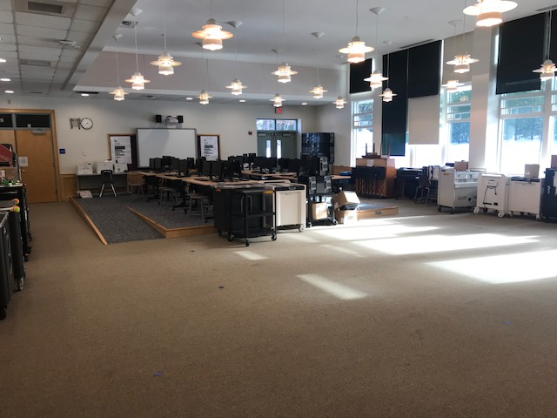
Lane School
Room 234 (18+)
Computer Lab aka MPR (18+)

Slide 6
Lane Demo Classroom

Slide 7
Full Space Inventory - Davis
The 6 foot room capacity is based on getting all new desks. If we don't the room capacity is 13 for most classrooms
Preschool |  | Kindergarten |  | 1st grade |  | 2nd grade |  | additional rooms |  | small offices
room number | 6 feet capacity | room number | 6 feet capacity | room number | 6 feet capacity | room number | 6 feet capacity | room #/current role | 6 feet capacity
177 | 16 | 114 | 16 | 120 | 16 | 112 | 16 | 116 / sail & Sped intervention | 16
178 | 16 | 123 | 16 | 124 | 16 | 113 | 16 | 156 / SAIL 2 | 10 | 118 / counseling | 4
179 | 16 | 133 | 16 | 213 | 16 | 131 | 16 | 228 & 229 / Bridge | 5 | 146 / counseling | 4
182 | 16 | 134 | 16 | 214 | 16 | 132 | 16 | 119 / EL pull out | 4 | 147A / counseling | 5
 |  | 135 | 16 | 231 | 16 | 215 | 16 | 230 / Reading pull out |  | 148 A / PA office | 1
 |  | 241 | 16 | 232 | 16 | 216 | 16 |  |  | 148 B / PA office | 1
 |  | 242 | 16 | 233 | 16 | 234 | 16 | 115 CASE / K-2 | 16 | 149 / school pyschologist | 1
 |  | 243 | 16 | 248 | 16 | 235 | 16 | 121 CASE / Preschool | 16 | 180 / speech | 1
 |  | 244 | 16 | 249 | 16 | 240 | 16 |  |  | 180 a / speech | 1
 |  | 245 | 16 | 117 / sail | 16 | 246 | 16 | Cafeteria |  | 183 / ot or speech | 1
 |  | 122 CASE / Preschool | 16 | 217 / music | 16 | 236 / art | 16 | Gym |  | 186 / OT | 1
 |  | 136 / bridge (no bathroom) | 16 |  |  |  |  | Library |  | 186 A / OT | 1
 |  |  |  |  |  |  |  |  |  | 186 b / motor room | 2
 |  |  |  |  |  |  |  |  |  |  | 2
 |  | remote | 20 | remote | 22 | remote | 22 |  |  |  | 1
 |  |  |  |  |  |  |  |  |  |  | 3
 |  | TOTAL | 212 | TOTAL | 198 |  | 198

Slide 8
Full Space Inventory - Lane
LANE |  |  | STUDENTS
ROOM Designation | DESCRIPTION | SQFT | # Pre Covid | # Covid 6' | NOTES
3 | Classroom | 868 | 23/24 | 18
5 | Classroom | 754 | 23/24 | 20
7 | Classroom | 754 | 23/24 | 20
10 | Classroom | 754 | 23/24 | 20
12 | Classroom | 754 | 23/24 | 20
14 | SPED | 364 | 11 | 11
16 | Classroom | 925 | 23/24 | 24 | 98 addition
17 | Classroom | 925 | 23/24 | 24 | 98 addition
18 | SPED | 520 | 11 | 11
22 | Classroom | 754 | 23/24 | 20
23 | Classroom | 754 | 23/24 | 20
24 | Classroom | 754 | 23/24 | 20
25 | Classroom | 754 | 23/24 | 20
32 | Art | 1440 | 23/24 | 24
37 | SPED | 192 | 3 | 3
38 | SPED | 500 | 11 | 11
40 | Classroom | 960 | 23/24 | 24 | 2003
41 | Classroom | 960 | 23/24 | 24
42 | SPED | 480 | 11 | 11
43 | SPED | 480 | 11 | 11
44 | Classroom | 1020 | 23/24 | 25 | 2003
45 | Classroom | 1020 | 23/24 | 25 | 2003
120A | Classroom | 930 | 23/24 | 20
120B | Classroom | 930 | 23/24 | 20

Slide 9
Full Space Inventory – Lane (continued)
LANE |  |  | STUDENTS
ROOM Designation | DESCRIPTION | SQFT | # Pre Covid | # Covid 6' | NOTES
136 | SPED | 380 | 11 | N/A
138 | SPED | 380 | 23/24 | N/A
142 | SPED | 350 | 11 | N/A
146 | SPED | 320 | 11 | N/A
203 | SPED | 200 | 11 | N/A
204 | SPED | 364 | 11 | N/A
205 | Classroom | 754 | 23/24 | 20
206 | Classroom | 754 | 23/24 | 20
208 | Classroom | 754 | 23/24 | 20
209 | Classroom | 754 | 23/24 | 20
211 | SPED | 512 | 11 | N/A
213 | Classroom | 925 | 23/24 | 24 | 1998
214 | Classroom | 925 | 23/24 | 24 | 1998
215A | SP ED | 500 | 23/24 | 12
215B | SP ED | 250 | 11 | N/A
216 | Classroom | 754 | 23/24 | 20
217 | Classroom | 754 | 23/24 | 20
218 | Classroom | 754 | 23/24 | 20
219 | SPED | 364 | 11 | N/A
220 | SPED | 364 | 11 | N/A
229 | SPED | 216 | 11 | N/A
230 | SPED | 150 | 3 | N/A
231 | SPED | 192 | 23/24 | N/A
232 | OT/PT | 475 | 23/24 | N/A
234 | Classroom | 960 | 23/24 | 22 | 2003
235 | Classroom | 960 | 23/24 | 22 | 2003
236 | SPED | 960 | 23/24
237 | Classroom | 1020 | 23/24 | 25 | 2015
238 | Classroom | 1020 | 23/24 | 25 | 2015

Slide 10
Full Space Inventory – Lane (continued)
LANE |  |  | STUDENTS
ROOM Designation | DESCRIPTION | SQFT | # Pre Covid | # Covid 6' | NOTES
239 | Classroom | 960 | 23/24 | 22 | 2003
135 (Music) |  | 1100 | 23/24 | N/A
156(LGI) |  | 1900
CAFÉ |  | 3600
Conference |  | 195 |  | N/A
Gym |  | 9,000 | 23/24
Library |  | 1500
Main Office |  | 420 |  | N/A
Principal |  | 225 |  | N/A
Vice principal |  | 135 |  | N/A

Slide 11
Full Space Inventory - JGMS
JGMS |  |  | STUDENTS
ROOM Designation | DESCRIPTION | SQFT | # Pre Covid | # Covid 6'
A105 |  | 800 | 25-28 | 16
A106 |  | 896 | 25-28 | 16
A107 |  | 896 | 25-28 | 16
A108 |  | 896 | 25-28 | 16
A109 |  | 896 | 25-28 | 16
A110 |  | 250 | 10 | N/A
A111 |  | 510 | 10 | N/A
A113 |  | 896 | 25-28 | 16
A114 |  | 896 | 25-28 | 24
A117 |  | 1100 | 25-28 | 24
A119 | Art | 1100 | 25-28 | 18
A120 |  |  | 25-28 | 18
A205 |  | 800 | 25-28 | 16
A206 |  | 896 | 25-28 | 12
A207 |  | 896 | 25-28 | 12
A208 |  | 896 | 25-28 | 16
A209 |  | 896 | 25-28 | 16
A210 |  | 250 | 10 | N/A
A211 |  | 510 | 10 | N/A
A213 |  | 896 | 25-28 | 16
A214 |  | 896 | 25-28 | 16
A215 |  | 350 | 10 | N/A
A221 |  | 896 | 25-28 | 16
AUD |  | 7700
B108 | science | 945 | 25-28 | 12
B109 | science | 945 | 25-28 | 12
B112 | science | 945 | 25-28 | 12

Slide 12
Full Space Inventory - JGMS
JGMS |  |  | STUDENTS
ROOM Designation | DESCRIPTION | SQFT | # Pre Covid | # Covid 6'
B113a |  | 300 | 10 | N/A
B113b |  | 300 | 10 | N/A
B114 |  | 945 | 25-28 | 16
B115 | science | 945 | 25-28 | 16
B116 |  | 945 | 25-28 | 18
B124 | SPED | 945 | 25-28 | 16
B125 | SPED | 945 | 25-28 | 16
B208 | General C R | 794 | 25-28 | 16
B209 | General C R | 794 | 25-28 | 16
B210 | General C R | 794 | 25-28 | 16
B211 | General C R | 794 | 25-28 | 16
B212 | SPED | 592 | 10 | N/A
B212A |  | 80 | N/A
B216 | General C R | 896 | 25-28 | 16
B217 | General C R | 448 | 25-28 | 10
B218 | General C R | 945 | 25-28 | 16
B219 | General C R | 945 | 25-28 | 16
B223 | General C R | 945 | 25-28 | 16
B224 | SPED | 540 | 10 | N/A
C235 (MUSIC) |  | 1000 | 25-28
CAFE |  | 3850
D204 | SPED | 312 | 10 | N/A
D211 | General C R | 810 | 25-28 | 16
D213 | General C R | 1344 | 25-28 | 16
D218 Teachers Dining |  | 484 | 10

Slide 13
Full Space Inventory - JGMS
JGMS |  |  | STUDENTS
ROOM Designation | DESCRIPTION | SQFT | # Pre Covid | # Covid 6'
Fitness |  | 1242 | 25-28
Gym 1 |  | 7700
LGI |  | 2108
Lib Conf B244c |  | 132
LibLC B244d |  | 206
LIBR |  | 2750
B227 | LABBB | 676 | 25-28
B230 | Main Off | 70 |  | N/A
B231 | Main Off | 81 |  | N/A
B232 | Main Off | 150 |  | N/A
B233 | Main Off | 208 |  | N/A
B234 | Main Off | 143 |  | N/A
B235 | Main Off | 143 |  | N/A
B237 VP | Main Off | 165 |  | N/A
B238 CONF | Main Off | 345 |  | N/A
B239 PRINC | Main Off | 165 |  | N/A
B242 MAIN | Main Off | 500 |  | N/A
NURSE | Main Off | 837 |  | N/A
TEACHERS DINING CAFÉ |  | 462 |  | N/A

Slide 14
Full Space Inventory - BHS
BHS |  |  | STUDENTS
ROOM Designation | DESCRIPTION | SQFT | # Pre Covid | # Covid 6'
A101 | MAIN OFFICE | 756 |  | N/A
A101A | WAITING | 252 |  | N/A
A101D | CONF | 395 |  | N/A
A101E | ASST PRIN | 175 |  | N/A
A101F | ASST PRIN | 159 |  | N/A
A101G | PRINCIPAL | 298 |  | N/A
A102 | GUIDANCE | 297 |  | N/A
A102A | STUDENT COMP | 173 |  | N/A
A102B | MEETING | 635 |  | N/A
A102C | GUID OFF | 120 |  | N/A
A102D | GUID OFF | 120 |  | N/A
A102E | GUID OFF | 120 |  | N/A
A102F | GUID OFF | 189 |  | N/A
A102G | GUID OFF | 122 |  | N/A
A102H | ADJUST COUNSEL | 200 |  | N/A
A102I | GUID CONF | 220 |  | N/A
A103 | NURSE OFF | 422 |  | N/A
A103B | COT | 264 |  | N/A
A103C | EXAM | 163 |  | N/A
A104 | ART | 1199 | 24-28 | 14
A105 | ART STORAGE | 350 |  | N/A
A106 | ART | 1199 | 24-28 | 14
A106D | ART Photo Lab | 720 | 24-28 | 14
A108 | ART | 720 | 24-28 | 10
A109 | ART Comp Lab | 650 | 24-28 | 10
A110 | ART OFFICE | 350 |  | N/A
A110A | ART OFFICE | 120 |  | N/A

Slide 15
Full Space Inventory - BHS
BHS |  |  | STUDENTS
ROOM Designation | DESCRIPTION | SQFT | # Pre Covid | # Covid 6'
A113 | SPED ASST OFF | 223 |  | N/A
A113A | SPED TESTING | 123 |  | N/A
A113B | SPED OFF | 164 |  | N/A
A113C | SPED CONF | 116 |  | N/A
A113D | PSYCOLOGIST | 155 |  | N/A
A114 | ITS OFFICE | 301 |  | N/A
A115 | TECH OFF | 560 |  | N/A
A115A | TECH STORAGE | 195 |  | N/A
A115B | TECH OFFICE - KEN | 186 |  | N/A
A115C | SERVER ROOM | 252 |  | N/A
A116 | AUDITORIUM | 5200
A116A | STAGE | 2000
A116B | LIGHT BOOTH | 80 |  | N/A
A201 | LIBRARY | 5234
A201A | SEMINAR- Open Space | 228 |  | N/A
A201B | LIB OFFICE | 141 |  | N/A
A201C | LIB WORKROOM | 364 |  | N/A
A201D | LIB COMP LAB | 993 | 24-28 | 16
A202 | Social Studies | 760 | 24-28 | 16
A203 | SS | 760 | 24-28 | 16
A204 | SS | 760 | 24-28 | 16
A205 | SS | 760 | 24-28 | 16
A208 | SS | 760 | 24-28 | 16
A209 | SS | 760 | 24-28 | 16
A210 | SS | 760 | 24-28 | 16
A212 | SPED | 404 | 12 | 6
A213 | SS | 760 | 24-28 | 15
A214 | SS | 760 | 24-28 | 15

Slide 16
Full Space Inventory - BHS
BHS |  |  | STUDENTS
ROOM Designation | DESCRIPTION | SQFT | # Pre Covid | # Covid 6'
A215 | NEWSPAPER | 486 | 12 | 8
A216 | SRO | 183 | 3 | 2
B101 | MATH | 850 | 24-28 | 16
B102 | MATH | 850 | 24-28 | 16
B103 | MATH | 850 | 24-28 | 16
B104 | MATH | 850 | 24-28 | 16
B105 | MATH | 850 | 24-28 | 16
B106 | MATH | 850 | 24-28 | 16
B107 | MATH | 850 | 24-28 | 16
B108 | MATH | 850 | 24-28 | 16
B201 | ESL | 286 | 5 | 3
B202 | ENG SS CONF | 318 |  | N/A
B202A | ENG OFF | 182 |  | N/A
B202B | SS OFF | 175 |  | N/A
B203 | ENG | 756 | 24-28 | 16
B204 | ENG | 756 | 24-28 | 16
B205 | ENG | 756 | 24-28 | 16
B206 | ENG | 756 | 24-28 | 16
B207 | ENG | 756 | 24-28 | 16
B208 | ENG | 756 | 24-28 | 16
B209 | ENG | 756 | 24-28 | 16
C101 | BEA OFFICE | 164 |  | N/A
C102 | SPED | 182 | 5 | 3
C102A | SPED | 175 | 5 | 3
C104 | SPED | 950 | 24-28 | 12
C105 | FOODS ROOM | 850 | 24-28
C106 | SCHOOL STORE | 154
C106A | SCHOOL STORE | 108 | 24-28

Slide 17
Full Space Inventory - BHS
BHS |  |  | STUDENTS
ROOM Designation | DESCRIPTION | SQFT | # Pre Covid | # Covid 6'
C107 | BUSINESS | 850 | 24-28 | 16
C108 | BUS/PROG COMP LAB | 1200 | 24-28 | 16
C109 | DRAFTING | 1200 | 24-28 | 16
C111 | TECH ED | 1000 | 24-28 | 14
C112 | OCC CONF | 176 | 5 | 3
C112A | OCC OFFICE | 170 | 5 | 3
C113 | SPED | 480 | 12 | 6
C114 | SPED | 480 | 12 | 6
C201 | Forgein Language | 850 | 24-28 | 16
C202 | FL | 850 | 24-28 | 16
C203 | FL | 850 | 24-28 | 14
C206 | FL | 850 | 24-28 | 16
C209 | FL LAB | 1000 | 24-28 | 18
C210 | FL | 850 | 24-28 | 15
C211 | FL PREP | 100 | 24-28
C212 | FL | 850 | 24-28 | 16
C214 | BYFS | 150 | 5
D101 | MIDI LAB | 899 | 24-28
D102 | MUSIC OFFICE AREA | 91
D102A | MUSIC PRACTICE | 76
D102B | MUSIC PRACTICE | 76
D102C | MUSIC PRACTICE | 127
D103B | MUSIC DIR OFF | 197
D103C | BAND OFF | 131
D103D | ORCH OFF | 127
D104 | BAND | 2340 | 24-28
D105 | ORCHESTRA | 1000 | 24-28 | 14
D106 | THEATER WORKSHOP | 900 | 24-28

Slide 18
Full Space Inventory - BHS
BHS |  |  | STUDENTS
ROOM Designation | DESCRIPTION | SQFT | # Pre Covid | # Covid 6'
E207 | FL | 826 | 24-28 | 16
E208 | SKILL CENTER | 1119 | 24-28
E208A | SKILL CENTER OFF | 129 |  | N/A
E209 | FL CONF | 190 |  | N/A
E209A | FL OFF | 96 |  | N/A
F101 | CAFÉ | 5363 |  | N/A
F102 | KITCHEN | 1581 |  | N/A
F103A | CAFÉ STORAGE | 234 |  | N/A
F104 | CAFÉ OFFICE | 116 |  | N/A
F105 | CAFÉ OFFICE | 116 |  | N/A
F106 | Café | 2732
F110 | TEACHER'S ROOM | 684 | 12
F115 | SERVERY | 1179 |  | N/A
G101 | GYM | 8216
G107 | WEIGHT ROOM | 2047 |  | N/A
G109 | DANCE STUDIO | 1709 |  | N/A
G110 | TRAINER RM | 360 |  | N/A
G114 | PE OFFICE | 473 |  | N/A
G114A | PE CONF | 125 |  | N/A
G115 | ATH DIR | 220 |  | N/A
G116 | ATH DIR ASST | 144 |  | N/A
H101 | PHYSICS | 1400 | 22-24 | 20
H102 | PHYSICS | 1400 | 22-24 | 20
H103 | PHYSICS | 1400 | 22-24 | 20
H106 | BIO | 1200 | 22-24 | 15
H107 | BIO | 1200 | 22-24 | 15
H201 | ENG | 800 | 24-28 | 18
H202 | ENG | 800 | 24-28 | 18
H203 | ENG | 800 | 24-28 | 18
H204 | SPED | 856 | 24-28 | 16
H205 | COMP LAB | 800 | 24-28 | 16
H206 | HEALTH | 800 | 24-28 | 16
H207 | LARGE GROUP | 1904
H208 | READING | 655 | 12
H208A | READING-TESTING/OFFICE | 116 |  | N/A

Slide 19
Full Space Inventory - BHS
F102 | KITCHEN | 1581
F103A | CAFÉ STORAGE | 234
F104 | CAFÉ OFFICE | 116
F105 | CAFÉ OFFICE | 116
F106 | Café | 2732
F110 | TEACHER'S ROOM | 684 | 12
F115 | SERVERY | 1179
G101 | GYM | 8216
G107 | WEIGHT ROOM | 2047
G109 | DANCE STUDIO | 1709
G110 | TRAINER RM | 360
G114 | PE OFFICE | 473
G114A | PE CONF | 125
G115 | ATH DIR | 220
G116 | ATH DIR ASST | 144
H101 | PHYSICS | 1400 | 22-24 |  | 20
H102 | PHYSICS | 1400 | 22-24 |  | 20
H103 | PHYSICS | 1400 | 22-24 |  | 20
H106 | BIO | 1200 | 22-24 |  | 15
H107 | BIO | 1200 | 22-24 |  | 15
H201 | ENG | 800 | 24-28 |  | 18
H202 | ENG | 800 | 24-28 |  | 18
H203 | ENG | 800 | 24-28 |  | 18
H204 | SPED | 856 | 24-28
H205 | COMP LAB | 800 | 24-28
H206 | HEALTH | 800 | 24-28 |  | 16
H207 | LARGE GROUP | 1904
H208 | READING | 655 | 12
H208A | READING-TESTING/OFFICE | 116

Slide 20
Conclusion
The capacity analysis will continue in conjunction with school and district leaders as they refine space needs going forward.

Slide 21
THANK YOU
Questions ??

