Slide 1
2010-2020 CLASS SIZE REPORT
OCTOBER 15, 2019

Slide 2
ENROLLMENT TRENDS
School | 10/1/12 | 10/1/13 | 10/1/14 | 10/1/15 | 10/1/16 | 10/1/17 | 10/1/18 | 10/1/19
PreSch | 40 | 36 | 36 | 36 | 33 | 42 | 38 | 51
Davis | 492 | 543 | 567 | 587 | 603 | 598 | 602 | 598
Lane | 537 | 533 | 540 | 534 | 566 | 609 | 611 | 601
JGMS | 577 | 565 | 503 | 530 | 557 | 586 | 567 | 594
BHS | 881 | 868 | 884 | 859 | 859 | 817 | 838 | 841
Total | 2487 | 2509 | 2494 | 2510 | 2585 | 2610 | 2618 | 2634
Tot/PreS | 2527 | 2545 | 2530 | 2546 | 2618 | 2652 | 2656 | 2685

Slide 3
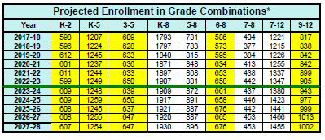
ENROLLMENT PROJECTIONS

Slide 4
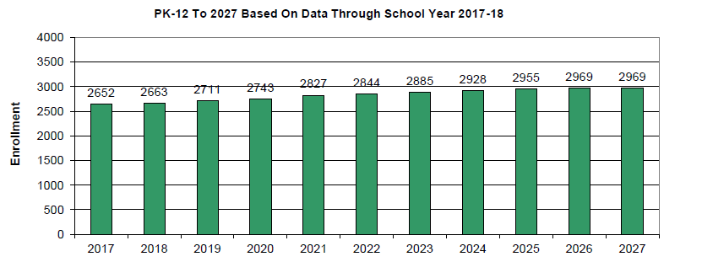
ENROLLMENT PROJECTIONS

Slide 5
CLASS SIZE GUIDELINES
Guideline Maximum
Kindergarten 18 20
Grade 1 20 22
Grades 2-5 22 24
Grades 6-8 23 25
High School 18 20 (college prep)
22 25 (honors and high honors)
Additionally, the middle and high school should strive to keep aggregate student numbers per teacher at a 100 limit.

Slide 6
Davis School
Integrated Pre-School
Special Education | Related Service | Non-Special Education
23 | 4 | 28

Slide 7
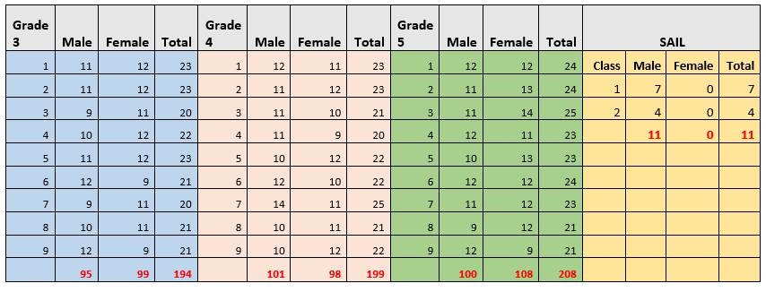
LANE SCHOOL

Slide 8
JGMS
Grade Level/YOG | Enrollment
8th/YOG 2024 | 182
7th/YOG 2025 | 210
6th/YOG 2026 | 202
JGMS Totals for 19-20 | 594

Slide 9
Core Class Size Averages
English 6 | 20.1
Learning Strategies 6 | 17.2
Social Studies 6 | 20.1
Math 6 | 19
Science 6 | 20.2
World Language 6 | 20.7
6th Grade Core Average | 19.55
English 7 | 20.8
Social Studies 7 | 20.8
Math 7 (Combined) | 16
Science 7 | 21
World Language 7 | 20.9
7th Grade Core Average | 19.9
English 8 (Combined) | 17.9
Social Studies 8 | 18.2
Math (Combined) | 14
Science 8 | 18.2
World Language | 17..25
8th Grade Core Average | 17.11
JGMS Core Average | 18.85

Slide 10
JGMS COMINGS AND GOINGS
Grade in Fall | New School District
2019 | Transferred to
8 | Boston
6 | Wellesley
6 | Shrewsbury
7 | Wisconson
6 | Billerica
7 | Chelmsford
6 | Private School
6 | Fenn
6 | Texas
6 | Fenn
6 | Fenn
6 | Moved
6 | Georgia
6 | Private School
6 | Private School
8 | Quincy School
8 | Holbrook
6 | Private School
Male or Female | YOG | Transferred From
F | 2026 | Private
M | 2025 | Waltham Public
F | 2025 | Lowell Public
M | 2026 | Metco
M | 2025 | California
M | 2025 | Boston Public
F | 2026 | Melrose Public
M | 2024 | Melrose Public
M | 2026 | Lawrence Public
M | 2024 | Charter School
F | 2025 | Private School
M | 2026 | Metco
M | 2025 | Lexington Montessori
M | 2025 | Lexington Montessori
M | 2024 | New York
F | 2025 | France
F | 2025 | Pennsylvania
F | 2026 | Billerica
M | 2024 | LABBB
M | 2025 | Private
F | 2024 | Lowell
M | 2024 | Private School
M | 2025 | Pennsylvania
M | 2026 | Metco
F | 2026 | New York
F | 2025 | Home School
F | 2026 | Home School
F | 2026 | METCO
M | 2026 | Winchester

Slide 11
JGMS Section with Class Size ≥ 25 | Class Size
Learning Strategies 6 Orange | 25
French 6 | 27
Art 6 | 27
Music 6 | 25
PE 6 (Average of 25.12) | 28, 30, 29, 30, 29
English 7 | 25
SS 7 | 25, 25
Science 7 | 25
Technology Education 7 | 26, 26, 25, 25, 26, 25
Art 7 | 25, 27, 27
Exploratory Courses 7 | 25, 25
PE 7 | 30, 30, 25, 25
Technology Education 8 | 25
PE 8 and Health 8 | 25, 25
Classes < 10
3 classes at or under 10/ 1 core subject
31 classes at or over 25/ 4 core subjects
_____________________________________
Classes > 25
12 classes at 25 max/ 4 core subjects
3 classes at 26
4 classes at 27
1 class at 28
2 classes at 29
4 classes at 30
JGMS Section with Class Size ⩽ 10 | Class Size
Directed Study 6 | 9, 8
7th Grade Math Purple | 8

Slide 12
BHS
YOG/Grade Level | Bedford | HAFB | Total
Class of 2020 (Gr. 12) | 174 | 20 | 194
Class of 2021 (Gr. 11) | 154 | 29 | 183
Class of 2022 (Gr. 10) | 199 | 37 | 236
Class of 2023 (Gr. 9) | 187 | 41 | 228
BHS Totals as of 10/1 | 714 | 127 | 841

Slide 13
Overlays and Average Class Sizes
 | All | Tier I | Tier II & III
Sections | 448 | 367 | 81
Overlays | 217 | 149 | 68
Average Class Size | 16 | 18.08 | 6.123

Slide 14
Course | Level | Class size | Rationale
Writing Lab | CP | 9 | Remedial minor for upperclassmen who need assistance with writing; given their writing needs, a small number works well for individualized attention
English I (2) | CP | 10 &10
Creative Writing |  | 10
STEM | CP | 7 | This is a course that requires individualized instruction and remediation to help students with Math and Science MCAS
Math Lab | CP | 10 | This cohort is part of our Calculus Project
Algebra I | CP | 10
Algebra I | H | 10
Modern World History | CP | 10
Intro to Programming | UL | 9 | Other section is at 25
AP Biology | AP | 8 | Second section has 20-when scheduling last year there were over 30 requests for course
Chemistry | CP | 10
Lifetime Activities | UL | 9
Latin 2 | CP | 8 | Other Latin 2 course is at 12. This course cannot run as a singleton as it is the second year of a graduation requirement and students must be able to fit it in their schedules.
Advanced Latin | H | 10 | Other Adv. Latin sections are at 18 and 16
French 3 | H | 10 | Other French 3 class is at 17. This course cannot run as a singleton as it is a graduation requirement and students must be able to fit it in their schedules.
French 4 | H | 10 | Other French 4 class is at 15. This course cannot run as a singleton as it is the second year of a graduation requirement and students must be able to fit it in their schedules.
Classes < 10
12 core subjects at or under 10
5 electives at or under 10

Slide 15
Course | Level | Class size | Rationale
English I (co-taught) | CP | 18 | Originally 2 sections but did not have enough coverage for Special Educator
English IV | CP | 20 | Only one section offered for seniors
Algebra I, Fundamentals of Math II, Math Applications (all overlayed and co-taught) | CP | 19 | There are two singleton students with complicated profiles that are included in this overlayed course
Intro. to Business (2) | CP | 24, 25
Accounting I (2) | CP | 21, 25 | Overlayed with Accounting II
Latin 1 | CP | 18
French 2 | CP | 23
Spanish 2 | CP | 21
Spanish 2 | CP | 21
Spanish 3 | CP | 22
Spanish 3 | CP | 19
Spanish 3-advanced | H | 25 | Largest Spanish 3-adv class in the last 5 years. Overall increased enrollment in this course. More FTEs were needed for CP novice courses than in previous years.
College Prep Classes > 18
10 core subjects
4 electives

Slide 16
Course | Level | Class size | Rationale
Healthy Behaviors (2) | UL | 26 & 27
Sports Activities | UL | 26
Sports Activities | UL | 26
Fitness Concepts (2) | UL | 26 &27
9th Grade Fitness (5) | UL | 26, 26, 27, 27, 28
Engligh I | H | 25
English I | HH | 26
AP Literature & Comp | AP | 25
Asian American Literature | UL | 26
British Literature (2) | UL | 25, 25
Film Analysis | UL | 25
AP Statistics | AP | 26 | Allowed 3 off waitlist
Geometry (3) | HH | 25, 25, 25
Business Math | UL | 25
AP Calculus | AP | 25
Intro to Programming | UL | 25
Psychology | AP/H | 26
Gender Studies | Heterogeneous | 27
Economics | HH/H | 25
Economics | HH/H | 25
Honor, High Honors, AP classes > 25
11 core subjects
6 elective majors
12 elective minors
13 at 25
10 at 26
5 at 27
1 at 28

